Slide 1
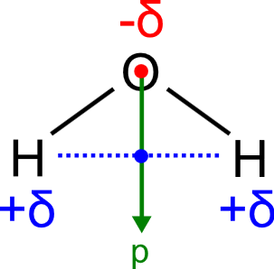
Electric dipole Transition moment

Slide 2
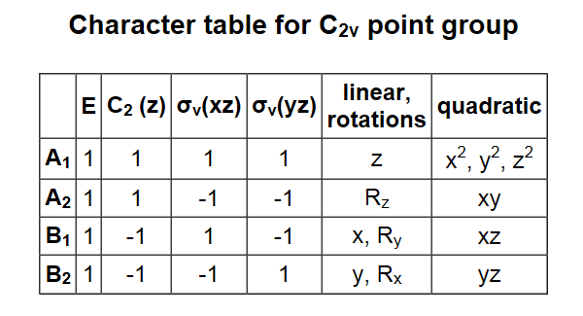
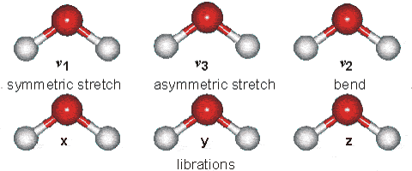

Slide 3
Gas | v₁, cm⁻¹ | v₂, cm⁻¹ | v₃, cm⁻¹
H₂¹⁶O | 3657.1 | 1594.7 | 3755.9
H₂¹⁷O | 3653.2 | 1591.3 | 3748.3
H₂¹⁸O | 3649.7 | 1588.3 | 3741.6
HD¹⁶O | 2723.7 | 1403.5 | 3707.5
D₂¹⁶O | 2671.7 | 1178.4 | 2787.7
HT¹⁶O | 2299.8 | 1332.5 | 3716.6
T₂¹⁶O | 2237.2 | 995.4 | 2366.6

Slide 4
Table 4.11: IR intensities for water. The values given are relative intensities, with the most intense assigned the value `1'. Theoretical and experimental values are from Yamaguchi et al. [161]. Frequencies are as obtained in this work.
ν | Relative Intensities
(cm) | Present | HF | HF | MP2 | Expt.
 |  | STO-3G | 6-311++G(3d,3p) | 6-31+G(d)
1598 | 1 | 0.163 | 1 | 1 | 1
3773 | 0.103 | 1 | 0.159 | 0.110 | 0.0371-0.0506
3883 | 0.904 | 0.677 | 0.945 | 0.664 | 0.860-0.891

Slide 5
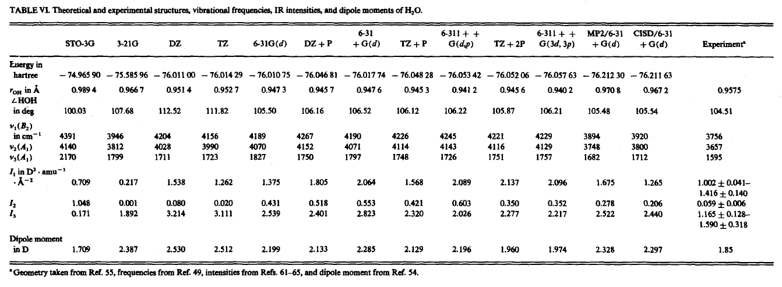

Slide 6

Elastic and Inelastic Scattering
Raman
Powerpoint Templates

Slide 7
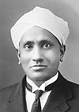
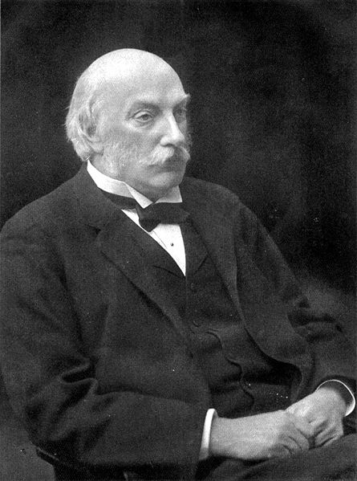
Rayleigh Scattering
vs
Raman Scattering

Slide 10
Classical Raman Physics
Interaction between electric field of incident photon and molecule
Electric field oscillating with incident frequency v_{i}:
Induces molecular electric dipole (p):
Proportional to molecular polarizability, α
Polarization results in nuclear displacement

Slide 11
For small distortions, polarizability is linearly proportional to the displacement
Resultant dipole:
Rayleigh Scattering
Stokes Raman
Anti-Stokes Raman

Slide 12
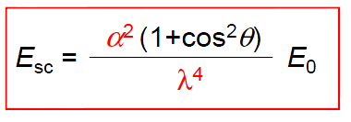
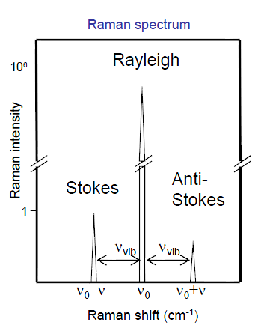

Slide 13
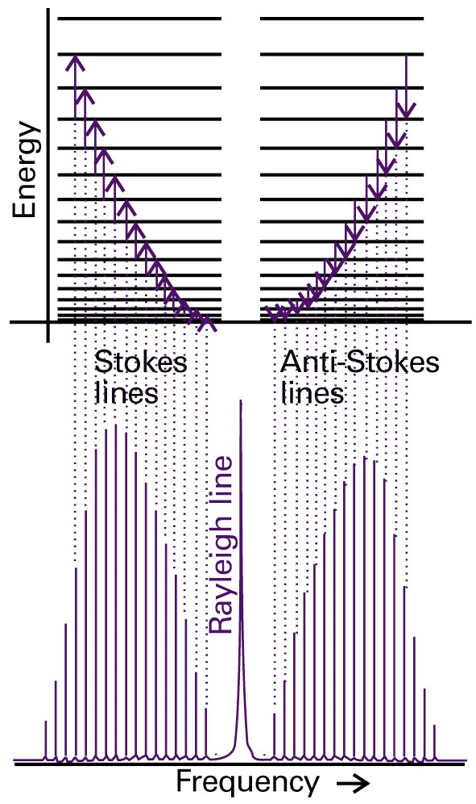
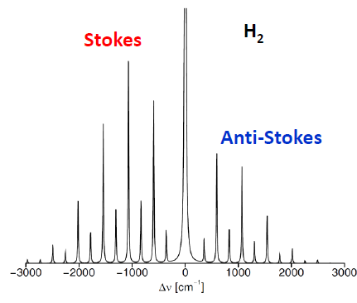
Roto-Vibrational Raman
ΔJ = 0 ± 2
Line Spacing 4B

Slide 14
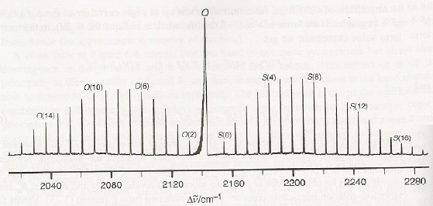

Slide 15
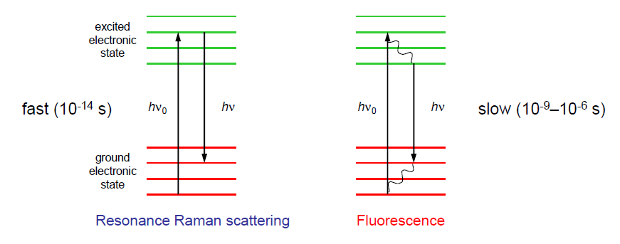
Ressonance Raman
Scattering effect enhanced by a factor 10⁶

Slide 16
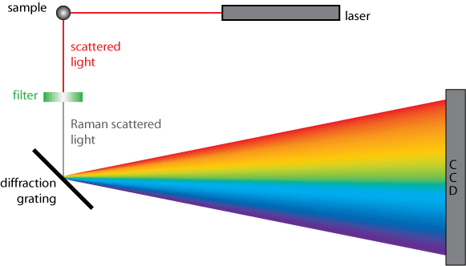
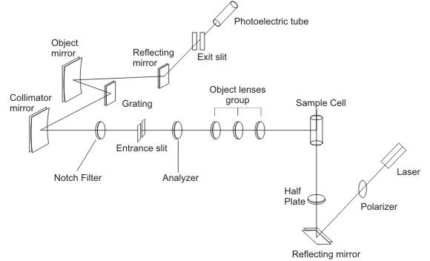
Instrumentation

Slide 17
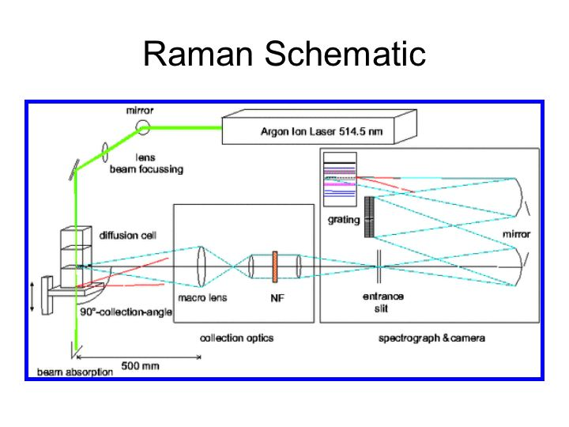

Slide 18
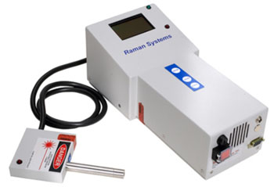
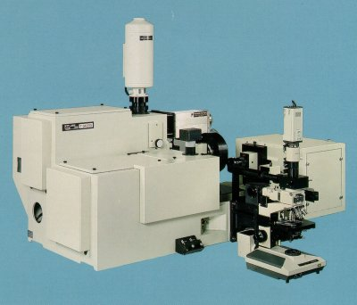

Slide 19
Lasers
Ar⁺ ion 488.0 nm & 514.5 nm
Kr⁺ ion 530.9 nm & 647.1 nm
He:Ne 632.8 nm
Nd:YAG 1064 nm
Diode 630 nm & 980 nm
Resolution < 6 cm⁻¹ →
Laser Linewidth < 1 cm⁻¹
Wavelength Stabilization is a must have
(most common 785 nm NIR 300 mW

Slide 20
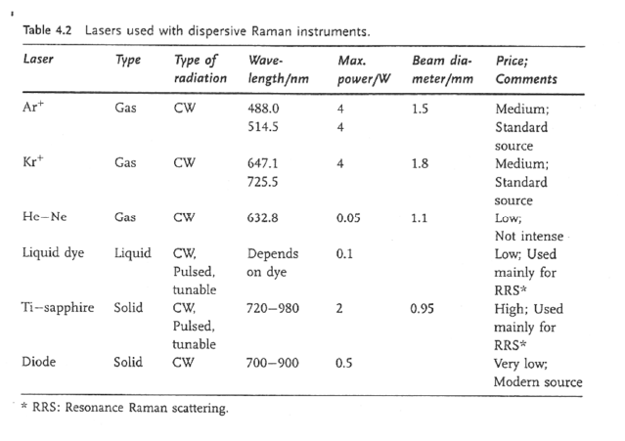

Slide 21
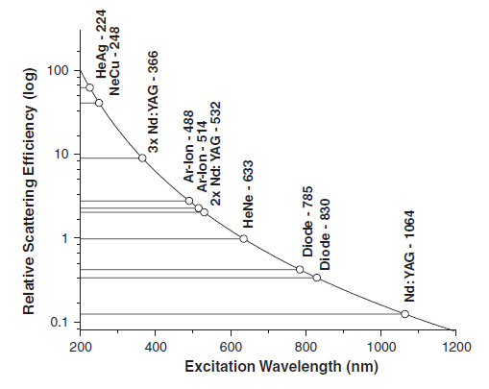

Slide 22
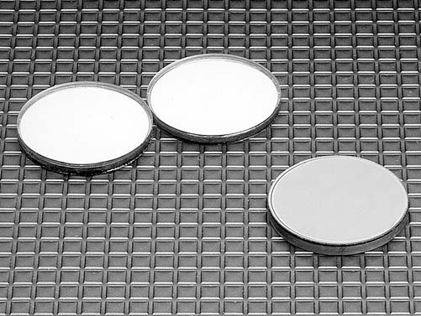
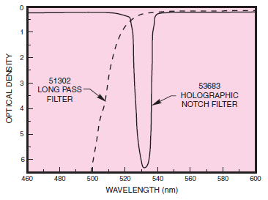
Holographic notch filter

Slide 23
