Slide 2
Improving Reliability of Compilers
Nuno Lopes Joint work with David Menendez, Santosh Nagarakatte, John Regehr, Sarah Winkler

Slide 3
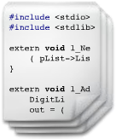
Compilers…
Frontend
Optimization 1
…
Optimization n
Backend
100101010
010001011
100110101
101010111
001010110

Slide 4
Why care about Compilers?
Today’s software goes through at least one compiler
Correctness and safety depends on compilers
Applications
OS
Compiler
Hardware

Slide 5
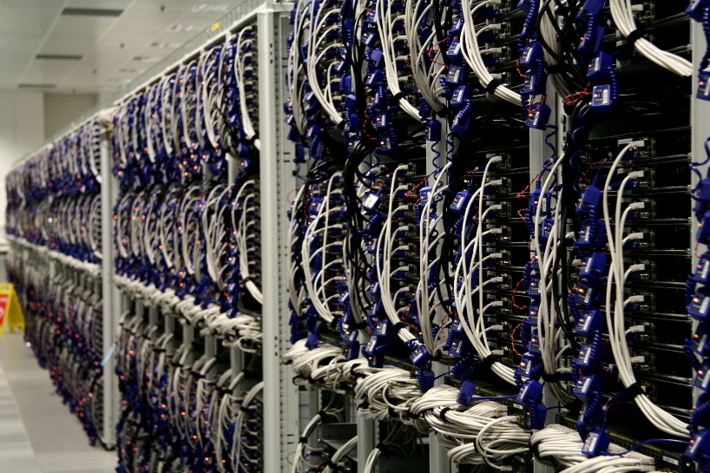
Pressure for better Compilers
Improve performance
Reduce code size
Reduce energy consumption

Slide 6
Compilers do deliver
LLVM 3.2 introduced a Loop Vectorizer
Performance improvement of 10-300% in benchmarks
Visual Studio 2015 Update 3: > 10% on SPEC CPU 2k/2k6

Slide 7
Compilers also have Bugs
Csmith [PLDI’11]:
79 bugs in GCC (25 P1)
202 bugs in LLVM
Orion [PLDI’14]:
40 wrong-code bugs in GCC
42 wrong-code bugs in LLVM
Last Week:
476 open wrong-code bug reports in GCC (out of 9,930)
22 open wrong-code bug reports in LLVM (out of 7,002)

Slide 8
Buggy Compilers = Security Bugs
CVE-2006-1902
GCC 4.1/4.2 (fold-const.c) had a bug that could remove valid pointer comparisons
Removed bounds checks in, e.g., Samba

Slide 9
Churn in Compiler’s code
gcc:

Slide 10
March to Disaster?
2015: Academics introduce backdoor in “sudo” through a known bug in LLVM
1984: 1st compiler backdoor by Ken Thompson
2006: 1st CVE report on a compiler introducing a security vulnerability
1974: idea of using compilers to introduce backdoors - US Air Force report on Multics
Backdoor in Windows/Linux?
1970
1980
1990
2000
2010
2020

Slide 11
Motivation
Pressure to Improve Compilers
More Bugs in Compilers
Potential Crashes and Vulnerabilities in Compiled Software

Slide 12
Software Development Practices
Unit tests
End-to-end tests
Fuzzing
Static Analysis
Verification of pseudo-code
…
Since ever?
Since 2000s (SLAM, PREfast, SAGE, Z3…)
?

Slide 13
Software Compiler Development Practices
Unit tests
End-to-end tests
Fuzzing
Static Analysis
Verification of pseudo-code
Semi-automated verification – CompCert (2008)
…
Unit tests
End-to-end tests
Fuzzing
Static Analysis
Verification of pseudo-code
…
Since ever?
Csmith – industry standard [PLDI’11]
Since 2000s
?
?

Slide 14
Why no Static Analysis for Compilers?
Static analysis for general software targets safety (i.e., no crashes)
Compiler correctness needs functional verification
Safety checking still an open research problem
Functional verification is harder

Slide 15
“Static Analysis” for Compilers
Compiler verification: verify compiler once and for all (e.g., CompCert, Alive [PLDI’15])
Compiler validation: verify output of compiler on every compilation (utcTV)
For new code: specify in a DSL and verify automatically
For legacy code: validation

Slide 16
Optimizations are Easy to Get Wrong
int a = x << c;
int b = a / d;
int t = d / (1 << c);
int b = x / t;
x * 2^{c} / d
x / (d / 2^{c})
= x / d * 2^{c}
= x * 2^{c} / d
(c and d are constants)
Notes:
School math vs compiler math

Slide 17
Optimizations are Easy to Get Wrong
int a = x << c;
int b = a / d;
int t = d / (1 << c);
int b = x / t;
ERROR: Domain of definedness of Target is smaller than Source's for i4 %b
Example:
%X i4 = 0x0 (0)
c i4 = 0x3 (3)
d i4 = 0x7 (7)
%a i4 = 0x0 (0)
(1 << c) i4 = 0x8 (8, -8)
%t i4 = 0x0 (0)
Source value: 0x0 (0)
Target value: undef
LLVM bug #21245
Notes:
Even people that do this everyday get it wrong

Slide 18
Implementing Peephole Optimizers
{
Value *Op1C = Op1;
BinaryOperator *BO = dyn_cast<BinaryOperator>(Op0);
if (!BO ||
(BO->getOpcode() != Instruction::UDiv &&
BO->getOpcode() != Instruction::SDiv)) {
Op1C = Op0;
BO = dyn_cast<BinaryOperator>(Op1);
}
Value *Neg = dyn_castNegVal(Op1C);
if (BO && BO->hasOneUse() &&
(BO->getOperand(1) == Op1C || BO->getOperand(1) == Neg) &&
(BO->getOpcode() == Instruction::UDiv ||
BO->getOpcode() == Instruction::SDiv)) {
Value *Op0BO = BO->getOperand(0), *Op1BO = BO->getOperand(1);
// If the division is exact, X % Y is zero, so we end up with X or -X.
if (PossiblyExactOperator *SDiv = dyn_cast<PossiblyExactOperator>(BO))
if (SDiv->isExact()) {
if (Op1BO == Op1C)
return ReplaceInstUsesWith(I, Op0BO);
return BinaryOperator::CreateNeg(Op0BO);
}
Value *Rem;
if (BO->getOpcode() == Instruction::UDiv)
Rem = Builder->CreateURem(Op0BO, Op1BO);
else
Rem = Builder->CreateSRem(Op0BO, Op1BO);
Rem->takeName(BO);
if (Op1BO == Op1C)
return BinaryOperator::CreateSub(Op0BO, Rem);
return BinaryOperator::CreateSub(Rem, Op0BO);
}
}

Slide 19
Alive
New language and tool for:
Specifying peephole optimizations
Proving them correct (or generate a counterexample)
Generating C++ code for a compiler
Design point: both practical and formal

Slide 20
A Simple Peephole Optimization
{
Value *Op1C = Op1;
BinaryOperator *BO = dyn_cast<BinaryOperator>(Op0);
if (!BO ||
(BO->getOpcode() != Instruction::UDiv &&
BO->getOpcode() != Instruction::SDiv)) {
Op1C = Op0;
BO = dyn_cast<BinaryOperator>(Op1);
}
Value *Neg = dyn_castNegVal(Op1C);
if (BO && BO->hasOneUse() &&
(BO->getOperand(1) == Op1C || BO->getOperand(1) == Neg) &&
(BO->getOpcode() == Instruction::UDiv ||
BO->getOpcode() == Instruction::SDiv)) {
Value *Op0BO = BO->getOperand(0), *Op1BO = BO->getOperand(1);
// If the division is exact, X % Y is zero, so we end up with X or -X.
if (PossiblyExactOperator *SDiv = dyn_cast<PossiblyExactOperator>(BO))
if (SDiv->isExact()) {
if (Op1BO == Op1C)
return ReplaceInstUsesWith(I, Op0BO);
return BinaryOperator::CreateNeg(Op0BO);
}
Value *Rem;
if (BO->getOpcode() == Instruction::UDiv)
Rem = Builder->CreateURem(Op0BO, Op1BO);
else
Rem = Builder->CreateSRem(Op0BO, Op1BO);
Rem->takeName(BO);
if (Op1BO == Op1C)
return BinaryOperator::CreateSub(Op0BO, Rem);
return BinaryOperator::CreateSub(Rem, Op0BO);
}
}
int f(int x, int y) {
return (x / y) * y;
}
Compile to LLVM IR
define i32 @f(i32 %x, i32 %y) {
%1 = sdiv i32 %x, %y
%2 = mul i32 %1, %y
ret i32 %2
}
Optimize
define i32 @f(i32 %x, i32 %y) {
%1 = srem i32 %x, %y
%2 = sub i32 %x, %1
ret i32 %2
}

Slide 21
A Simple Peephole Optimization
{
Value *Op1C = Op1;
BinaryOperator *BO = dyn_cast<BinaryOperator>(Op0);
if (!BO ||
(BO->getOpcode() != Instruction::UDiv &&
BO->getOpcode() != Instruction::SDiv)) {
Op1C = Op0;
BO = dyn_cast<BinaryOperator>(Op1);
}
Value *Neg = dyn_castNegVal(Op1C);
if (BO && BO->hasOneUse() &&
(BO->getOperand(1) == Op1C || BO->getOperand(1) == Neg) &&
(BO->getOpcode() == Instruction::UDiv ||
BO->getOpcode() == Instruction::SDiv)) {
Value *Op0BO = BO->getOperand(0), *Op1BO = BO->getOperand(1);
// If the division is exact, X % Y is zero, so we end up with X or -X.
if (PossiblyExactOperator *SDiv = dyn_cast<PossiblyExactOperator>(BO))
if (SDiv->isExact()) {
if (Op1BO == Op1C)
return ReplaceInstUsesWith(I, Op0BO);
return BinaryOperator::CreateNeg(Op0BO);
}
Value *Rem;
if (BO->getOpcode() == Instruction::UDiv)
Rem = Builder->CreateURem(Op0BO, Op1BO);
else
Rem = Builder->CreateSRem(Op0BO, Op1BO);
Rem->takeName(BO);
if (Op1BO == Op1C)
return BinaryOperator::CreateSub(Op0BO, Rem);
return BinaryOperator::CreateSub(Rem, Op0BO);
}
}
define i32 @f(i32 %x, i32 %y) {
%1 = sdiv i32 %x, %y
%2 = mul i32 %1, %y
ret i32 %2
}
define i32 @f(i32 %x, i32 %y) {
%1 = sdiv i32 %x, %y
%2 = mul i32 %1, %y
ret i32 %2
}
=>
define i32 @f(i32 %x, i32 %y) {
%1 = srem i32 %x, %y
%2 = sub i32 %x, %1
ret i32 %2
}
Optimize
define i32 @f(i32 %x, i32 %y) {
%1 = srem i32 %x, %y
%2 = sub i32 %x, %1
ret i32 %2
}

Slide 22
A Simple Peephole Optimization
{
Value *Op1C = Op1;
BinaryOperator *BO = dyn_cast<BinaryOperator>(Op0);
if (!BO ||
(BO->getOpcode() != Instruction::UDiv &&
BO->getOpcode() != Instruction::SDiv)) {
Op1C = Op0;
BO = dyn_cast<BinaryOperator>(Op1);
}
Value *Neg = dyn_castNegVal(Op1C);
if (BO && BO->hasOneUse() &&
(BO->getOperand(1) == Op1C || BO->getOperand(1) == Neg) &&
(BO->getOpcode() == Instruction::UDiv ||
BO->getOpcode() == Instruction::SDiv)) {
Value *Op0BO = BO->getOperand(0), *Op1BO = BO->getOperand(1);
// If the division is exact, X % Y is zero, so we end up with X or -X.
if (PossiblyExactOperator *SDiv = dyn_cast<PossiblyExactOperator>(BO))
if (SDiv->isExact()) {
if (Op1BO == Op1C)
return ReplaceInstUsesWith(I, Op0BO);
return BinaryOperator::CreateNeg(Op0BO);
}
Value *Rem;
if (BO->getOpcode() == Instruction::UDiv)
Rem = Builder->CreateURem(Op0BO, Op1BO);
else
Rem = Builder->CreateSRem(Op0BO, Op1BO);
Rem->takeName(BO);
if (Op1BO == Op1C)
return BinaryOperator::CreateSub(Op0BO, Rem);
return BinaryOperator::CreateSub(Rem, Op0BO);
}
}
%1 = sdiv i32 %x, %y
%2 = mul i32 %1, %y
=>
%t = srem i32 %x, %y
%2 = sub i32 %x, %t

Slide 23
A Simple Peephole Optimization
{
Value *Op1C = Op1;
BinaryOperator *BO = dyn_cast<BinaryOperator>(Op0);
if (!BO ||
(BO->getOpcode() != Instruction::UDiv &&
BO->getOpcode() != Instruction::SDiv)) {
Op1C = Op0;
BO = dyn_cast<BinaryOperator>(Op1);
}
Value *Neg = dyn_castNegVal(Op1C);
if (BO && BO->hasOneUse() &&
(BO->getOperand(1) == Op1C || BO->getOperand(1) == Neg) &&
(BO->getOpcode() == Instruction::UDiv ||
BO->getOpcode() == Instruction::SDiv)) {
Value *Op0BO = BO->getOperand(0), *Op1BO = BO->getOperand(1);
// If the division is exact, X % Y is zero, so we end up with X or -X.
if (PossiblyExactOperator *SDiv = dyn_cast<PossiblyExactOperator>(BO))
if (SDiv->isExact()) {
if (Op1BO == Op1C)
return ReplaceInstUsesWith(I, Op0BO);
return BinaryOperator::CreateNeg(Op0BO);
}
Value *Rem;
if (BO->getOpcode() == Instruction::UDiv)
Rem = Builder->CreateURem(Op0BO, Op1BO);
else
Rem = Builder->CreateSRem(Op0BO, Op1BO);
Rem->takeName(BO);
if (Op1BO == Op1C)
return BinaryOperator::CreateSub(Op0BO, Rem);
return BinaryOperator::CreateSub(Rem, Op0BO);
}
}
%1 = sdiv i32 %x, %y
%2 = mul i32 %1, %y
=>
%t = srem i32 %x, %y
%2 = sub i32 %x, %t

Slide 24
A Simple Peephole Optimization
{
Value *Op1C = Op1;
BinaryOperator *BO = dyn_cast<BinaryOperator>(Op0);
if (!BO ||
(BO->getOpcode() != Instruction::UDiv &&
BO->getOpcode() != Instruction::SDiv)) {
Op1C = Op0;
BO = dyn_cast<BinaryOperator>(Op1);
}
Value *Neg = dyn_castNegVal(Op1C);
if (BO && BO->hasOneUse() &&
(BO->getOperand(1) == Op1C || BO->getOperand(1) == Neg) &&
(BO->getOpcode() == Instruction::UDiv ||
BO->getOpcode() == Instruction::SDiv)) {
Value *Op0BO = BO->getOperand(0), *Op1BO = BO->getOperand(1);
// If the division is exact, X % Y is zero, so we end up with X or -X.
if (PossiblyExactOperator *SDiv = dyn_cast<PossiblyExactOperator>(BO))
if (SDiv->isExact()) {
if (Op1BO == Op1C)
return ReplaceInstUsesWith(I, Op0BO);
return BinaryOperator::CreateNeg(Op0BO);
}
Value *Rem;
if (BO->getOpcode() == Instruction::UDiv)
Rem = Builder->CreateURem(Op0BO, Op1BO);
else
Rem = Builder->CreateSRem(Op0BO, Op1BO);
Rem->takeName(BO);
if (Op1BO == Op1C)
return BinaryOperator::CreateSub(Op0BO, Rem);
return BinaryOperator::CreateSub(Rem, Op0BO);
}
}
%1 = sdiv %x, %y
%2 = mul %1, %y
=>
%t = srem %x, %y
%2 = sub %x, %t

Slide 25
A Simple Peephole Optimization
{
Value *Op1C = Op1;
BinaryOperator *BO = dyn_cast<BinaryOperator>(Op0);
if (!BO ||
(BO->getOpcode() != Instruction::UDiv &&
BO->getOpcode() != Instruction::SDiv)) {
Op1C = Op0;
BO = dyn_cast<BinaryOperator>(Op1);
}
Value *Neg = dyn_castNegVal(Op1C);
if (BO && BO->hasOneUse() &&
(BO->getOperand(1) == Op1C || BO->getOperand(1) == Neg) &&
(BO->getOpcode() == Instruction::UDiv ||
BO->getOpcode() == Instruction::SDiv)) {
Value *Op0BO = BO->getOperand(0), *Op1BO = BO->getOperand(1);
// If the division is exact, X % Y is zero, so we end up with X or -X.
if (PossiblyExactOperator *SDiv = dyn_cast<PossiblyExactOperator>(BO))
if (SDiv->isExact()) {
if (Op1BO == Op1C)
return ReplaceInstUsesWith(I, Op0BO);
return BinaryOperator::CreateNeg(Op0BO);
}
Value *Rem;
if (BO->getOpcode() == Instruction::UDiv)
Rem = Builder->CreateURem(Op0BO, Op1BO);
else
Rem = Builder->CreateSRem(Op0BO, Op1BO);
Rem->takeName(BO);
if (Op1BO == Op1C)
return BinaryOperator::CreateSub(Op0BO, Rem);
return BinaryOperator::CreateSub(Rem, Op0BO);
}
}
Name: sdiv general
%1 = sdiv %x, %y
%2 = mul %1, %y
=>
%t = srem %x, %y
%2 = sub %x, %t
Name: sdiv exact
%1 = sdiv exact %x, %y
%2 = mul %1, %y
=>
%2 = %x

Slide 26
Alive Language
Precondition
Pre: C2 % (1<<C1) == 0
%s = shl nsw %X, C1
%r = sdiv %s, C2
=>
%r = sdiv %X, C2/(1<<C1)
Source template
Target template
Predicates in preconditions may be the result of a dataflow analysis.

Slide 27
Alive Language
Pre: C2 % (1<<C1) == 0
%s = shl nsw %X, C1
%r = sdiv %s, C2
=>
%r = sdiv %X, C2/(1<<C1)
Constants
Generalized from LLVM IR:
Symbolic constants
Implicit types

Slide 28
Alive
Typing Constraints
Transformation
Alive
Refinement Constraints
C++

Slide 29
Type Inference
Encode type constraints in SMT
Operand have same type
Result of trunc has fewer bits than argument
Find all solutions for the constraint
Up to a bounded bitwidth, e.g., 64

Slide 30
Correctness Criteria
Target invokes undefined behavior only when the source does
Result of target = result of source when source does not invoke undefined behavior
Final memory states are equivalent
LLVM has 3 types of UB:
Poison values
Undef values
True UB

Slide 31
The story of a new optimization
A developer wrote a new optimization that improves benchmarks:
3.8% perlbmk (SPEC CPU 2000)
1% perlbench (SPEC CPU 2006)
1.2% perlbench (SPEC CPU 2006) w/ LTO+PGO
40 lines of code
August 2014

Slide 32
The story of a new optimization
The first patch was wrong
Pre: isPowerOf2(C1 ^ C2)
%x = add %A, C1
%i = icmp ult %x, C3
%y = add %A, C2
%j = icmp ult %y, C3
%r = or %i, %j
=>
%and = and %A, ~(C1 ^ C2)
%lhs = add %and, umax(C1, C2)
%r = icmp ult %lhs, C3
ERROR: Mismatch in values of %r
Example:
%A i4 = 0x0 (0)
C1 i4 = 0xA (10, -6)
C3 i4 = 0x5 (5)
C2 i4 = 0x2 (2)
%x i4 = 0xA (10, -6)
%i i1 = 0x0 (0)
%y i4 = 0x2 (2)
%j i1 = 0x1 (1, -1)
%and i4 = 0x0 (0)
%lhs i4 = 0xA (10, -6)
Source value: 0x1 (1, -1)
Target value: 0x0 (0)

Slide 33
The story of a new optimization
The second patch was wrong
The third patch was correct!
Still fires on the benchmarks!
Pre: C1 u> C3 &&
C2 u> C3 &&
isPowerOf2(C1 ^ C2) &&
isPowerOf2(-C1 ^ -C2) &&
(-C1 ^ -C2) == ((C3-C1) ^ (C3-C2)) &&
abs(C1-C2) u> C3
%x = add %A, C1
%i = icmp ult %x, C3
%y = add %A, C2
%j = icmp ult %y, C3
%r = or %i, %j
=>
%and = and %A, ~(C1^C2)
%lhs = add %and, umax(C1,C2)
%r = icmp ult %lhs, C3

Slide 34
Experiments
Translated > 300 optimizations from LLVM’s InstCombine to Alive. Found 8 bugs; remaining proved correct.
Automatic optimal post-condition strengthening
Significantly better than developers
Replaced InstCombine with automatically generated code

Slide 35
InstCombine: Stats per File
File | # opts. | # translated | # bugs
AddSub | 67 | 49 | 2
AndOrXor | 165 | 131 | 0
Calls | 80 | - | -
Casts | 77 | - | -
Combining | 63 | - | -
Compares | 245 | - | -
LoadStoreAlloca | 28 | 17 | 0
MulDivRem | 65 | 44 | 6
PHI | 12 | - | -
Select | 74 | 52 | 0
Shifts | 43 | 41 | 0
SimplifyDemanded | 75 | - | -
VectorOps | 34 | - | -
Total | 1,028 | 334 | 8
14% wrong!
Notes:
Found bugs even after all the fuzzing

Slide 36
Optimal Attribute Inference
Pre: C1 % C2 == 0
%m = mul nsw %X, C1
%r = sdiv %m, C2
=>
%r = mul nsw %X, C1/C2
States that the operation will not result in a signed overflow
Notes:
Devs not confident in adding/propagating attributes.

Slide 37
Optimal Attribute Inference
Weakened 1 precondition
Strengthened the postcondition for 70 (21%) optimizations
40% for AddSub, MulDivRem, Shifts
Postconditions state, e.g., when an operation will not overflow
Notes:
Devs not confident in adding/propagating attributes.

Slide 38
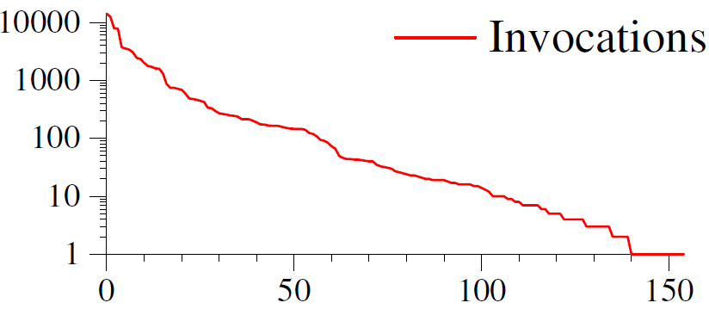
Long Tail of Optimizations
SPEC gives poor code coverage

Slide 39
Alive is Useful!
Released as open-source in Fall 2014
In use by developers across 6 companies
Already caught dozens of bugs in new patches
Talks about replacing InstCombine

Slide 40
utcTV: Validation for UTC
Frontend
Optimization 1
…
Optimization n
Backend
OK / Bug
utcTV
100101010
010001011
100110101
101010111
001010110

Slide 41
utcTV: Validation for UTC
New compiler switch: /d2Verify
Validates optimizers at the IR/IL level
No full correctness guarantee (yet) for some cases

Slide 42
utcTV: Early Results
Benchmark | Lines of code | Compile with /d2Verify | Slowdown
bzip2 | 7k | 5 min | 106x
gcc | 754k | 8 hours | 186x
gzip | 9k | 2 min | 70x
sqlite3 | 189k | 1 h 20 min | 234x
Z3 | 500k | 17 hours | 32x
Note: 32-bits, single-threaded compiler

Slide 44
Conclusion
Today’s software passes through at least one compiler
Compilers can introduce bugs and security vulnerabilities in correct programs
We need reliable compilers
Alive and utcTV are first steps in this direction
Can we replicate the success of Static Analysis?

