Slide 1
Pointers, Alias & ModRef Analyses
Alina Sbirlea (Google), Nuno Lopes (Microsoft Research)
Joint work with: Juneyoung Lee, Gil Hur (SNU), Ralf Jung (MPI-SWS), Zhengyang Liu, John Regehr (U. Utah)

Slide 2
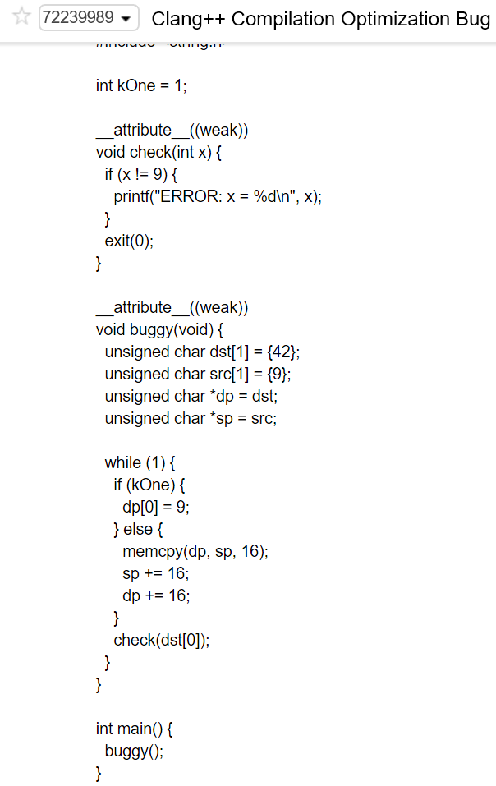
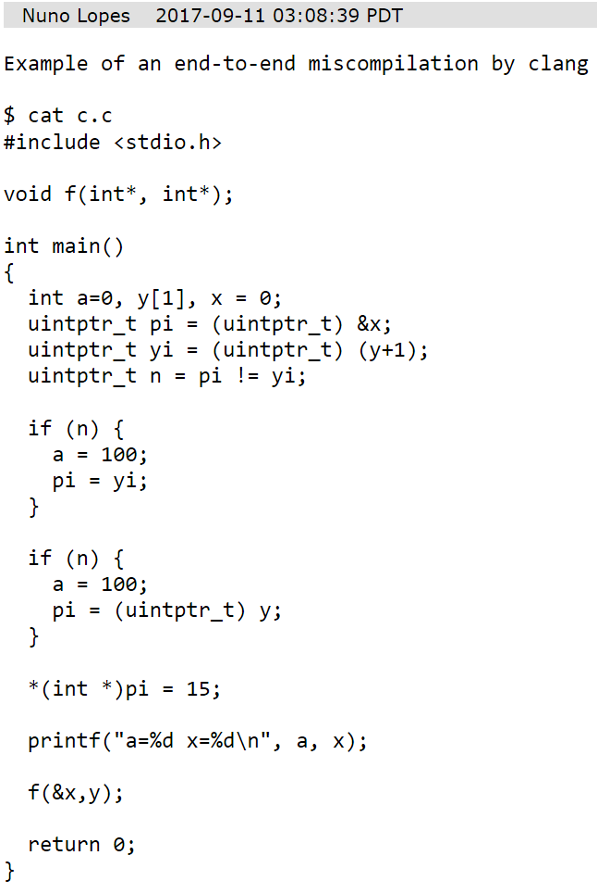
PR34548: incorrect Instcombine fold of inttoptr/ptrtoint
pub fn test(gp1: &mut usize, gp2: &mut usize, b1: bool, b2: bool) -> (i32, i32) {
let mut g = 0;
let mut c = 0;
let y = 0;
let mut x = 7777;
let mut p = &mut g as *const _;
{
let mut q = &mut g;
let mut r = &mut 8888;
if b1 {
p = (&y as *const _).wrapping_offset(1);
}
if b2 {
q = &mut x;
}
*gp1 = p as usize + 1234;
if q as *const _ == p {
c = 1;
*gp2 = (q as *const _) as usize + 1234;
r = q;
}
*r = 42;
}
return (c, x);
}
PR36228: miscompiles Android: API usage mismatch between AA and AliasSetTracker
Safe Rust program miscompiled by GVN

Slide 3
Pointers ≠ Integers

Slide 4
What’s a Memory Model?
char *p = malloc(4);
char *q = malloc(4);
q[2] = 0;
p[6] = 1;
print(q[2]);
When is a memory operation UB?
What’s the value of a load operation?
UB?
0 or 1?

Slide 5
Flat memory model
char *p = malloc(4);
char *q = malloc(4);
q[2] = 0;
p[6] = 1;
print(q[2]);
p+6
1
0
p[0]
p[2]
q[0]
q[2]
Not UB
print(1)
Simple, but inhibits optimizations!

Slide 6
Two Pointer Types
Logical Pointers, which originate from allocation functions (malloc, alloca, …):
char *p = malloc(4);
char *q = p + 2;
char *r = q - 1;
Physical Pointers, which originate from inttoptr casts:
int x = ...;
char *p = (char*)x;
char *q = p + 2;

Slide 7
Logical Pointers: data-flow provenance
p+6
← out-of-bounds
char *p = malloc(4);
char *q = malloc(4);
char *q2 = q + 2;
char *p6 = p + 6;
*q2 = 0;
*p6 = 1;
print(*q2);
0
p[0]
p[2]
q[0]
q[2]
UB
print(0)
Pointer must be inbounds of object found in use-def chain!

Slide 8
Logical Pointers: simple NoAlias detection
char *p = malloc(4);
char *q = malloc(4);
char *p2 = p + ...;
char *q2 = q + ...;
Don’t alias
If 2 pointers are derived from different objects, they don’t alias!

Slide 9
Physical Pointers: control-flow provenance
char *p = malloc(3);
char *q = malloc(3);
char *r = malloc(3);
int x = (int)p + 3;
int y = (int)q;
if (x == y) {
*(char*)x = 1; // OK
}
*(char*)x = 1; // UB
p
p
p
p
q
q
q
q
r
r
r
r
Observed address of p (data-flow)
Observed p+n == q (control-flow)
Can’t access r, only p and q
Only p observed; p[3] is out-of-bounds

Slide 10
Physical Pointers: p ≠ (int*)(int)p
char *p = malloc(4);
char *q = malloc(4);
int x = (int)p + 4;
int y = (int)q;
*q = 0;
if (x == y)
*(char*)y = 1;
print(*q); // 0 or 1
char *p = malloc(4);
char *q = malloc(4);
int x = (int)p + 4;
int y = (int)q;
*q = 0;
if (x == y)
*(char*)x = 1;
print(*q); // 0 or 1
GVN
Ok to replace with q
Not ok to replace with ‘p + 4’

Slide 11
Physical Pointers: p+n and q
int x = (int)q; // or p+4
*(char*)x = 0; // q[0]
*(((char*)x)+1) = 0; // q[1]
*(((char*)x)-1) = 0; // p[3]
p[4]: Valid
q[0]: Valid & dereferenceable
At inttoptr time we don’t know which objects the pointer may refer to (1 or 2 objects).

Slide 12
GEP Inbounds
%q = getelementptr inbounds %p, 4
Both %p and %q must be inbounds of the same object
char *p = malloc(4);
char *q = foo(p);
char *r = q +_{inbounds} 2;
p[0] = 0;
*r = 1;
char *p = malloc(4);
char *q = p +_{inbounds} 5;
*q = 0; // UB
p[0]
foo(p)
foo(p)+2

Slide 13
Delayed ‘GEP inbounds’ Checking
char *p = malloc(4);
char *q = p +_{inbounds} 5; // poison
*q = 0; // UB
Logical pointers: there’s a use-def chain to alloc site, so immediate inbounds check is OK
Physical pointers: there might be no path to alloc; delaying ensures gep doesn’t depend on memory state
char *r = (char*)(int)p;
char *s = r +_{inbounds} 5; // OK
*s = 0; // UB
// OOB of all observed objects

Slide 14
No Layout Guessing
Dereferenceable pointers: p+2 == q+2 is always false
p[2]
q[2]
Valid, but not dereferenceable pointers: p+n == q is undef
p[4]
q[0]
Notes:
Explain what’s memory layout in this context

Slide 15
Consequences of Undef Ptr Comparison
char *p = ...;
char *q = ...;
if (p == q) {
// p and q equal or
// p+n == q (undef)
}
GVN for pointers: not safe to replace p with q unless:
q is nullptr (~50% of the cases)
q is inttoptr
Both p and q are logical and are dereferenceable
…

Slide 16
Address Spaces
Virtual view of the memory(ies)
Arbitrary overlap between spaces
(int*)0 not dereferenceable in address space 0
Main RAM
GPU RAM
address space 0 (default)
address space 1
Hypothetical
address space 2

Slide 17
Pointer Subtraction
Implemented as (int)p – (int)q
Correct, but loses information vs p – q (only defined for p,q in same object)
Analyses don’t recognize this idiom yet

Slide 18
Malloc and ICmp Movement
ICmp moves freely
It’s only valid to compare pointers with overlapping liveness ranges
Potentially illegal to trim liveness ranges
char *p = malloc(4);
char *q = malloc(4);
// valid
if (p == q) { ... }
free(p);
char *p = malloc(4);
free(p);
char *q = malloc(4);
// poison
if (p == q) { ... }
invalid

Slide 19
Summary: so far
Two pointer types:
Logical (malloc/alloca): data-flow provenance
Physical (inttoptr): control-flow provenance
p ≠ (int*)(int)p
There’s no “free” GVN for pointers

Slide 20
Alias Analysis

Slide 21
Alias Analysis queries
alias()
getModRefInfo()

Slide 22
AA Query
alias(p, sz_{p}, q, sz_{q})
what’s the aliasing between pointers p, q and resp. access sizes sz_{p}, sz_{q}
char *p = ...;
int *q = ...;
*p = 0;
*q = 1;
print(*p); // 0 or 1?
alias(p, 1 , q, 4) = ?

Slide 23
AA Results
p
MayAlias
q
obj 1
obj 2
NoAlias
MustAlias
PartialAlias

Slide 24
AA caveats
“Obvious” relationships between aliasing queries often don’t hold
E.g. alias(p, sp, q, sq) == MustAlias doesn’t imply alias(p, sp2, q, sq2) == MustAlias
MustAlias
PartialAlias
p
p
q
q
And: alias(p, sp, q, sq) == NoAlias doesn’t imply alias(p, sp2, q, sq2) == NoAlias
NoAlias
MayAlias
p
p
q
q

Slide 25
AA results
p
q
obj 1
sz = 4
= MustAlias
char *p = obj + x;
char *q = obj + y;
alias(p, 4, q, 4)
access size == object size implies idx == 0
p
q
AA results assume no UB.
sz = 4
sz = 4
alias(p, 3, q, 4) = PartialAlias
MustAlias requires further information
(e.g. know p = q)
p
p
q
q
AA results are sometimes unexpected and can be overly conservative.

Slide 26
AA must consider UB (PR36228)
i8* p = alloca (2);
i8* q = alloca (1);
*p = 42;
magic = *p;
t00 = p;
*p = 42;
t00 = p;
t0 = Ф(t00, t1);
t0 = Ф(t00, t1)
*t0 = 9;
memcpy(t0, q, 2);
t2 = *(t0+1);
*t0 = 9
memcpy(t0, q, 2);
t2 = *(t0+1);
t1 = Ф(t0, t2);
print(*p);
t1 = Ф(t0, t2);
print(magic);
26

Slide 27
New in AA: precise access size
Recent API changes introduced two access size types:
Precise: when the exact size is known
Upper bound: maximum size, but no minimum size guaranteed (can be 0)
See D45581, D44748
27
Notes:
AA can use Precise/Upper to reason about potential UB cases.
Useful for accesses that aren’t guaranteed to be executed.

Slide 28
ModRef Analysis

Slide 29
ModRefInfo
How instructions affect memory instructions:
- Mod = modifies / writes
- Ref = accesses / reads
Notes:
ModRefInfo stores info for memory access and between memoryaccesses.

Slide 30
ModRefInfo Overview
may modify and/or reference
ModRef
Found no Ref
Found no Mod
may modify, no reference
Mod
Ref
may reference, does not modify
Found no Mod
Found no Ref
NoModRef
does not modify or reference

Slide 31
ModRef Example
declare i32 @g(i8*)
declare i32 @h(i8*) argmemonly
define void @f(i8* %p) {
%1 = call i32 @g(i8* %p) ; ModRef %p
store i8 0, i8* %p ; Mod %p (no Ref %p)
%2 = load i8, i8* %p ; Ref %p (no Mod %p)
%3 = call i32 @g(i8* readonly %p) ; ModRef %p (%p may be a global)
%4 = call i32 @h(i8* readonly %p) ; Ref %p (h only accesses args)
%a = alloca i8
%5 = call i32 @g(i8* readonly %a) ; ModRef %a (tough %a doesn’t escape)
Notes:
Last entry: LLVM will give ModRef result. AA does not do control flow analysis and this is the expected result, even though %a doesn’t escape. The ideal result would be Ref, but the cost of AA analysis would also increase.

Slide 32
New ModRefInfo API
Checks:
isNoModRef
isModOrRefSet
isModAndRefSet
isModSet
isRefSet
Retrieve ModRefInfo from FunctionModRefBehavior
createModRefInfo
New value generators:
setMod
setRef
setModAndRef
clearMod
clearRef
unionModRef
intersectModRef
Notes:
Checks return a boolean values.
Generators return a new ModRefInfo value.
Both receive one ModRefInfo values as params. Only union and intersect receive two params.

Slide 33
Using the New ModRef API
Result == MRI_NoModRef
isNoModRef(Result)
if (onlyReadsMemory(MRB))
Result = ModRefInfo(Result & MRI_Ref);
else if (doesNotReadMemory(MRB))
Result = ModRefInfo(Result & MRI_Mod);
if (onlyReadsMemory(MRB))
Result = clearMod(Result);
else if (doesNotReadMemory(MRB))
Result = clearRef(Result);
Result = ModRefInfo(Result & ...);
Result = intersectModRef(Result, ...);

Slide 34
Using the New ModRef API
ModRefInfo ArgMask = getArgModRefInfo(CS1, CS1ArgIdx); ModRefInfo ArgR = getModRefInfo(CS2, CS1ArgLoc);
if (((ArgMask & MRI_Mod) != MRI_NoModRef && (ArgR & MRI_ModRef) != MRI_NoModRef) || ((ArgMask & MRI_Ref) != MRI_NoModRef && (ArgR & MRI_Mod) != MRI_NoModRef)) {
...
}
ModRefInfo ArgModRefCS1 = getArgModRefInfo(CS1, CS1ArgIdx); ModRefInfo ModRefCS2 = getModRefInfo(CS2, CS1ArgLoc);
if ((isModSet(ArgModRefCS1) && isModOrRefSet(ModRefCS2)) ||
(isRefSet(ArgModRefCS1) && isModSet(ModRefCS2))) {
…
}

Slide 35
Why have MustAlias in ModRefInfo?
AliasAnalysis calls are expensive!
Avoid double AA calls when ModRef + alias() info is needed.
Currently used in MemorySSA
Notes:
We sometimes need ModRef + alias information. If the alias info is “free”, we can avoid the double AA calls.

Slide 36
Example: promoting call arguments
Call foo is argmemonly a
isMustSet(getModRefInfo(foo, a))
getModRefInfo(foo, a) can have both Mod and Ref set.
char *a, *b;
for {
foo (a);
b = *a + 5;
*a ++;
}
char *a, *b, tmp;
// promote to scalar
tmp = *a;
for {
foo (&tmp);
b = tmp + 5;
tmp ++;
}
*a = tmp;
Notes:
Discuss other use cases:
-> Def-Use chains in MemorySSA can use this info for getting AliasSets with a limit based on optimized accesses. A set of accesses can become non-promotable if unoptimized or must not set.
-> Also in MemorySSA Def chains, A MustAlias found between two defs can facilitate DCE if there are no uses for the first Def.

Slide 37
MustAlias can include NoAlias for calls?
Call foo is argmemonly a
isMustSet(getModRefInfo(foo, a))
getModRefInfo(foo, a) can have both Mod and Ref set.
char *a, *b;
char *c = malloc;
for {
foo (a, c);
b = *a + 5;
*a ++;
}
char *a, *b, tmp;
char *c = malloc; // noalias(a, c)
// promote to scalar
tmp = *a;
for {
foo (&tmp, c);
b = tmp + 5;
tmp ++;
}
*a = tmp;
Notes:
Discuss other use cases:
-> Def-Use chains in MemorySSA can use this info for getting AliasSets with a limit based on optimized accesses. A set of accesses can become non-promotable if unoptimized or must not set.
-> Also in MemorySSA Def chains, A MustAlias found between two defs can facilitate DCE if there are no uses for the first Def.

Slide 38
New ModRef Lattice
ModRef
Mod
MustModRef
Ref
MustMod
MustRef
Found no mod
NoModRef
Found no ref
Found must alias

Slide 39
Common Misconceptions of Must in ModRefInfo
MustMod = may modify, must alias found, NOT must modify
E.g., foo has readnone attribute => ModRef(foo(a), a) = NoModRef.
MustRef = may reference, must alias found, NOT must reference
MustModRef = may modify and may reference, must alias found, NOT must modify and must reference
Notes:
readnone' attribute

Slide 40
Key takeaways
ModRef is the most general response: may modify or reference
Mod is cleared when we’re sure a location is not modified
Ref is cleared when we’re sure a location is not referenced
Must is set when we’re sure we found a MustAlias
NoModRef means we’re sure location is neither modified or referenced, i.e. written or read
The “Must” bit in the ModRefInfo enum class is provided for completeness, and is not used

Slide 41
ModRefInfo API
Checks:
isNoModRef
isModOrRefSet
isModAndRefSet
isModSet
isRefSet
isMustSet
Retrieve ModRefInfo from FunctionModRefBehavior
createModRefInfo
New value generators:
setMod
setRef
setMust
setModAndRef
clearMod
clearRef
clearMust
unionModRef
intersectModRef
Notes:
Checks return a boolean values. Generators return a new ModRefInfo value. Both receive one or two ModRefInfo values as params.

Slide 42
New ModRef Lattice
ModRef
Mod
MustModRef
Ref
Intersect ModRef
Union ModRef
MustMod
MustRef
Found no mod
NoModRef
Found no ref
Found must alias

Slide 43
Disclaimers / Implementation details
GlobalsModRef relies on a certain number of bits available for alignments. To mitigate this, Must info is being dropped.
FunctionModRefBehavior still relies on bit-wise operations. Changes similar to ModRefInfo may happen in the future.
Notes:
Must is never set in GlobalsModRef

Slide 44
ModRefInfo API overview
getModRefBehavior (CallSite)
getArgModRefInfo (CallSite, ArgIndex)
getModRefInfo(...)
MRB
Arg-MRI
MRI

Slide 45
ModRefInfo API overview
getModRefBehavior (CallSite)
getArgModRefInfo (CallSite, ArgIndex)
getModRefInfo(...)
Instruction, Optional<MemoryLocation>
Instruction, CallSite
CallSite, CallSite
CallSite, MemoryLocation
Instruction, CallSite
MRB
Arg-MRI
MRI

Slide 46
ModRefInfo API overview
Use this when Memory Location is None!
MRI( I, CS )
MRI( I, Optional<MemLoc> )
I must define a Memory Location!
MRI( CS1, CS2 )
MRI( LoadInst..., MemLoc )
MRI( StoreInst..., MemLoc )
MRI(CS, MemLoc )
MRI( CallInst..., MemLoc )
Arg-MRI(CS, Idx)
MRB(CS)

Slide 47
getModRefInfo for instruction I, optional mem. loc
Special cases memory accessing instructions:
LoadInst, StoreInst, CallInst.
Use ModRefBehavior if I == CS and Loc == None
Notes:
...another API

Slide 48
getModRefInfo for two call sites CS1, CS2
NoModRef: CS1 does not write to memory CS2 reads or writes
NoModRef: CS2 does not write to memory CS1 reads or writes
Ref: CS1 may read memory written by CS2
Mod: CS1 may write memory read or written by CS2
ModRef: CS1 may read or write memory read or written by CS2
Must: is set only if either:
CS2 only accesses and modifies arguments & MustAlias is found between CS1 and all CS2 args
CS1 only accesses and modifies arguments & MustAlias is found between CS2 and all CS1 args
Notes:
ModRef relation is not commutative.
Must is only set if CS1 only accesses and modifies arguments, and MustAlias is found between CS2 and all the arguments of CS1.

Slide 49
getModRefInfo for call site CS, memory Loc
Filter using CS properties
CS does not access memory => NoModRef
CS does not write => clearMod
CS does not read => clearRef
CS only accesses arguments, check alias of all arguments against Loc
Must only set if CS only accesses arguments and MustAlias found with all args.

Slide 50
getModRefInfo for CS, instruction I
If I is a call, use the getModRefInfo for two call sites CS1, CS2
If I is a Fence, return ModRef
If I defines a memory location Loc, use getModRefInfo for CS, Loc
If I does not define a memory location, this method will assert!
Default case: NoModRef - only taken if above result is NoModRef

Slide 51
Assumptions in LLVM
Cannot allocate > half address space

Slide 52
Summary

Slide 53
Summary: Pointers ≠ Integers
Two pointer types:
Logical (malloc/alloca): data-flow provenance
Physical (inttoptr): control-flow provenance
AA: what’s the NoAlias/MustAlias/PartialAlias/MayAlias relation between 2 memory accesses?
ModRef: what’s the (Must)NoModRef/Mod/Ref/ModRef relation between 2 operations?
p ≠ (int*)(int)p
There’s no “free” GVN for pointers
Use new pointer analyses APIs to reduce compilation time

