Slide 1


A system of ODEs affected by data uncertainty
steered by Monte Carlo on the Web (dialysis)
Miguel Casquilho¹, Manuel Monteirinho²,
Pedro Pacheco², and Rui Galhano¹
¹Department of Chemical Engineering, IST, University of Lisbon, Portugal, and CERENA (Centre for Natural Resources and the Environment)
²Dept. of Computer Science and Eng.ing, IST, Univ. of Lisbon, Portugal
http://web.tecnico.ulisboa.pt/mcasquilho/ mcasquilho@tecnico.ulisboa.pt
CHARUSAT, Changa, Anand, India  Hanoi, Vietnam — 09–11 December 2025

Slide 2
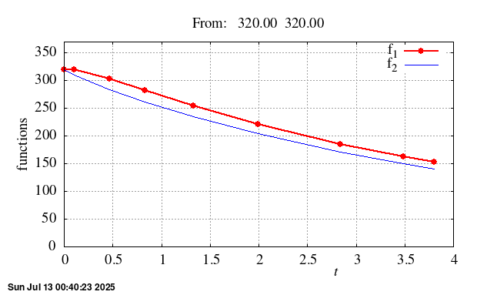
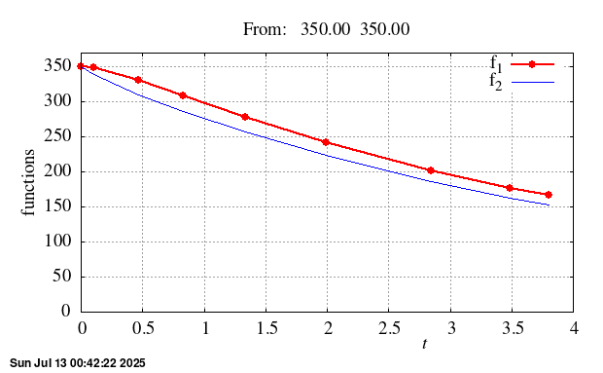
A system of ODEs affected by data uncertainty
steered by Monte Carlo on the Web (dialysis)
What happens if the initial values are wrong ?
Final values: correct, from 320→150; wrong, from 350→166
https://www.google.com/search?q=Miguel+Casquilho → Research…

Slide 3
A system of ODEs affected by data uncertainty
steered by Monte Carlo on the Web (dialysis)
Abstract — We study a system of ODEs (ordinary differential equations) as an IVP (initial value problem): a “good” model with “bad” data.
The data are the initial values (IVs), which will be made random.
We solve the system of ODEs numerically (more general);
We explore the solution by Gaussian perturbation of the IVs; and
We provide a web page for verification of the results: from our data or from data inserted by the user.
The computation assesses the consequences (variability) in the results — hardly predictable without such a procedure.
This Web verification is one of the contributions in this study. We shorten the distance from academia to industry.

Slide 4
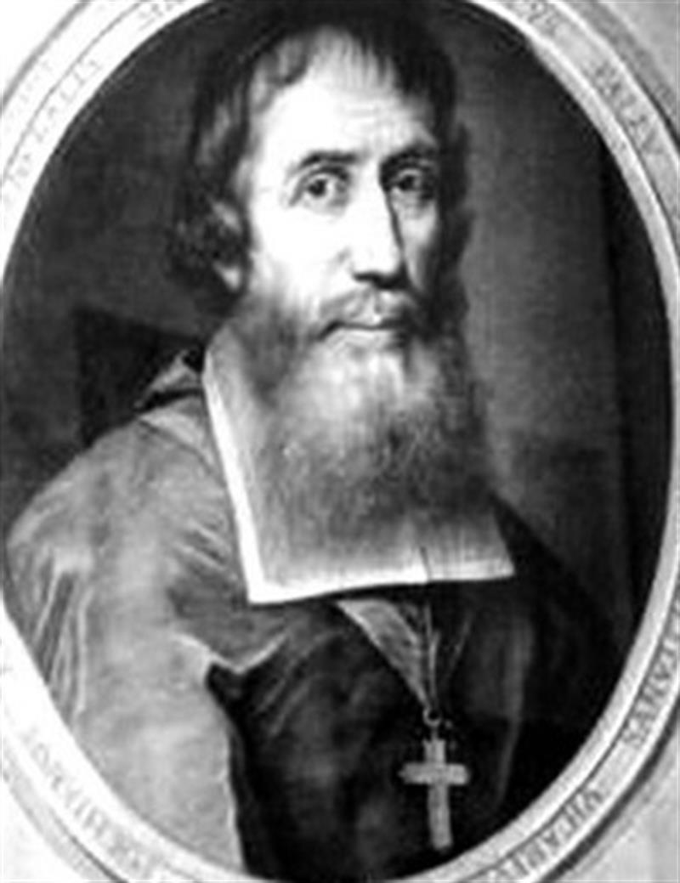
A system of ODEs affected by data uncertainty
steered by Monte Carlo on the Web (dialysis)
Computing over the Web
The problem
Conclusions
Portuguese Francisco de Pina
(1585–1625)
Vietnamese alphabet

Slide 5
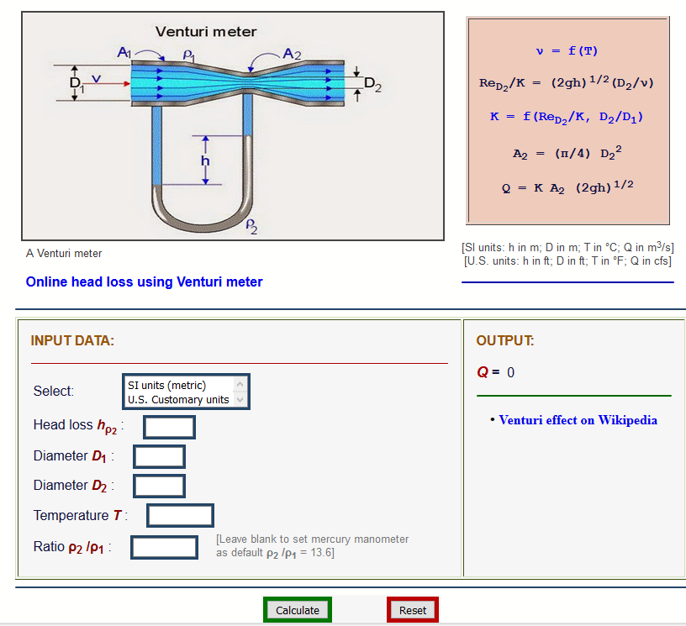
1. 2. 3. Computing over the Web
###The Web supplies almost everything, frequently free of charge.
In the Web, nevertheless, technology and education (teaching, learning) are strangely underrepresented.
Exception, in technology & education: V. M. Ponce
(San Diego State Univ.), Hydraulics
  Problem 168 #: insert data; “Calculate”; get result.
  (He offers no default data.)
  (Next slide)
We (these authors) did not find articles with
links for us to directly verify (and use) their findings.
(Neither did ChatGPT, DeepSeek.)

Slide 6
1. 2. 3. Computing over the Web
### Input / output without user data / output with invented data

Slide 7
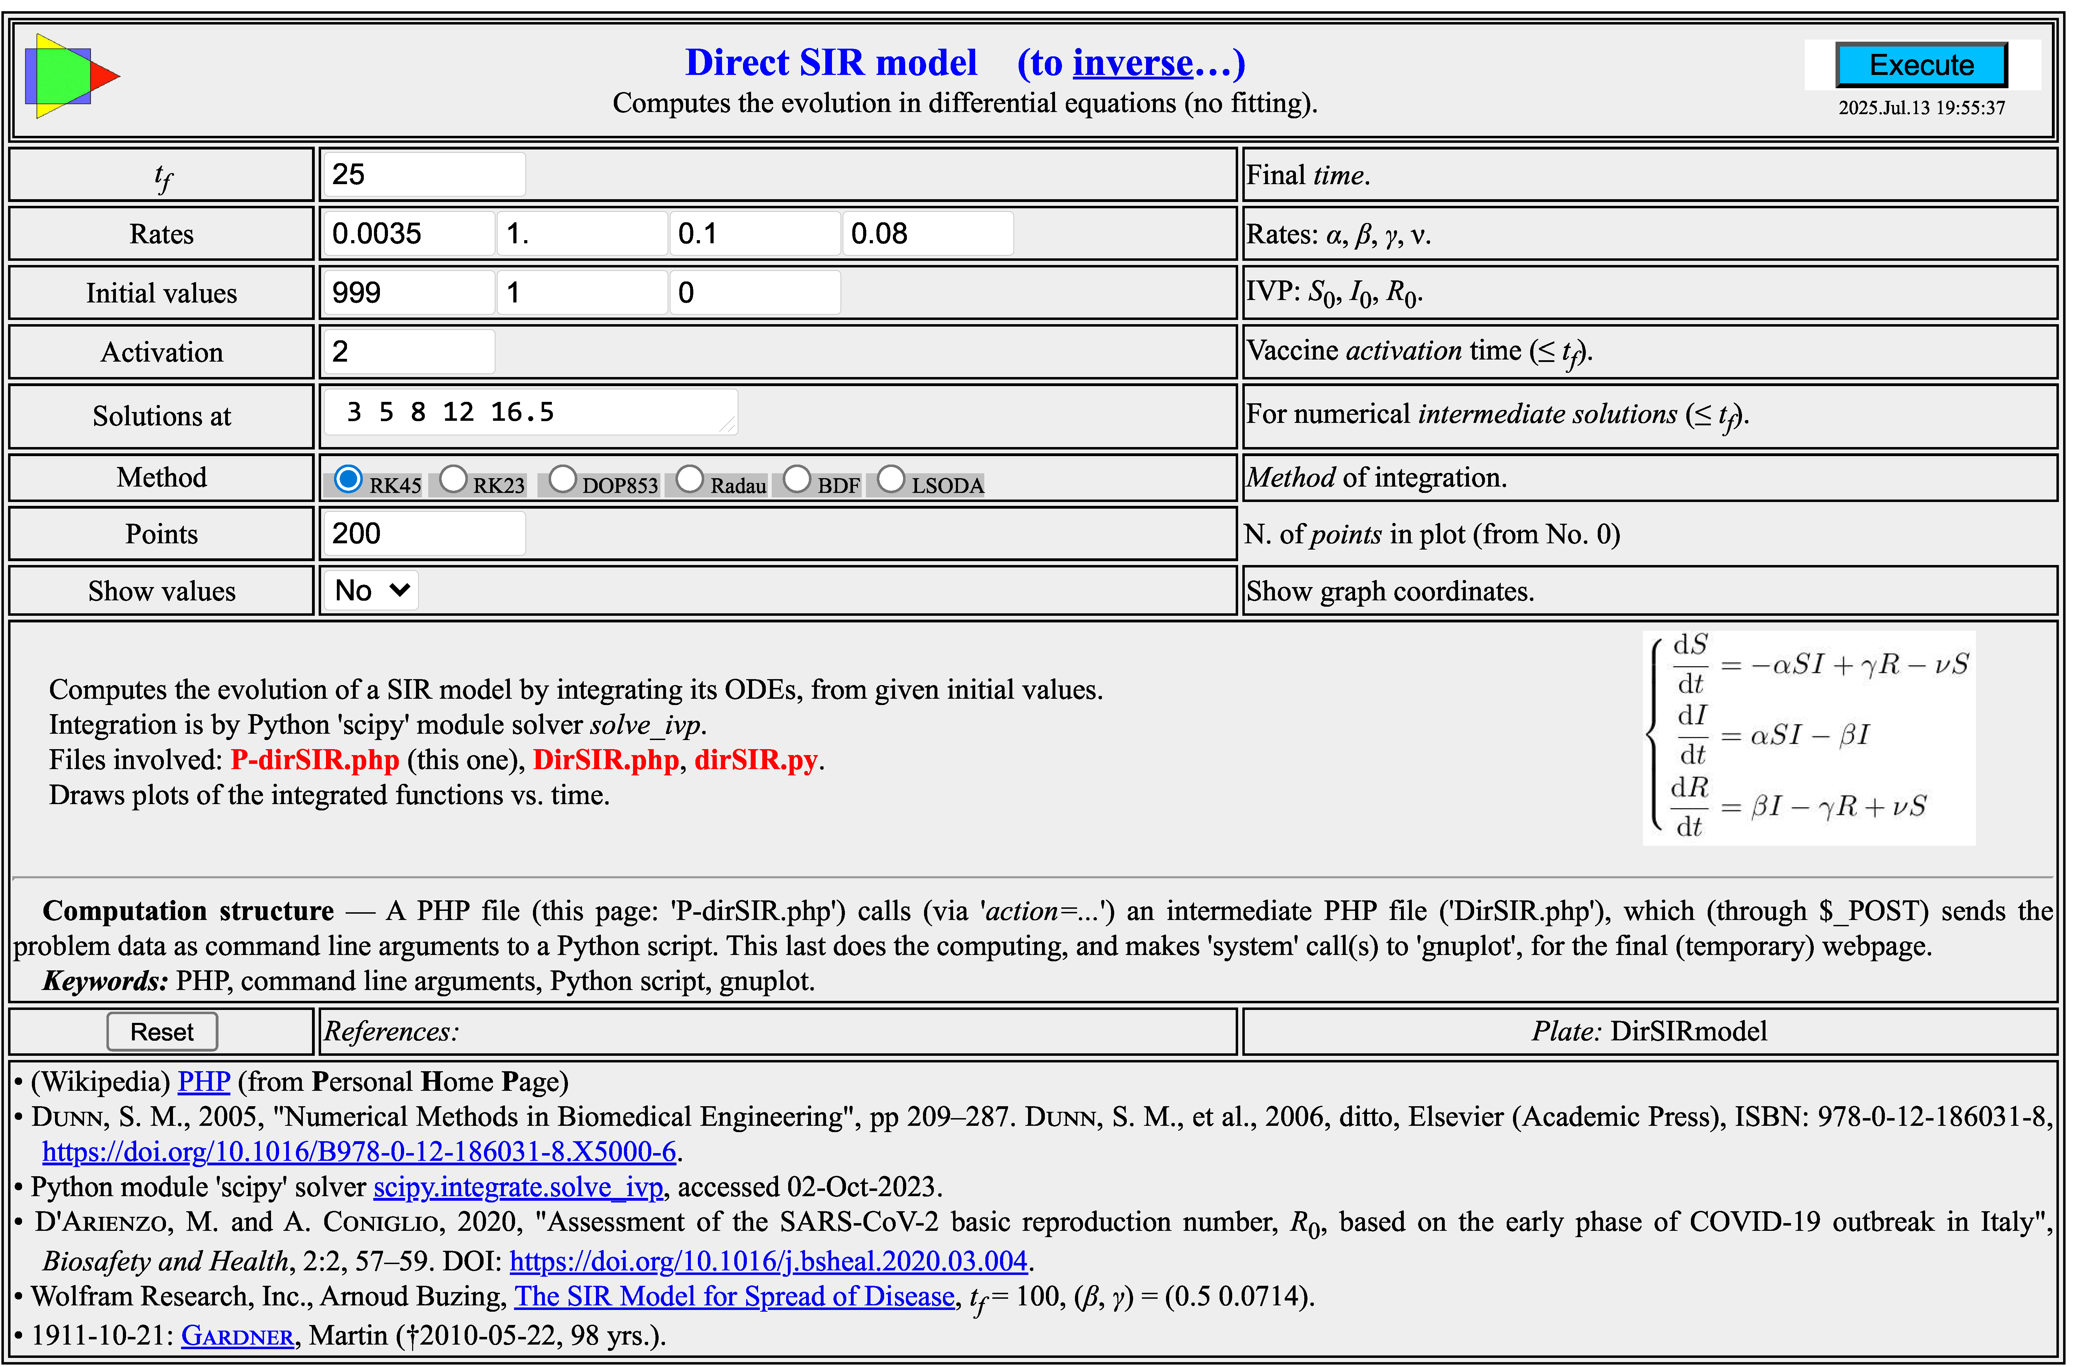
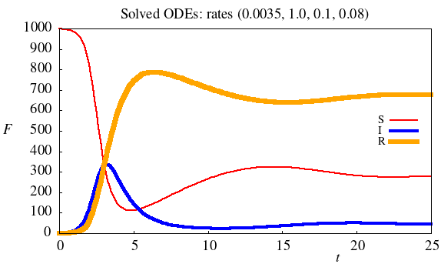
1. 2. 3. Computing over the Web
An example from our works:
Evolution of an epidemic (such as Covid-19) through an SIR model vs. time.
Image is
link → …

Slide 8

A system of ODEs affected by data uncertainty
steered by Monte Carlo on the Web (dialysis)
Computing over the Web
The problem
Conclusions
Imperial Citadel
Hanoi

Slide 9
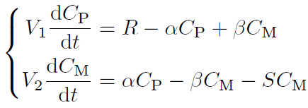
1. 2. 3. The problem
ODEs with uncertain initial values
ODEs in C_{P}(t) (patient) and C_{M}(t) (machine), soluble analytically but
solved numerically for generality.
Objective: from an initial value of
supposedly C_{P}(0) = C_{M}(0) = 320,
find T (hours) when C_{P}(T) decreases to 150.
Under uncertainty (IV ≠ 320), we have, at prescribed time T:
  IV > 320: the patient is left with too high urea.
  IV < 320: the patient suffers too long a treatment.
A simple inspection of (rare) extreme uncertainty is not realistic.
From “true” IV (μ = 320, e.g.), we use c_{v} (5%, e.g.), so σ = μ c_{v} to impose a Gaussian behavior to IV and to assess the random final C_{P}(T).

Slide 10
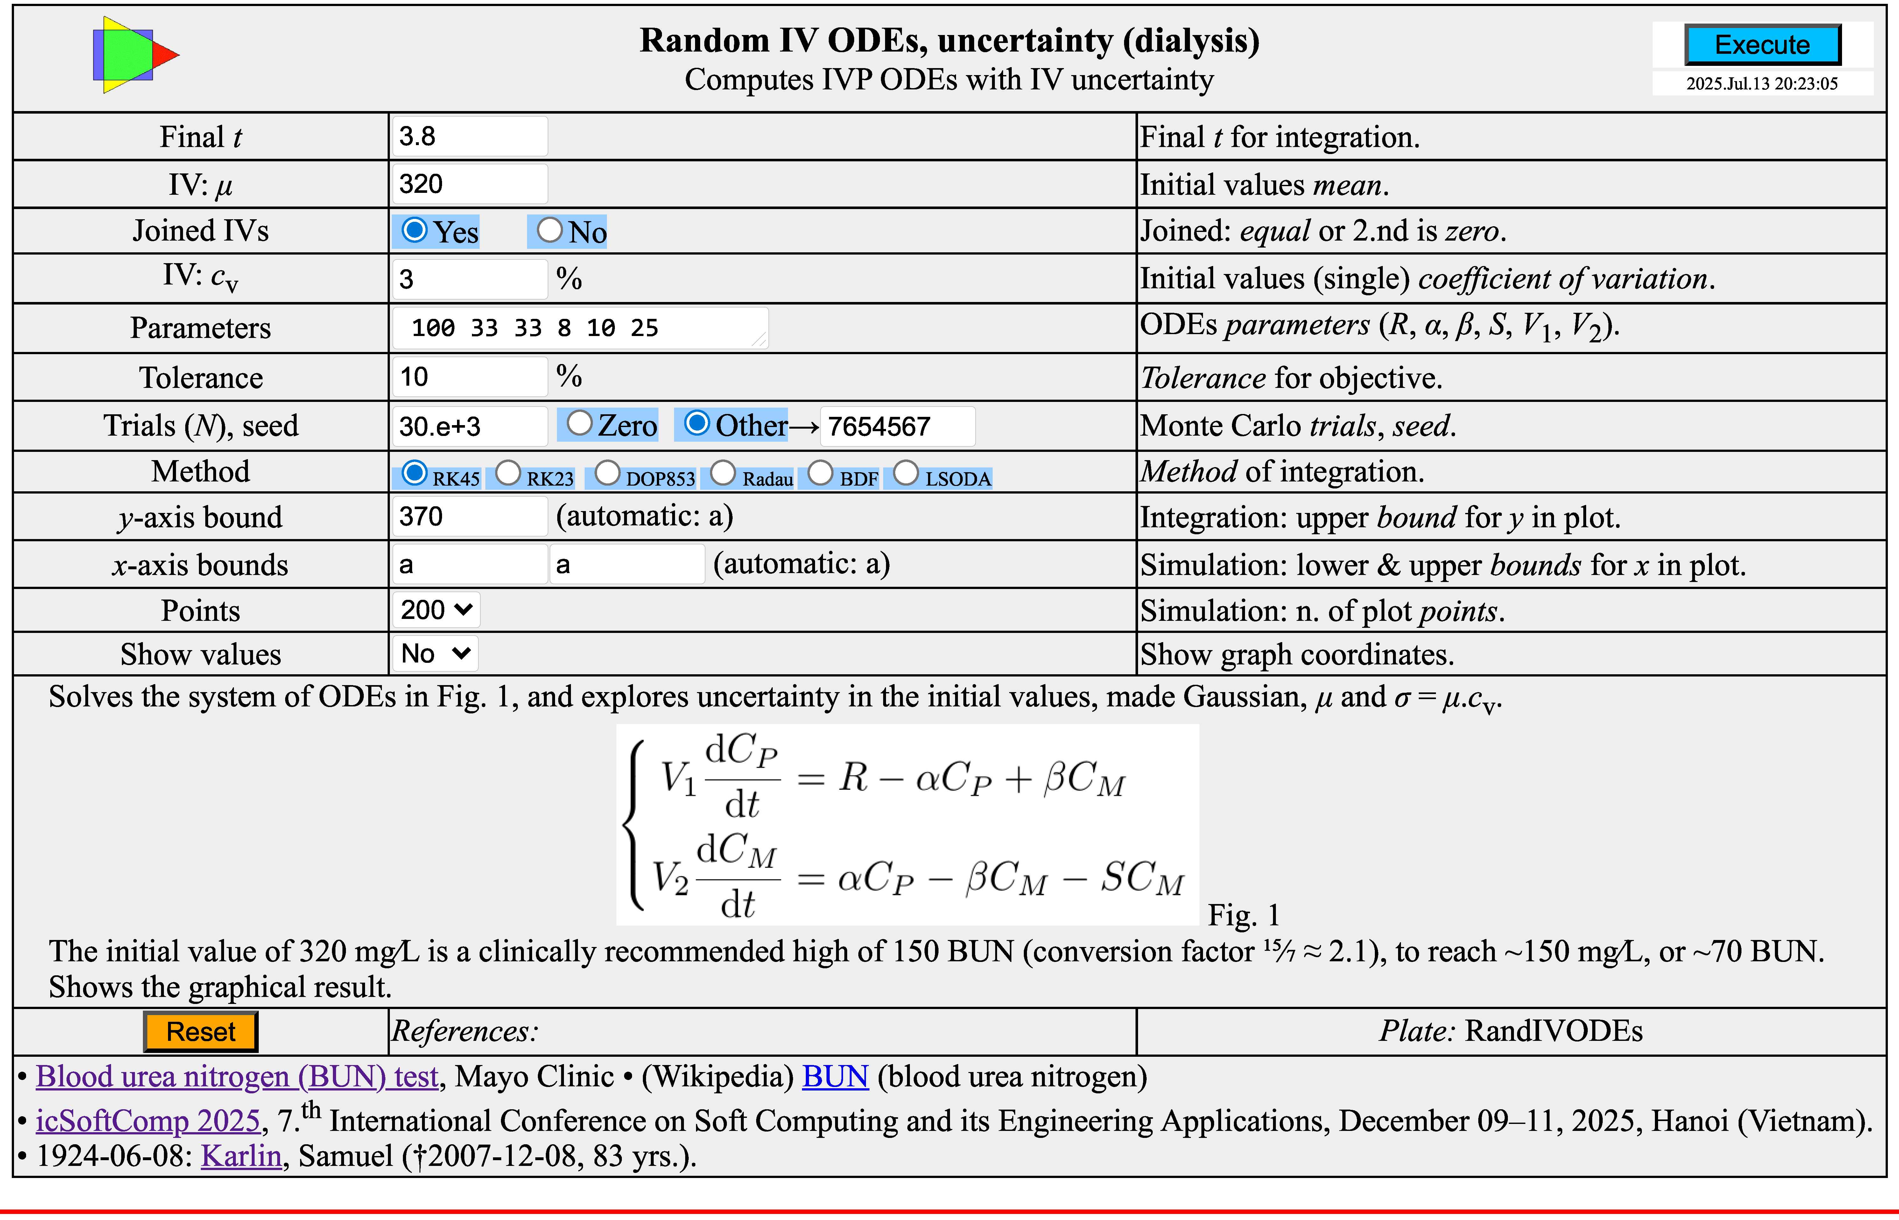
1. 2. 3. The problem
Uncertain IVs in ODEs (here, the IVs are usually equal, “joined”)
Image
is link
(Result
in next
slide)
or…

Slide 11
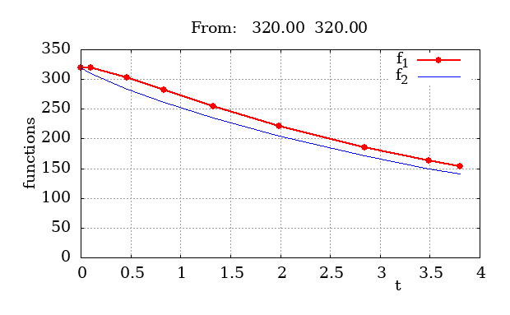
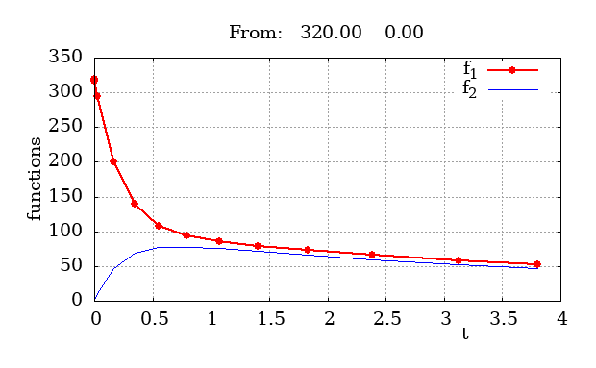
1. 2. 3. The problem
Solutions, always at prescribed T = 3.8 hours
Left: “joined” (equal IVs), C_{P}(0) = C_{M}(0) = 320.
Right: “disjoined” (different IVs), (C_{P}(0), C_{M}(0)) = (320, 0).
For the Monte Carlo exploration we will use the “joined” case, but both are available in the web page.

Slide 12
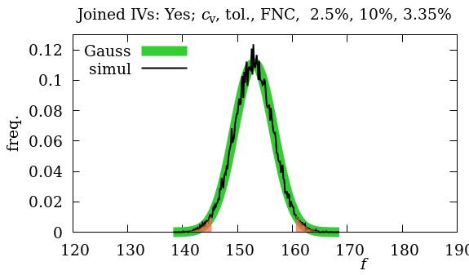
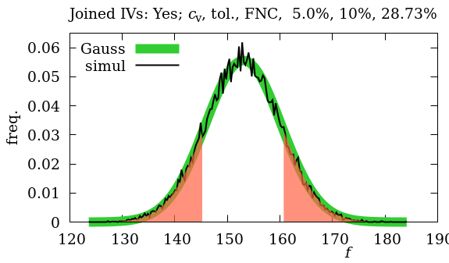
1. 2. 3. The problem
If the initial values are uncertain, so are the final values
Final time T = 3.8; target C_{P}(T) = 150 (patient). Irrelevant C_{M}(T) (machine).
N Monte Carlo trials = 30 000, repeatable (so, verifiable), in ~20 s
Left, cv = 2.5%, bad fraction 3.35%; right, cv = 5%, bad fraction 28.7%
Most values in 145–161 instead of the “correct” 150.

Slide 13
1. 2. 3. The problem
The adopted ODEs relate to a medical application.
We believe in the equations but can doubt the data.
The dialysis treatment is based on a given initial state of the patient.
If the initial state is not systematically measured, it may vary.
The health professionals will decide whether the final variation is acceptable.
If it is acceptable, there will be 3% or 28%, etc., unsatisfactory treatments.
If it is not acceptable, measurement (clinical test) must be done.
The model — if credible — and the procedure permit to decide.
The Monte Carlo strategy seems to be adequate in this type of situations.

Slide 14
1. 2. 3. The problem
Observations
Mathematics Solving ODEs is routine —e.g., with Python solve_ivp (or Matlab, Mathematica, etc.)— if the language is adequate (maybe free, duly licensed).
Applicability From theory to practice, there is a certain, well-known distance.
Operations Research A Monte Carlo simulation steered the above to reach realistic results.
Web The task is offered to any user, permitting to verify and use with default data or other data.

Slide 15
1. 2. 3. The problem
Results, discussion
The study is a template exercise on initial value problem (IVP) ordinary differential equations (ODEs), with random initial values.
The illustration happens to be in a medical technique.
The ODEs might be solved analytically, but the numerical resolution makes the case more general.
The initial values are, typically, made equal, but this condition can be freely altered.
The Gaussian uncertainty in the IVs was produced by Monte Carlo simulation.
In our School (public) computing system, the time limit (~2 min) can prevent more realistic simulations. Work on eliminating this limit is underway.

Slide 16
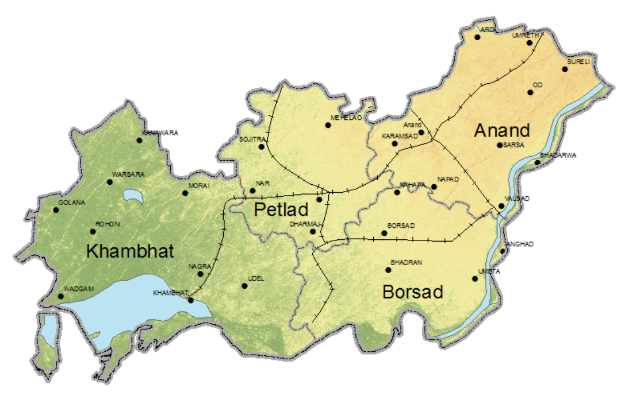
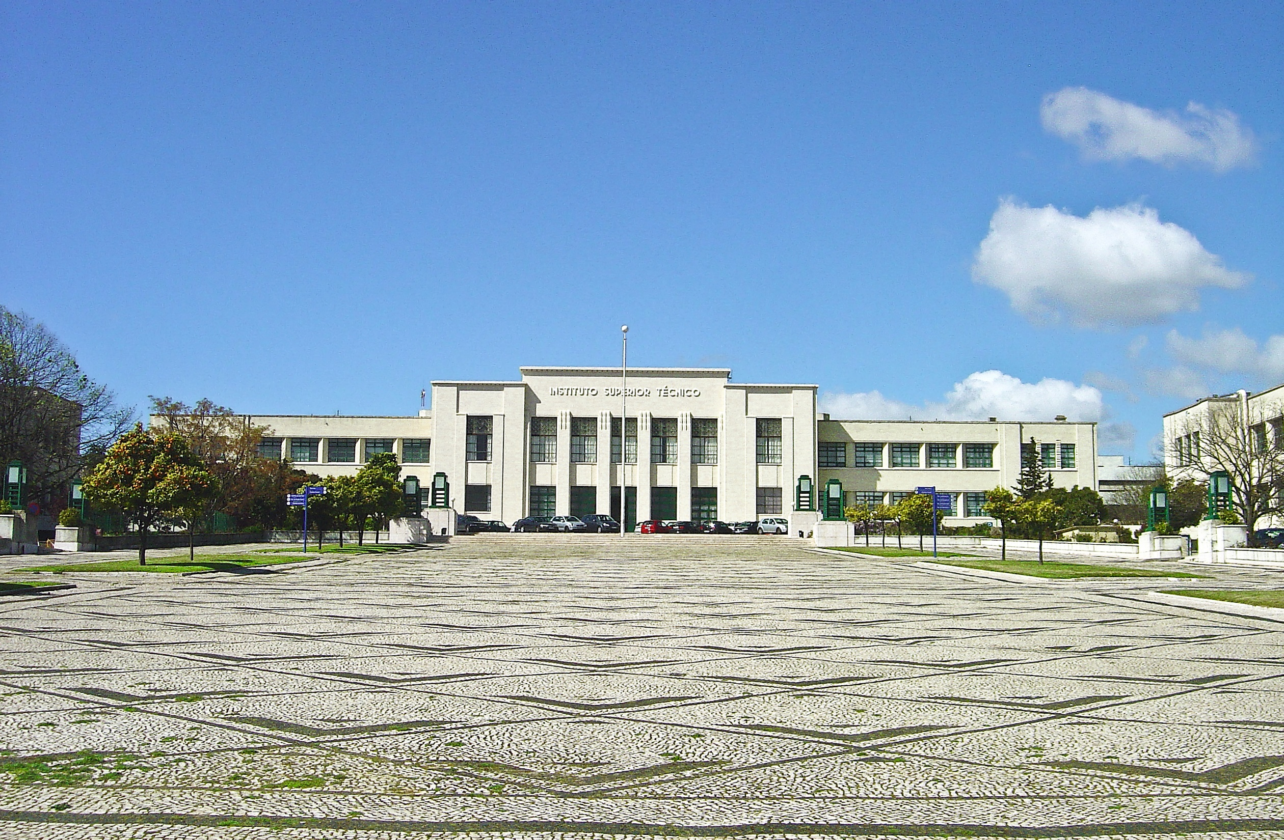
A system of ODEs affected by data uncertainty
steered by Monte Carlo on the Web (dialysis)
Computing over the Web
The problem
Conclusions
2026, Anand ?
Instituto Superior Técnico
(University of Lisbon)

Slide 17
1. 2. 3. Conclusions
### A system of ODEs was routinely solved using Python (solve_ivp).
The IVs were considered uncertain and were subjected to Monte Carlo simulation, as Gaussian random variables.
With uncertain initial values, the selected final value (supposed to meet a given target) was assessed: the effect of “bad” data on a “good” model.
This type of effect is rarely addressed, emphasis going strongly to the quality of the mathematical models and of the infomatic route.
Computing, Mathematics, and Operations Research were combined, but we stress the availability of the dynamic resolution on the Web, a feature uncommon in the literature.
This last feature, while benefiting teaching, facilitates the desirable link between academia and industry.

Slide 18
Acknowledgements
M. Casquilho, R. Galhano
Department of Chemical Engineering, IST, University of Lisbon, Lisbon, Portugal, and CERENA, “Centro de Recursos Naturais e Ambiente” (Centre for Natural Resources and the Environment), funded by FCT, “Fundação para a Ciência e a Tecnologia” (Portuguese National Science Foundation)
M. Monteirinho, P. Pacheco
Department of Computer Science and Engineering, IST, University of Lisbon, Lisbon, Portugal
CIIST, “Centro de Informática do IST” (Informatics Centre of IST) supplies the computing system.

Slide 19
Bibliography
*Barros, M., and M. Casquilho (2019) “Linear Programming with CPLEX: an illustrative application over the Internet", CISTI'2019, 14.ª Conferência Ibérica de Sistemas e Tecnologias de Informação (14.th Iberian Conference on Information Systems and Technologies), Coimbra (Portugal).
*Casquilho, M., J. Buescu (2022) "Mean of Exponential distribution: estimation from sums of unequal size samples", COMPSTAT 2022, 24.th Int’l Conf. on Comput’l Statistics, Aug., Bologna (Italy).
*Casquilho, M., R. Galhano, J. Buescu (2024) “From Einstein on the Beach to Collatz on the Web", ICMASC’24, Int’l Conf. on Math. Anal. and Appl.s in Sci. and Eng.ing, Jun., Porto (Portugal).
*Casquilho, M., P. Pacheco, M. Monteirinho, R. Galhano, S. Carvalho, J. Bordado (2025) “Assignment Problem: a Linear Programming application with uncertain data, running on the Web", CISTI’2025, 20.th Iberian Conf. on Information Systems and Technologies), Lisbon (Portugal).
*Franco, B., and M. Casquilho (2011) “A Web application for scientic computing: combining several tools and languages to solve a statistical problem", CISTI'2011 (6.th Iberian Conf. on Inform. Sys. and Techn.s), Chaves (Vila Real), Portugal.
*Silva, P. M., M. Casquilho, C. Caridade and M. Monteirinho (2025) “Ordinary differential equations for dialysis: from theory to the Web — A simulation tool", CISTI’2025 (20.th Iberian Conf. on Inform. Sys. and Techn.s), Jun., Lisbon, Portugal.
* With links to computing.

Slide 20
A system of ODEs affected by data uncertainty
steered by Monte Carlo on the Web (dialysis)
Miguel Casquilho¹, Manuel Monteirinho²,
Pedro Pacheco², and Rui Galhano¹
¹Department of Chemical Engineering, IST, University of Lisbon, Portugal, and CERENA (Centre for Natural Resources and the Environment)
²Dept. of Computer Science and Eng.ing, IST, Univ. of Lisbon, Portugal
http://web.tecnico.ulisboa.pt/mcasquilho/ mcasquilho@tecnico.ulisboa.pt
CHARUSAT, Changa, Anand, India  Hanoi, Vietnam — 09–11 December 2025

