Slide 1
INTEGER PROGRAMMING MODELS
Isaac Gottlieb (Temple Univ.)

Slide 2
Learning Objectives
Formulate integer programming (IP) models.
Set up and solve IP models using Excel’s Solver.
Understand the difference between general integer and binary integer variables
Understand use of binary integer variables in formulating problems involving fixed (or setup) costs.

Slide 3
Integer Programming Models
Some business problems can be solved only if variables have integer values.
  Airline decides on the number of flights to operate in a given sector must be an integer or whole number amount.
  Other examples:
  The number of aircraft purchased this year
  The number of machines needed for production
  The number of trips made by a sales person
  The number of police officers assigned to the night shift.

Slide 4
Some Facts
Integer variables may be required when the model represents a one time decision (not an ongoing operation).
Integer Linear Programming (ILP) models are much more difficult to solve than Linear Programming (LP) models.
Algorithms that solve integer linear models do not provide valuable sensitivity analysis results.

Slide 5
Types of Integer Variables
General integer variables and
Binary variables.
General integer variables can take on any non-negative, integer value that satisfies all constraints in the model.
Binary variables can only take on either of two values: 0 or 1.

Slide 6
Types of Integer Programming Problems
Pure integer programming problems.
  All decision variables must have integer solutions.
Mixed integer programming problems.
  Some, but not all, decision variables must have integer solutions.
  Non-integer variables can have fractional optimal values.
Pure binary (or Zero - One) integer programming problems.
  All decision variables are of special type known as binary.
  Variables must have solution values of either 0 or 1.
Mixed binary integer programming problems.
  Some decision variables are binary, and other decision variables are either general integer or continuous valued.

Slide 7
Models With General Integer Variables
A model with general integer variables (IP) has objective function and constraints identical to LP models.
No real difference in basic procedure for formulating an IP model and LP model.
Only additional requirement in IP model is one or more of the decision variables have to take on integer values in the optimal solution.
Actual value of this integer variable is limited by the model constraints. (Values such as 0, 1, 2, 3, etc. are perfectly valid for these variables as long as these values satisfy all model constraints.)

Slide 8
Complexities of ILPS
If an integer model is solved as a simple linear model, at the optimal solution non-integer values may be attained.
Rounding to integer values may result in:
  Infeasible solutions
  Feasible but not optimal solutions
  Optimal solutions.

Slide 9
Some Features of Integer Programming Problems
Rounding non-integer solution values up to the nearest integer value can result in an infeasible solution
A feasible solution is ensured by rounding down non-integer solution values but may result in a less than optimal (sub-optimal) solution.

Slide 10
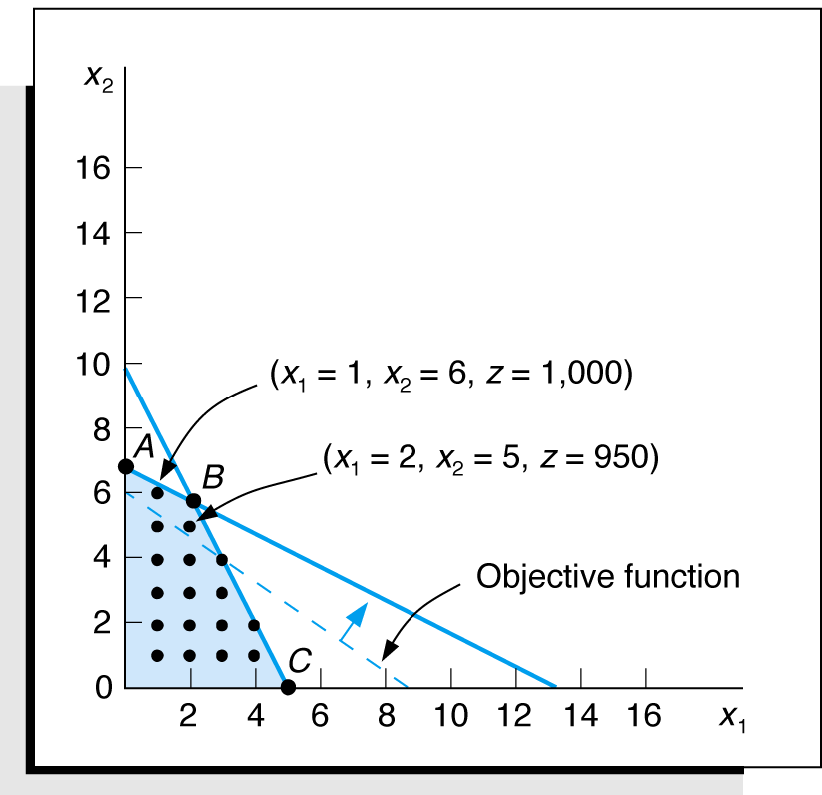
Integer Programming Example
Graphical Solution of Maximization Model
Maximize Z = $100x₁ + $150x₂
subject to:
8,000x₁ + 4,000x₂ ≤ $40,000
15x₁ + 30x₂ ≤ 200 ft²
x₁, x₂ ≥ 0 and integer
Optimal Solution:
Z = $1,055.56
x₁ = 2.22 presses
x₂ = 5.55 lathes
Feasible Solution Space with Integer Solution Points

Slide 11
Why not enumerate all the feasible integer points and select the best one?
Enumerating all the integer solutions is impractical because of the large number of feasible integer points.
Is rounding ever done? Yes, particularly if:
  The values of the positive decision variables are relatively large, and
  The values of the objective function coefficients relatively small.

Slide 12
General Integer Variables:
Pure Integer Programming Models

Slide 13
Pure Integer Programming
Example 1: Harrison Electric Company (1 of 8)
Produces two expensive products popular with renovators of historic old homes:
  Ornate chandeliers (C) and
  Old-fashioned ceiling fans (F).
Two-step production process:
  Wiring ( 2 hours per chandelier and 3 hours per ceiling fan).
  Final assembly time (6 hours per chandelier and 5 hours per fan).

Slide 14
Pure Integer Programming
Example 1: Harrison Electric Company (2 of 8)
Production capability this period:
  12 hours of wiring time available and
  30 hours of final assembly time available.
Profits:
  Chandelier profit $600 / unit and
  Fan profit $700 / unit.

Slide 15
Pure Integer Programming
Example 1: Harrison Electric Company (3 of 8)
Objective: maximize profit = $600C + $700F
subject to
2C + 3F <= 12 (wiring hours)
6C + 5F <= 30 (assembly hours)
C, F >= 0 and integer
where
C = number of chandeliers to be produced
F = number of ceiling fans to be produced

Slide 16
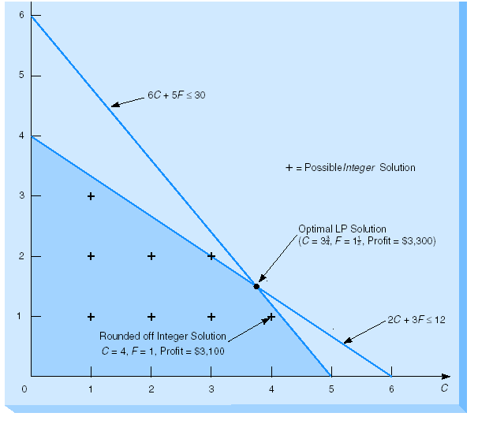
Pure Integer Programming
Example 1: Harrison Electric Company (4 of 8)
Graphical LP Solution

Slide 17
Pure Integer Programming
Example 1: Harrison Electric Company (5 of 8)
Shaded region 1 shows feasible region for LP problem.
Optimal corner point solution:
  C = 3.75 chandeliers and
  F = 1.5 ceiling fans.
Profit of $3,300 during production period.
But, we need to produce and sell integer values of the products.
The table shows all possible integer solutions for this problem.

Slide 18
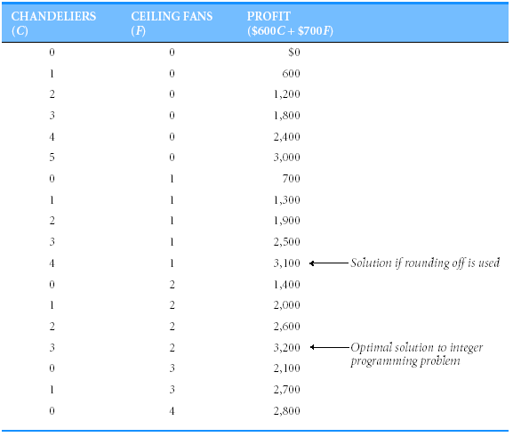
Pure Integer Programming
Example 1: Harrison Electric Company (6 of 8)
Enumeration of all integer solutions

Slide 19
Pure Integer Programming
Example 1: Harrison Electric Company (7 of 8)
Table lists the entire set of integer-valued solutions for problem.
By inspecting the right-hand column, optimal integer solution is:
  C = 3 chandeliers,
  F = 2 ceiling fans.
Total profit = $3,200.
The rounded off solution:
C = 4
F = 1
Total profit = $3,100.

Slide 20
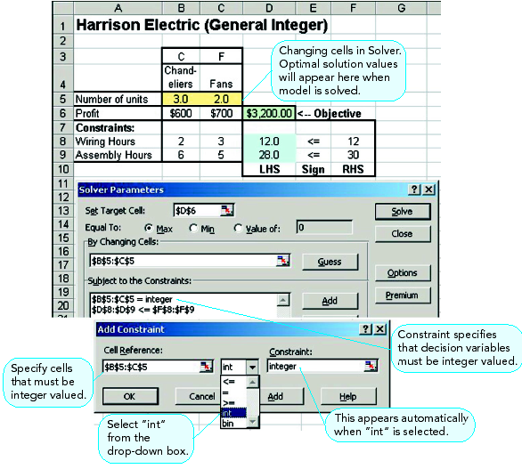
General Integer Variables Excel Solver Solution
Example 1: Harrison Electric Company (8 of 8)

Slide 21

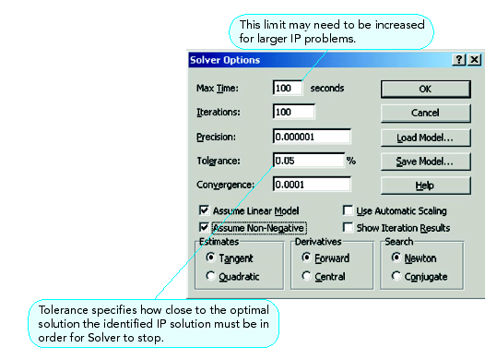
Solver Options

Slide 22
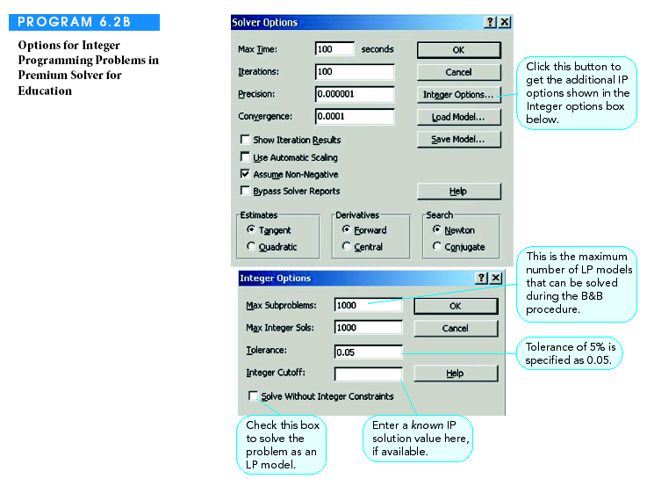
Premium Solver for Education

Slide 23
Pure Integer Programming
Example 2: Boxcar Burger Restaurants (1 of 4)
Boxcar Burger is a new chain of fast-food establishments.
Boxcar is planning expansion in the downtown and suburban areas.
Management would like to determine how many restaurants to open in each area in order to maximize net weekly profit.

Slide 24
Pure Integer Programming
Example 2: Boxcar Burger Restaurants (2 of 4)
Requirements and Restrictions:
No more than 19 managers can be assigned
At least two downtown restaurants are to be opened
Total investment cannot exceed $2.7 million

Slide 25
Pure Integer Programming
Example 2: Boxcar Burger Restaurants (3 of 4)
Decision Variables
  X1 = Number of suburban boxcar burger restaurants to be opened.
  X2 = Number of downtown boxcar burger restaurants to be opened.
The mathematical model is formulated next

Slide 26
Pure Integer Programming
Example 2: Boxcar Burger Restaurants (4 of 4)
Net weekly profit
Total investment cannot exceed $2.7 dollars
At least 2 downtown restaurants
Not more than 19 managers can be assigned

Slide 27
Pure Integer Programming
Example 3: Personnel Scheduling Problem (1 of 6)
The City of Sunset Beach staffs lifeguards 7 days a week.
Regulations require that city employees work five days.
Insurance requirements mandate 1 lifeguard per 8000
average daily attendance on any given day.
The city wants to employ as few lifeguards as possible.

Slide 28
Pure Integer Programming
Example 3: Personnel Scheduling Problem (2 of 6)
Problem Summary
  Schedule lifeguard over 5 consecutive days.
  Minimize the total number of lifeguards.
  Meet the minimum daily lifeguard requirements
  Sun. Mon. Tue Wed. Thr. Fri. Sat.
  8 6 5 4 6 7 9
  For each day, at least the minimum required lifeguards must be on duty.

Slide 29
Pure Integer Programming
Example 3: Personnel Scheduling Problem (3 of 6)
Decision Variables:
  X_{i} = the number of lifeguards scheduled to
  begin on day “I” for i=1, 2, …,7 (i=1 is Sunday)
Objective Function:
  Minimize the total number of lifeguards scheduled

Slide 30
Pure Integer Programming
Example 3: Personnel Scheduling Problem (4 of 6)
To ensure that enough lifeguards are scheduled for each day,
ask which workers are on duty. For example:
X3
Who works on Sunday ?
X4
X5
X6
X1
Tue. Wed. Thu. Fri. Sun.
Repeat this procedure for each day of the week, and build the constraints accordingly.

Slide 31
Pure Integer Programming
Example 3: Personnel Scheduling Problem (5 of 6)
The Mathematical Model

Slide 32
Pure Integer Programming
Example 3: Personnel Scheduling Problem (6 of 6)
Note: An alternate optimal solution exists.

Slide 33
Pure Integer Programming
Example 4: Machine Shop (1 of 2)
Machine shop obtaining new presses and lathes.
Marginal profitability: each press $100/day; each lathe $150/day.
Resource constraints: $40,000; 200 sq. ft. floor space.
Machine purchase prices and space requirements:

Slide 34
Pure Integer Programming
Example 4: Machine Shop (2 of 2)
Integer Programming Model:
Maximize Z = $100x₁ + $150x₂
subject to:
8,000x₁ + 4,000x₂ ≤ $40,000
15x₁ + 30x₂ ≤ 200 ft²
x₁, x₂ ≥ 0 and integer
x₁ = number of presses
x₂ = number of lathes

Slide 35
Pure Integer Programming
Example 5:Textbook Company (1 of 2)
Textbook company developing two new regions.
Planning to transfer some of its 10 salespeople into new regions.
Average annual expenses for sales person:
  Region 1 - $10,000/salesperson
  Region 2 - $7,500/salesperson
Total annual expense budget is $72,000.
Sales generated each year:
  Region 1 - $85,000/salesperson
  Region 2 - $60,000/salesperson
How many salespeople should be transferred into each region in order to maximize increased sales?

Slide 36
Pure Integer Programming
Example 5:Textbook Company (2 of 2)
Step 1:
Formulate the Integer Programming Model
Maximize Z = $85,000x₁ + 60,000x₂
subject to:
x₁ + x₂ ≤ 10 salespeople
$10,000x₁ + 7,000x₂ ≤ $72,000 expense budget
x₁, x₂ ≥ 0 or integer
Step 2:
Solve the Model using QM for Windows

Slide 37
Sensitivity in ILP
In ILP models, there is no pattern to the disjoint effects of changes to the objective function and right hand side coefficients.
When changes occur, they occur in big ”steps,” rather than the smooth, marginal fashion experienced in linear programming.
Therefore, sensitivity analysis for integer models must be made by re-solving the problem, a very time-consuming process.

Slide 38
General Integer Variables:
Mixed Integer Programming Models

Slide 39
General Integer Variable (IP):
Mixed Integer Programming
A mixed integer linear programming model is one in which some, but not all, the variables are restricted integers.
The Shelly Mednick Investment Problem illustrates this situation

Slide 40
Mixed Integer Linear Programming
Example 1: Shelly Mednick Investment Problem (1 of 3)
Shelley Mednick has decided to give the stock market a try.
She will invest in
  TCS, a communication company stock, and or,
  MFI, a mutual fund.
Shelley is a cautious investor. She sets limits on the level of investments, and a modest goal for gain for the year.

Slide 41
Mixed Integer Linear Programming
Example 1: Shelly Mednick Investment Problem (2 of 3)
Data
  TCS is been sold now for $55 a share.
  TCS is projected to sell for $68 a share in a year.
  MFI is predicted to yield 9% annual return.
Restrictions
  Expected return should be at least $250.
  The maximum amount invested in TCS is not to exceed 40 % of the total investment.
  The maximum amount invested in TCS is not to exceed $750.

Slide 42
Mixed Integer Linear Programming
Example 1: Shelly Mednick Investment Problem (3 of 3)
Decision variables
  X1 = Number of shares of the TCS purchased.
  X2 = Amount of money invested in MFI.
The mathematical model
Projected yearly return
Not more than 40%
in TCS
Not more than $750
in TCS

Slide 43
Mixed Integer Programming
Example 2: Investment Problem (1 of 2)
$250,000 available for investments providing greatest return after one year.
Data:
  Condominium cost $50,000/unit, $9,000 profit if sold after one year.
  Land cost $12,000/ acre, $1,500 profit if sold after one year.
  Municipal bond cost $8,000/bond, $1,000 profit if sold after one year.
  Only 4 condominiums, 15 acres of land, and 20 municipal bonds available.

Slide 44
Mixed Integer Programming
Example 2: Investment Problem (2 of 2)
Integer Programming Model:
Maximize Z = $9,000x₁ + 1,500x₂ + 1,000x₃
subject to:
50,000x₁ + 12,000x₂ + 8,000x₃ ≤ $250,000
x₁ ≤ 4 condominiums
x₂ ≤ 15 acres
x₃ ≤ 20 bonds
x₂ ≥ 0
x₁, x₃ ≥ 0 and integer
x₁ = condominiums purchased
x₂ = acres of land purchased
x₃ = bonds purchased

Slide 45
Models with Binary Variables

Slide 46
Models With Binary Variables
Binary variables restricted to values of 0 or 1.
Model explicitly specifies that variables are binary.
Typical examples include decisions such as:
  Introducing new product (introduce it or not),
  Building new facility (build it or not),
  Selecting team (select a specific individual or not), and
  Investing in projects (invest in a specific project or not).

Slide 47
Any situation that can be modeled by “yes”/“no”, “good”/“bad” etc., falls into the binary category.
Examples

Slide 48
Pure Binary Integer Programming Models

Slide 49
Pure Binary Integer Programming Models:
Example 1: Oil Portfolio Selection (1 of 7)
Firm specializes in recommending oil stock portfolios.
At least two Texas oil firms must be in portfolio.
No more than one investment can be made in foreign oil.
Exactly one of two California oil stocks must be purchased.
If British Petroleum stock is included in portfolio, then Texas-Trans Oil stock must also be included in portfolio.
Client has $3 million available for investments and insists on purchasing large blocks of shares of each company for investment.
Objective is to maximize annual return on investment.

Slide 50
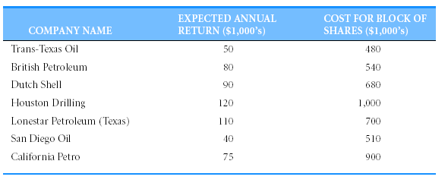
Pure Binary Integer Programming Models:
Example 1. Oil Portfolio Selection (2 of 7)
Investment Opportunities

Slide 51
Pure Binary (0, 1) IP Models:
Example 1. Oil Portfolio Selection (3 of 7)
Objective: maximize return on investment =
$50X_{T} + $80X_{B} + $90X_{D} + $120X_{H} + $110X_{L} + $40X_{S} + $75X_{C}
Binary variable defined as:
X_{i} = 1 if large block of shares in company i is purchased
= 0 if large block of shares in company i is not purchased
where i =
T (for Trans-Texas Oil),
B (for British Petroleum),
D (for Dutch Shell),
H (for Houston Drilling),
L (for Lonestar Petroleum),
S (for San Diego Oil), or
C (for California Petro).

Slide 52
Pure Binary IP Models:
Example 1. Oil Portfolio Selection (4 of 7)
Constraint regarding $3 million investment limit expressed as (in thousands of dollars):
$480X_{T} + $540X_{B} + $680X_{D} + $1,000X_{H} +
$700X_{L} + $510X_{S} + $900X_{C} ≤ $3,000
k Out of n Variables.
  Requirement at least two Texas oil firms be in portfolio.
  Three (i.e., n = 3) Texas oil firms (X_{T}, X_{H}, and X_{L}) of which at least two (that is, k = 2) must be selected.
X_{T} + X_{H} + X_{L} ≥ 2

Slide 53
Pure Binary IP Models:
Example 1. Oil Portfolio Selection (5 of 7)
Condition no more than one investment be in foreign oil companies (mutually exclusive constraint).
X_{B} + X_{D} ≤ 1
Condition for California oil stock is mutually exclusive variable.
  Sign of constraint is an equality rather than inequality.
  Simkin must include California oil stock in portfolio.
X_{S} + X_{C} = 1

Slide 54
Pure Binary IP Models:
Example 1. Oil Portfolio Selection (6 of 7)
Condition if British Petroleum stock is included in portfolio, then Texas-Trans Oil stock must also be in portfolio. (if-then constraints)
X_{B} ≤ X_{T}
or X_{B} - X_{T} ≤ 0
If X_{B} equals 0, constraint allows X_{T} to equal either 0 or 1.
If X_{B} equals 1, then X_{T} must also equal 1.
If the relationship is two-way (either include both or include neither), rewrite constraint as:
X_{B} = X_{T}
or X_{B} - X_{T} = 0

Slide 55
Pure Binary IP Models:
Example 1. Oil Portfolio Selection (7 of 7)
Objective: maximize return =
$50X_{T} + $80X_{B} + $90X_{D} + $120X_{H} +
$110X_{L} + $40X_{S} + $75X_{C}
subject to
$480X_{T} + $540X_{B} + $680X_{D} + $1,000X_{H} + $700X_{L} +
$510X_{S} + $900X_{C} ≤ $3,000 (Investment limit)
X_{T} + X_{H} + X_{L} ≥ 2 (Texas)
X_{B} + X_{D} ≤ 1 (Foreign Oil)
X_{S} + X_{C} = 1 (California)
X_{B} - X_{T} ≤ 0 (Trans-Texas and British
Petroleum)

Slide 56
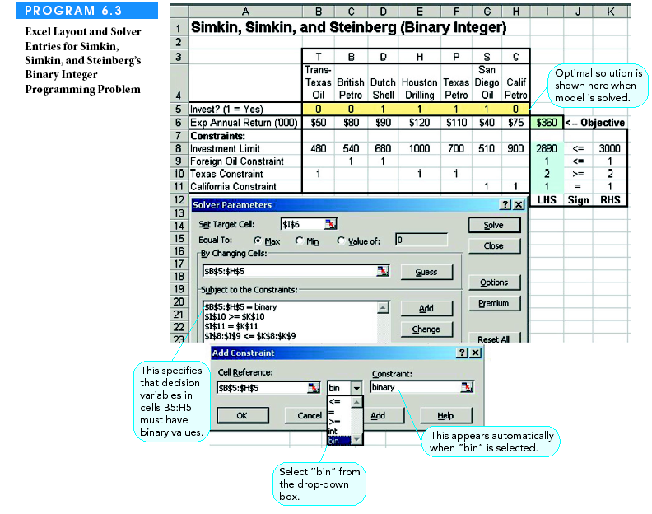
Excel Solver Setup

Slide 57
Pure Binary IP Models:
Example 2: Construction Projects (1 of 2)
Recreation facilities selection to maximize daily usage by residents.
Resource constraints: $120,000 budget; 12 acres of land.
Selection constraint: either swimming pool or tennis center (not both).
Data:

Slide 58
Pure Binary IP Models:
Example 2: Construction Projects (2 of 2)
Integer Programming Model:
Maximize Z = 300x₁ + 90x₂ + 400x₃ + 150x
subject to:
$35,000x₁ + 10,000x₂ + 25,000x₃ + 90,000x₄ ≤ $120,000
4x₁ + 2x₂ + 7x₃ + 3x₃ ≤ 12 acres
x₁ + x₂ ≤ 1 facility
x₁, x₂, x₃, x₄ = 0 or 1
x₁ = construction of a swimming pool
x₂ = construction of a tennis center
x₃ = construction of an athletic field
x₄ = construction of a gymnasium

Slide 59
Pure Binary IP Models:
Example 3: Capital Budgeting (1 of 3)
University bookstore expansion project.
Not enough space available for both a computer department and a clothing department.
Data:

Slide 60
Pure Binary IP Models:
Example 3: Capital Budgeting (2 of 3)
x₁ = selection of web site project
x₂ = selection of warehouse project
x₃ = selection clothing department project
x₄ = selection of computer department project
x₅ = selection of ATM project
x_{i} = 1 if project “i” is selected, 0 if project “i” is not selected
Maximize Z = $120x₁ + $85x₂ + $105x₃ + $140x₄ + $70x₅
subject to:
55x₁ + 45x₂ + 60x₃ + 50x₄ + 30x₅ ≤ 150
40x₁ + 35x₂ + 25x₃ + 35x₄ + 30x₅ ≤ 110
25x₁ + 20x₂ + 30x₄ ≤ 60
x₃ + x₄ ≤ 1
x_{i} = 0 or 1

Slide 61
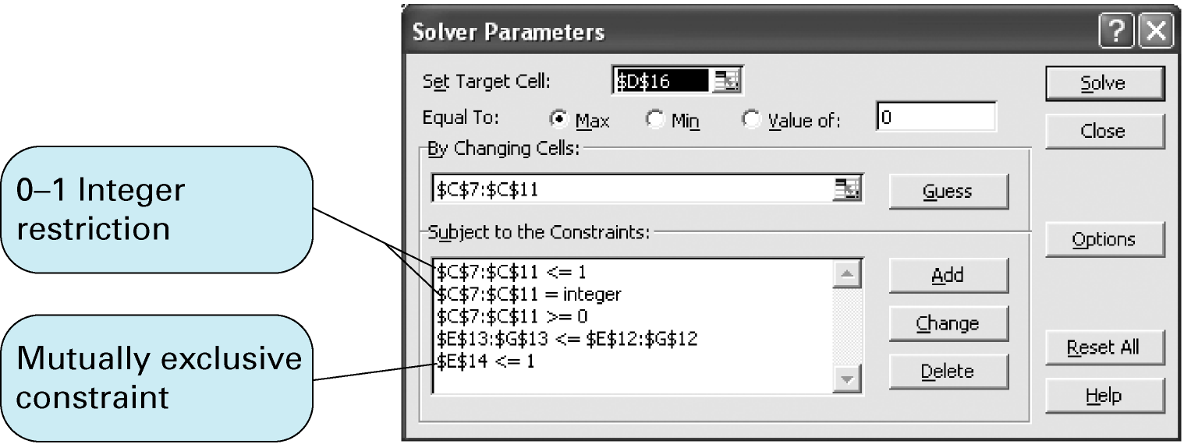
Pure Binary IP Models:
Example 3: Capital Budgeting (3 of 3)

Slide 62
Pure Binary IP Models
Example 4: Salem City Council (1 of 6)
The Salem City Council must choose projects to fund, such that public support is maximized
Relevant data covers constraints and concerns the City Council has, such as:
  Estimated costs of each project.
  Estimated number of permanent new jobs a project can create.
  Questionnaire point tallies regarding the 9 project ranking.

Slide 63
Pure Binary IP Models
Example 4: Salem City Council (2 of 6)
The Salem City Council must choose projects to fund, such that public support is maximized while staying within a set of constraints and answering some concerns.
Data:
Survey results

Slide 64
Pure Binary IP Models
Example 4: Salem City Council (3 of 6)
Decision Variables:
  X_{j}- a set of binary variables indicating if a project j is selected (X_{j}=1) or not (X_{j}=0) for j=1,2,..,9.
Objective function:
  Maximize the overall point score of the funded projects
Constraints:
  See the mathematical model.

Slide 65
Pure Binary IP Models
Example 4: Salem City Council (4 of 6)
The maximum amounts of funds to be allocated is $900,000
The number of new jobs created must be at least 10
The number of police-related activities selected is at most 3 (out of 4)
Either police car or fire truck be purchased
Sports funds and music funds must be restored / not restored together
Sports funds and music funds must be
restored before computer equipment
is purchased
CONTINUE

Slide 66
Pure Binary IP Models
Example 4: Salem City Council (5 of 6)
At least $250,000 must be reserved (do not use more than $650,000)
At least three police and fire stations should be funded
Three of these 5 constraints must be satisfied:
Must hire seven new police officers
At least fifteen new jobs should be created (not 10)
Three education projects should be funded
The condition that at least three of these objectives
are to be met can be expressed by the binary variable
CONTINUE

Slide 67
Pure Binary IP Models
Example 4: Salem City Council (6 of 6)
THE CONDITIONAL CONSTRAINTS ARE
MODIFIED AS FOLLOWS:
The following constraint is added to ensure
that at most two of the above objectives do not hold

Slide 68
Mixed Binary Integer Programming Models

Slide 69
Mixed Binary Integer Programming Models –Fixed Charge Problems
Fixed costs may include costs to set up machines for production run or construction costs to build new facility.
  Fixed costs are independent of volume of production.
  Incurred whenever decision to go ahead with project is
  taken.
Linear programming does not include fixed costs in its cost considerations. It assumes these costs as costs that cannot be avoided. However, this may be incorrect.

Slide 70
Problems involving fixed and variable costs are mixed integer programming models or fixed-charge problems.
  Binary variables are used for fixed costs.
  Ensures whenever a decision variable associated with variable cost is non-zero, the binary variable associated with fixed cost takes on a value of 1 (i.e., fixed cost is also incurred).

Slide 71
Example 1: Fixed Charge and Facility Example (1 of 3)
Which of six farms should be purchased that will meet current production capacity at minimum total cost, including annual fixed costs and shipping costs?
Data:

Slide 72
Example 1: Fixed Charge and Facility Example (2 of 3)
y_{i} = 0 if farm i is not selected, and 1 if farm i is selected, i = 1,2,3,4,5,6
x_{ij} = potatoes (tons, 1000s) shipped from farm i, i = 1,2,3,4,5,6 to plant j, j = A,B,C.
Minimize Z = 18x_{1A} + 15x_{1B} + 12x_{1C} + 13x_{2A} + 10x_{2B} + 17x_{2C} + 16x_{3A} +
14x_{3B} + 18x_{3C} + 19x_{4A} + 15x_{4b} + 16x_{4C} + 17x_{5A} + 19x_{5B} + 12x_{5C} + 14x_{6A} + 16x_{6B} + 12x_{6C} + 405y₁ + 390y₂ + 450y₃ + 368y₄ + 520y₅ + 465y₆
subject to:
x_{1A} + x_{1B} + x_{1B} - 11.2y₁ = 0 x_{2A} + x_{2B} + x_{2C} -10.5y₂ = 0
x_{3A} + x_{3A} + x_{3C} - 12.8y₃ = 0 x_{4A} + x_{4b} + x_{4C} - 9.3y₄ = 0
x_{5A} + x_{5B} + x_{5B} - 10.8y₅ = 0 x_{6A} + x_{6B} + X_{6C} - 9.6y₆ = 0
x_{1A} + x_{2A} + x_{3A} + x_{4A} + x_{5A} + x_{6A} =12
x_{1B} + x_{2B} + x_{3A} + x_{4b} + x_{5B} + x_{6B} = 10
x_{1B} + x_{2C} + x_{3C}+ x_{4C} + x_{5B} + x_{6C} = 14
x_{ij} = 0 y_{i} = 0 or 1

Slide 73
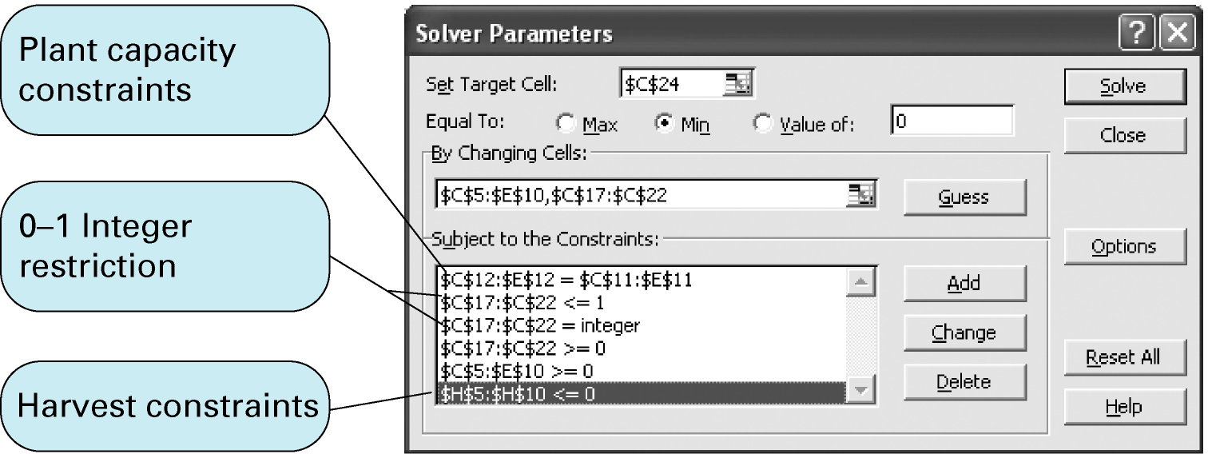
Example 1: Fixed Charge and Facility Example (3 of 3)
Exhibit 5.19

Slide 74
The Fixed Charge Location Problem
In the Fixed Charge Problem we have:
where:
C is a variable cost, and F is a fixed cost

Slide 75
Fixed Charge Problems:
Example 2: Hardgrave Machine Company –Location (1 of 9)
Produces computer components at its plants in Cincinnati and Pittsburgh.
  Plants are not able to keep up with demand for orders at warehouses in Detroit, Houston, New York, and Los Angeles.
  Firm is to build a new plant to expand its productive capacity.
  Sites being considered are Seattle, Washington and Birmingham.
Table presents -
  Production costs and capacities for existing plants and demand at each warehouse.
  Estimated production costs of new (proposed) plants.
Transportation costs from plants to warehouses are also summarized in the Table

Slide 76
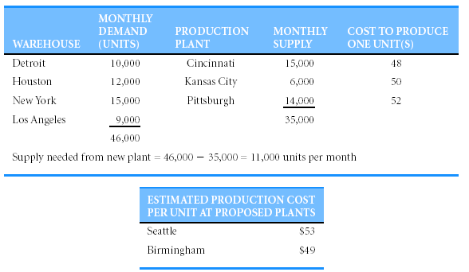
Fixed Charge Problems
Example 2: Hardgrave Machine Company (2 of 9)

Slide 77
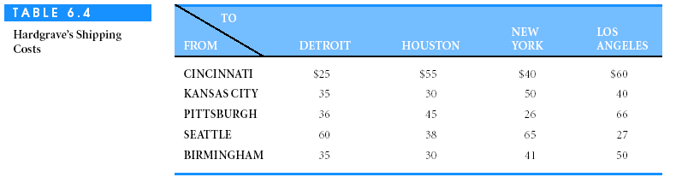
Fixed Charge Problems:
Example 2: Hardgrave Machine Company (3 of 9)

Slide 78
Fixed Charge Problems:
Example 2: Hardgrave Machine Company (4 of 9)
Monthly fixed costs are $400,000 in Seattle and $325,000 in Birmingham
Which new location will yield lowest cost in combination with existing plants and warehouses?
Unit cost of shipping from each plant to warehouse is found by adding shipping costs to production costs
Solution must consider monthly fixed costs of operating new facility.

Slide 79
Fixed Charge Problems
Example 2: Hardgrave Machine Company (5 of 9)
Use binary variables for each of the two locations.
Y_{S} = 1 if Seattle selected as new plant.
= 0 otherwise.
Y_{B} = 1 if Birmingham is selected as new plant.
= 0 otherwise.
Use binary variables for representative quantities.
X_{ij} = # of units shipped from plant i to warehouse j
where
i = C (Cincinnati), K (Kansas City), P ( Pittsburgh),
S ( Seattle), or B (Birmingham)
j = D (Detroit), H (Houston), N (New York), or
L (Los Angeles)

Slide 80
Fixed Charge Problems
Example 2: Hardgrave Machine Company (6 of 9)
Objective: minimize total costs =
$73X_{CD} + $103X_{CH} + $88X_{CN} + $108X_{CL} + $85X_{KD} + $80X_{KH} + $100X_{KN} + $90X_{KL} + $88X_{PD} + $97X_{PH} + $78X_{PN} + $118X_{PL} + $84X_{SD} + $79X_{SH} + $90X_{SN} + $99X_{SL} + $113X_{BD} + $91X_{BH} + $118X_{BN} + $80X_{BL} + $400,000Y_{S} + $325,000Y_{B}
Last two terms in above expression represent fixed costs.
Costs incurred only if plant is built at location that has variable Y_{i} = 1.

Slide 81
Fixed Charge Problems
Example 2: Hardgrave Machine Company (7 of 9)
Flow balance constraints at plants and warehouses:
Net flow = (Total flow in to node) - (Total flow out of node)
Flow balance constraints at existing plants (Cincinnati, Kansas City, and Pittsburgh) :
(0) - (X_{CD} + X_{CH} + X_{CN} + X_{CL}) = -15,000 (Cincinnati supply)
(0) - (X_{KD} + X_{KH} + X_{KN} + X_{KL}) = -6,000 (Kansas City supply)
(0) - (X_{PD} + X_{PH} + X_{PN} + X_{PL}) = -14,000 (Pittsburgh supply)
Flow balance constraint for new plant - account for the 0,1 (Binary) Y_{S} and Y_{B} variables:
(0) - (X_{SD} + X_{SH} + X_{SN} + X_{SL}) = -11,000Y_{S} (Seattle supply)
(0) - (X_{BD} + X_{BH} + X_{BN} + X_{BL}) = -11,000Y_{B} (Birmingham
supply)

Slide 82
Fixed Charge Problems
Example 2: Hardgrave Machine Company (8 of 9)
Flow balance constraints at existing warehouses (Detroit, Houston, New York, and Los Angeles):
X_{CD} + X_{KD} + X_{PD} + X_{SD} + X_{BD} = 10,000 (Detroit demand)
X_{CH} + X_{KH} + X_{PH} + X_{SH} + X_{BH} = 12,000 (Houston demand)
X_{CN} + X_{KN} + X_{PN} + X_{SN} + X_{BN} = 15,000 (New York demand)
X_{CL} + X_{KL} + X_{PL} + X_{SL} + X_{BL} = 9,000 (Los Angeles
demand)
Ensure exactly one of two sites is selected for new plant.
Mutually exclusive variable:
Y_{S} + Y_{B} = 1

Slide 83
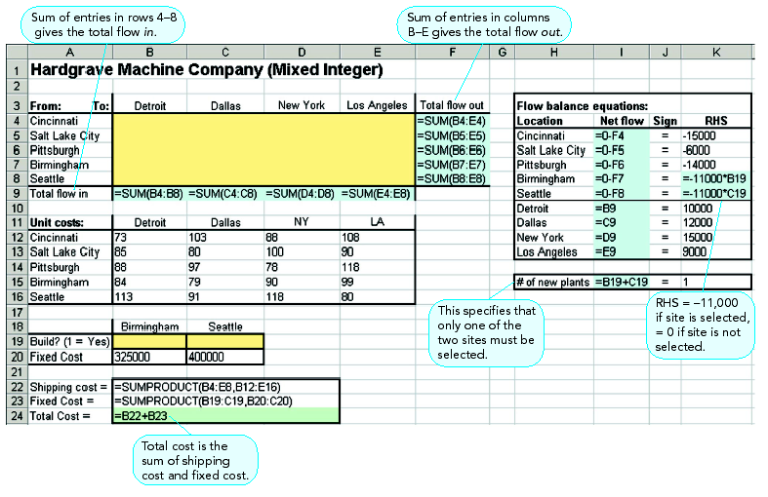
Excel Layout

Slide 84
Fixed Charge Problems
Example 2: Hardgrave Machine Company (9 of 9)
Cost of shipping was $3,704,000 if new plant built at Seattle.
Cost was $3,741,000 if new plant built at Birmingham.
Including fixed costs, total costs would be:
Seattle: $3,704,000 + $400,000 = $4,104,000
Birmingham: $3,741,000 + $325,000 = $4,066,000
Select Birmingham as site for new plant.

Slide 85
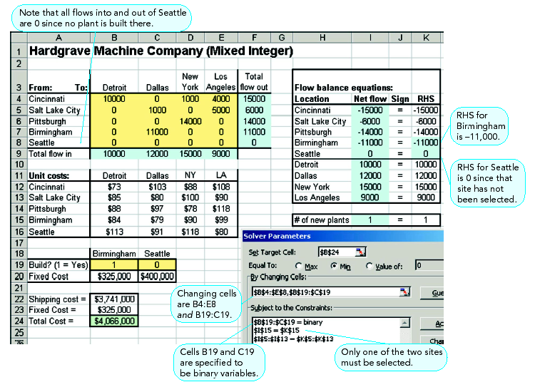
Excel Layout

Slide 86
Globe Electronics, Inc.
Two Different Problems,
Two Different Models

Slide 87
Fixed Charge Problems
Example 3.Globe Electronics, Inc. Data (1 of 5)
Globe Electronics, Inc. manufactures two styles of remote control cable boxes, G50 and G90.
Globe runs four production facilities and three distribution centers.
Each plant operates under unique conditions, thus has a different fixed operating cost, production costs, production rate, and production time available.

Slide 88
Fixed Charge Problems
Example 3.Globe Electronics, Inc. Data (2 of 5)
Demand has decreased, therefore, management
is contemplating either:
working undercapacity at one or some of its plants or,
closing one or more of its facilities.
So Management wishes to:
  Develop an optimal distribution policy.
  Determine which plant(s) to be 1) operated under capacity or closed (if any).

Slide 89
Fixed Charge Problems
Example 3.Globe Electronics, Inc. Data (3 of 5)
Data
Production costs, Times, Availability
Monthly Demand Projection

Slide 90
Fixed Charge Problems
Example 3.Globe Electronics, Inc. Data (4 of 5)
  Transportation Costs per 100 units
  At least 70% of the demand in each distribution center must be satisfied.
  Unit selling price
    G50 = $22; G90 = $28.
Cincinnati
Kansas
San
City
Francisco
Philadelphia
$200
300
500
St.Louis
100
100
400
New Orleans
200
200
300
Denver
300
100
100

Slide 91
Fixed Charge Problems
Example 3.Globe Electronics, Inc. Dec. Vrbs.(5 of 5)
Decision Variables
  X_{i} = hundreds of G50s produced at plant i
  Z_{i} = hundreds of G90s produced at plant i
  X_{ij} = hundreds of G50s shipped from plant i to distribution center j
  Z_{ij} = hundreds of G90s shipped from plant i to distribution center j
Location Identification

Slide 92
Globe Electronics
Model No. 1:
All The Plants Remain Operational

Slide 93
Objective function
  Management wants to maximize net profit.
  Gross profit per 100 = 22(100) [minus] (production cost per 100)
  Net profit per 100 units produced at plant i and shipped to center j = [Gross profit] -[Transportation cost from to j per 100]
  Max 1200X1+1000X2+1400X3+ 900X4
  +1400Z1+1600Z2+1800Z3+1300Z4
  - 200X11 - 300X12 - 500X13
  - 100X21 - 100X22 - 400X23
  - 200X31 - 200X32 - 300X33
  - 300X41 - 100X42 - 100X43
  - 200Z11 - 300Z12 - 500Z13
  - 100Z21 - 100Z22 - 400Z23
  - 200Z31 - 200Z32 - 300Z33
  - 300Z41 - 100Z42 - 100Z43
Gross profit
G50
Transportation cost
G90

Slide 94
Constraints:
Ensure that the amount shipped from a plant equals the amount produced in a plant
For G50
X11 + X12 + X13 = X1
X21 + X22 + X23 = X2
X31 + X32 + X33 = X3
X41 + X42 + X43 = X4
For G90
Z11 + Z12 + Z13 = Z1
Z21 + Z22 + Z23 = Z2
Z31 + Z32 + Z33 = Z3
Z41 + Z42 + Z43 = Z4
Production time used at each plant cannot exceed the time available:
6X1 + 6Z1 640
7X2 + 8Z2 960
9X3 + 7Z3 480
5X4 + 9Z4 640
All the variables are non negative
Amount received by a distribution center cannot exceed its
demand or be less than 70% of its demand
For G50
X11 + X21 + X31 + X41 < 20
X11 + X21 + X31 + X41 > 14
X12 + X22 + X32 + X42 < 30
X12 + X22 + X32 + X42 > 21
X13 + X23 + X33 + X43 < 50
X13 + X23 + X33 + X43 > 35
For G90
Z11 + Z21 +Z31 + Z41 < 50
Z11 + Z21 + Z31 + Z41 > 35
Z12 + Z22 + Z32 + Z42 < 60
Z12 + Z22 + Z32 + Z42 > 42
Z13 + Z23 + Z33 + Z43 < 70
Z13 + Z23 + Z33 + Z43 > 49

Slide 95
A portion of the WINQSB optimal solution

Slide 96
Solution summary:
The optimal value of the objective function is $356,571.
Note that the fixed cost of operating the plants was not included in the objective function because all the plants remain operational.
Subtracting the fixed cost of $125,000 results in a net monthly profit of $231,571

Slide 97
Globe Electronics Model No. 2:
The number of plants that remain operational is a decision variable

Slide 98
Decision Variables
  X_{i} = hundreds of G50 s produced at plant i
  Z_{i} = hundreds of G90 s produced at plant i
  X_{ij} = hundreds of G50 s shipped from plant i to distribution center j
  Z_{ij} = hundreds of G90 s shipped from plant i to distribution center j
  Y_{i} = A 0-1 variable that describes the number of operational plants in city i.

Slide 99
Objective function
  Management wants to maximize net profit.
  Gross profit per 100 = 22(100) - (production cost per 100)
  Net profit per 100 produced at plant i and shipped to center j =
Gross profit - Costs of transportation from i to j - Conditional fixed costs

Slide 100
Objective function
  Max 1200X1+1000X2+1400X3+ 900X4
  +1400Z1+1600Z2+1800Z3+1300Z4
  - 200X11 - 300X12 - 500X13
  - 100X21 - 100X22 - 400X23
  - 200X31 - 200X32 - 300X33
  - 300X41 - 100X42 - 100X43
  - 200Z11 - 300Z12 - 500Z13
  - 100Z21 - 100Z22 - 400Z23
  - 200Z31 - 200Z32 - 300Z33
  - 300Z41 - 100Z42 - 100Z43
  - 40000Y1 - 35000Y2 - 20000Y3 - 30000Y4

Slide 101
Constraints:
Ensure that the amount shipped from a plant equals the amount produced in a plant
For G50
X11 + X12 + X13 = X1
X21 + X22 + X23 = X2
X31 + X32 + X33 = X3
X41 + X42 + X43 = X4
For G90
Z11 + Z12 + Z13 = Z1
Z21 + Z22 + Z23 = Z2
Z31 + Z32 + Z33 = Z3
Z41 + Z42 + Z43 = Z4
Amount received by a distribution center cannot exceed its
demand or be less than 70% of its demand
Production time used at each plant cannot exceed the time available:
6X1 + 6Z1 - 640Y1 0
7X2 + 8Z2 - 960Y2 0
9X3 + 7Z3 - 480Y3 0
5X4 + 9Z4 - 640Y4 0
All X_{ij}, X_{i,} Z_{ij}, Z_{i} > 0, and Y_{i} are 0,1.
For G50
X11 + X21 + X31 + X41 < 20
X11 + X21 + X31 + X41 > 14
X12 + X22 + X32 + X42 < 30
X12 + X22 + X32 + X42 > 21
X13 + X23 + X33 + X43 < 50
X13 + X23 + X33 + X43 > 35
For G90
Z11 + Z21 +Z31 + Z41 < 50
Z11 + Z21 + Z31 + Z41 > 35
Z12 + Z22 + Z32 + Z42 < 60
Z12 + Z22 + Z32 + Z42 > 42
Z13 + Z23 + Z33 + Z43 < 70
Z13 + Z23 + Z33 + Z43 > 49

Slide 102
A portion of the WINQSB optimal solution

Slide 103
Solution Summary:
The Philadelphia plant should be closed.
Schedule monthly production according
to the quantities shown in the output.
The net monthly profit will be $266,115, which is $34,544 per month greater than the optimal monthly profit obtained when all four plants are operational.

