Slide 1
Lab 8 – Low Functionality Prototype
Group 9

Slide 2
Face recognition

Slide 3
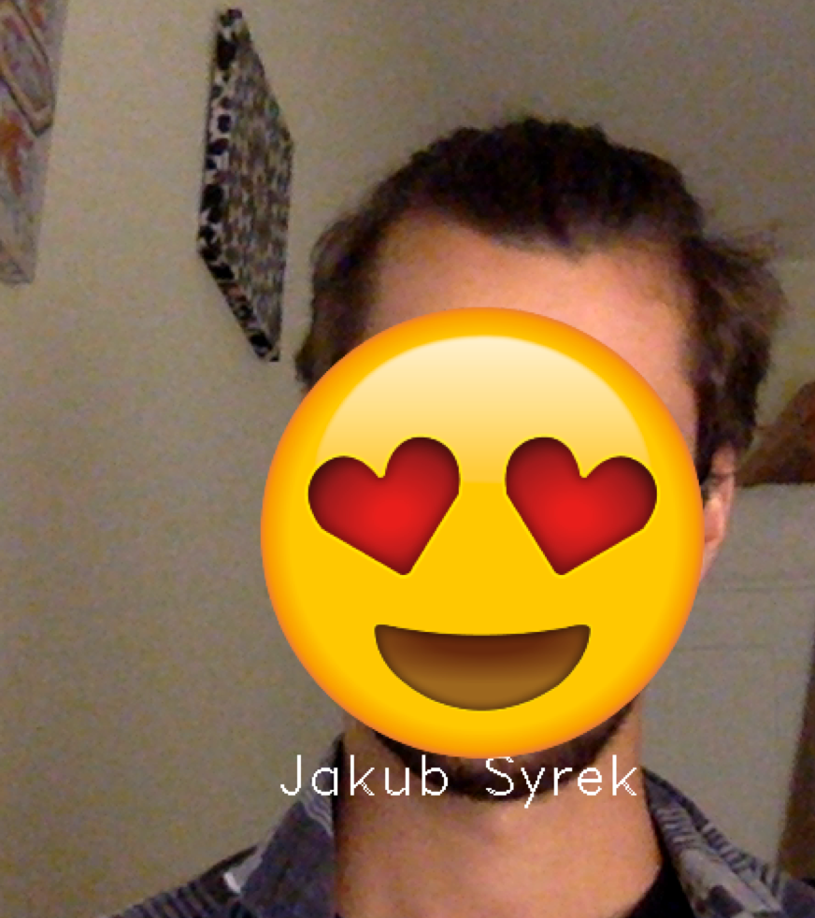
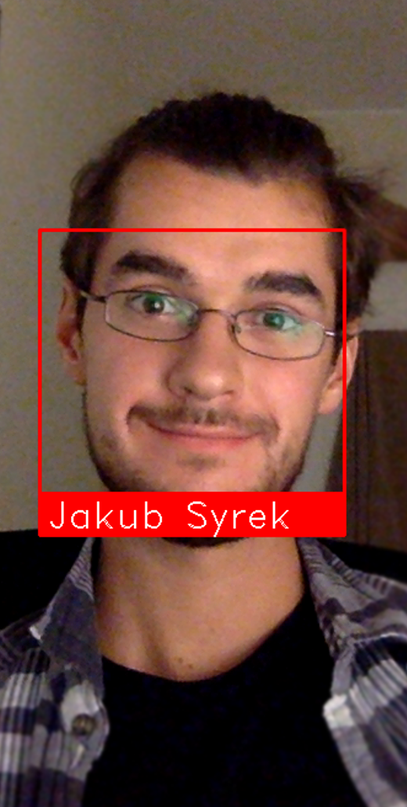
Initial face recognition
Face recognition with filtering

Slide 4
Mobile app

Slide 5
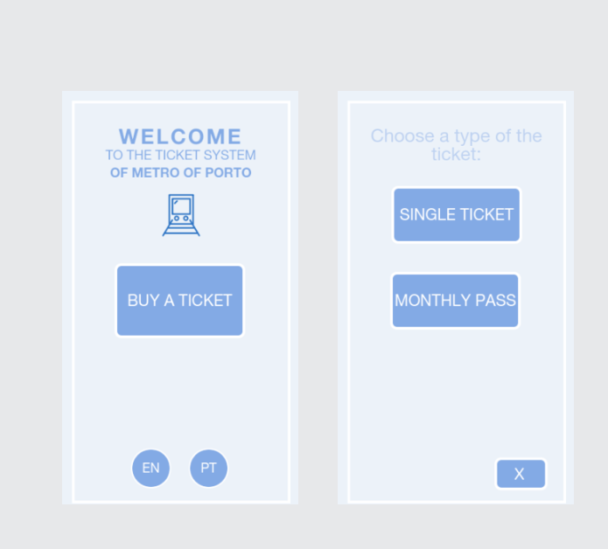

Slide 6
Organization

Slide 7
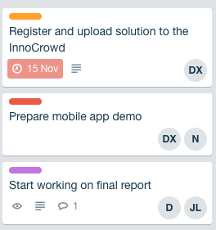
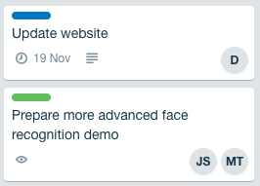
JS - Jakub Syrek - Manager
N - Natalia Kostrzewa - Designer
MT - Michał Tomaszewski - Back-end developer
DX - Diogo Caria Ferreira - Review
JL - João Legas - UX
D - Diogo Landeiro - Front-end developer

Slide 8
Questions?

