Slide 1
Lab 8 – Formative User Study
Group 9

Slide 2
Think Aloud with Wizard of Oz
Used methods
Notes:
describe (and justify) what methods were used:

Slide 3
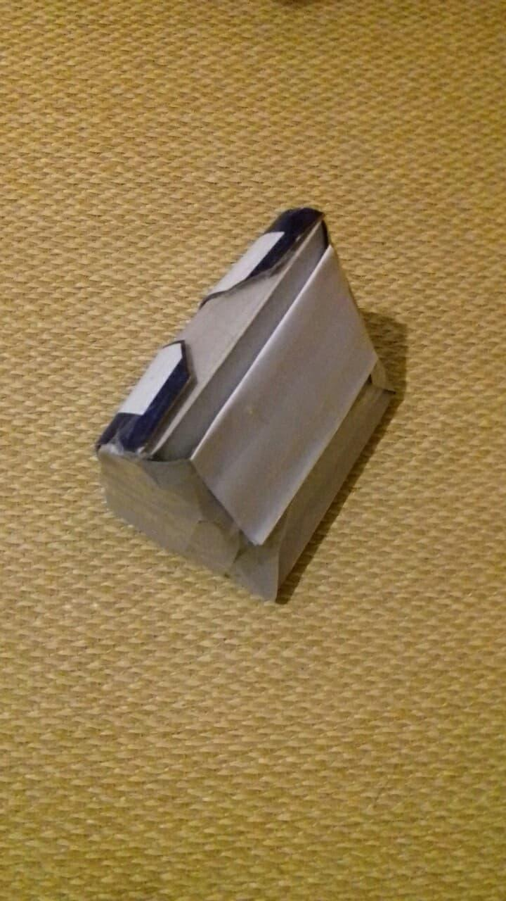
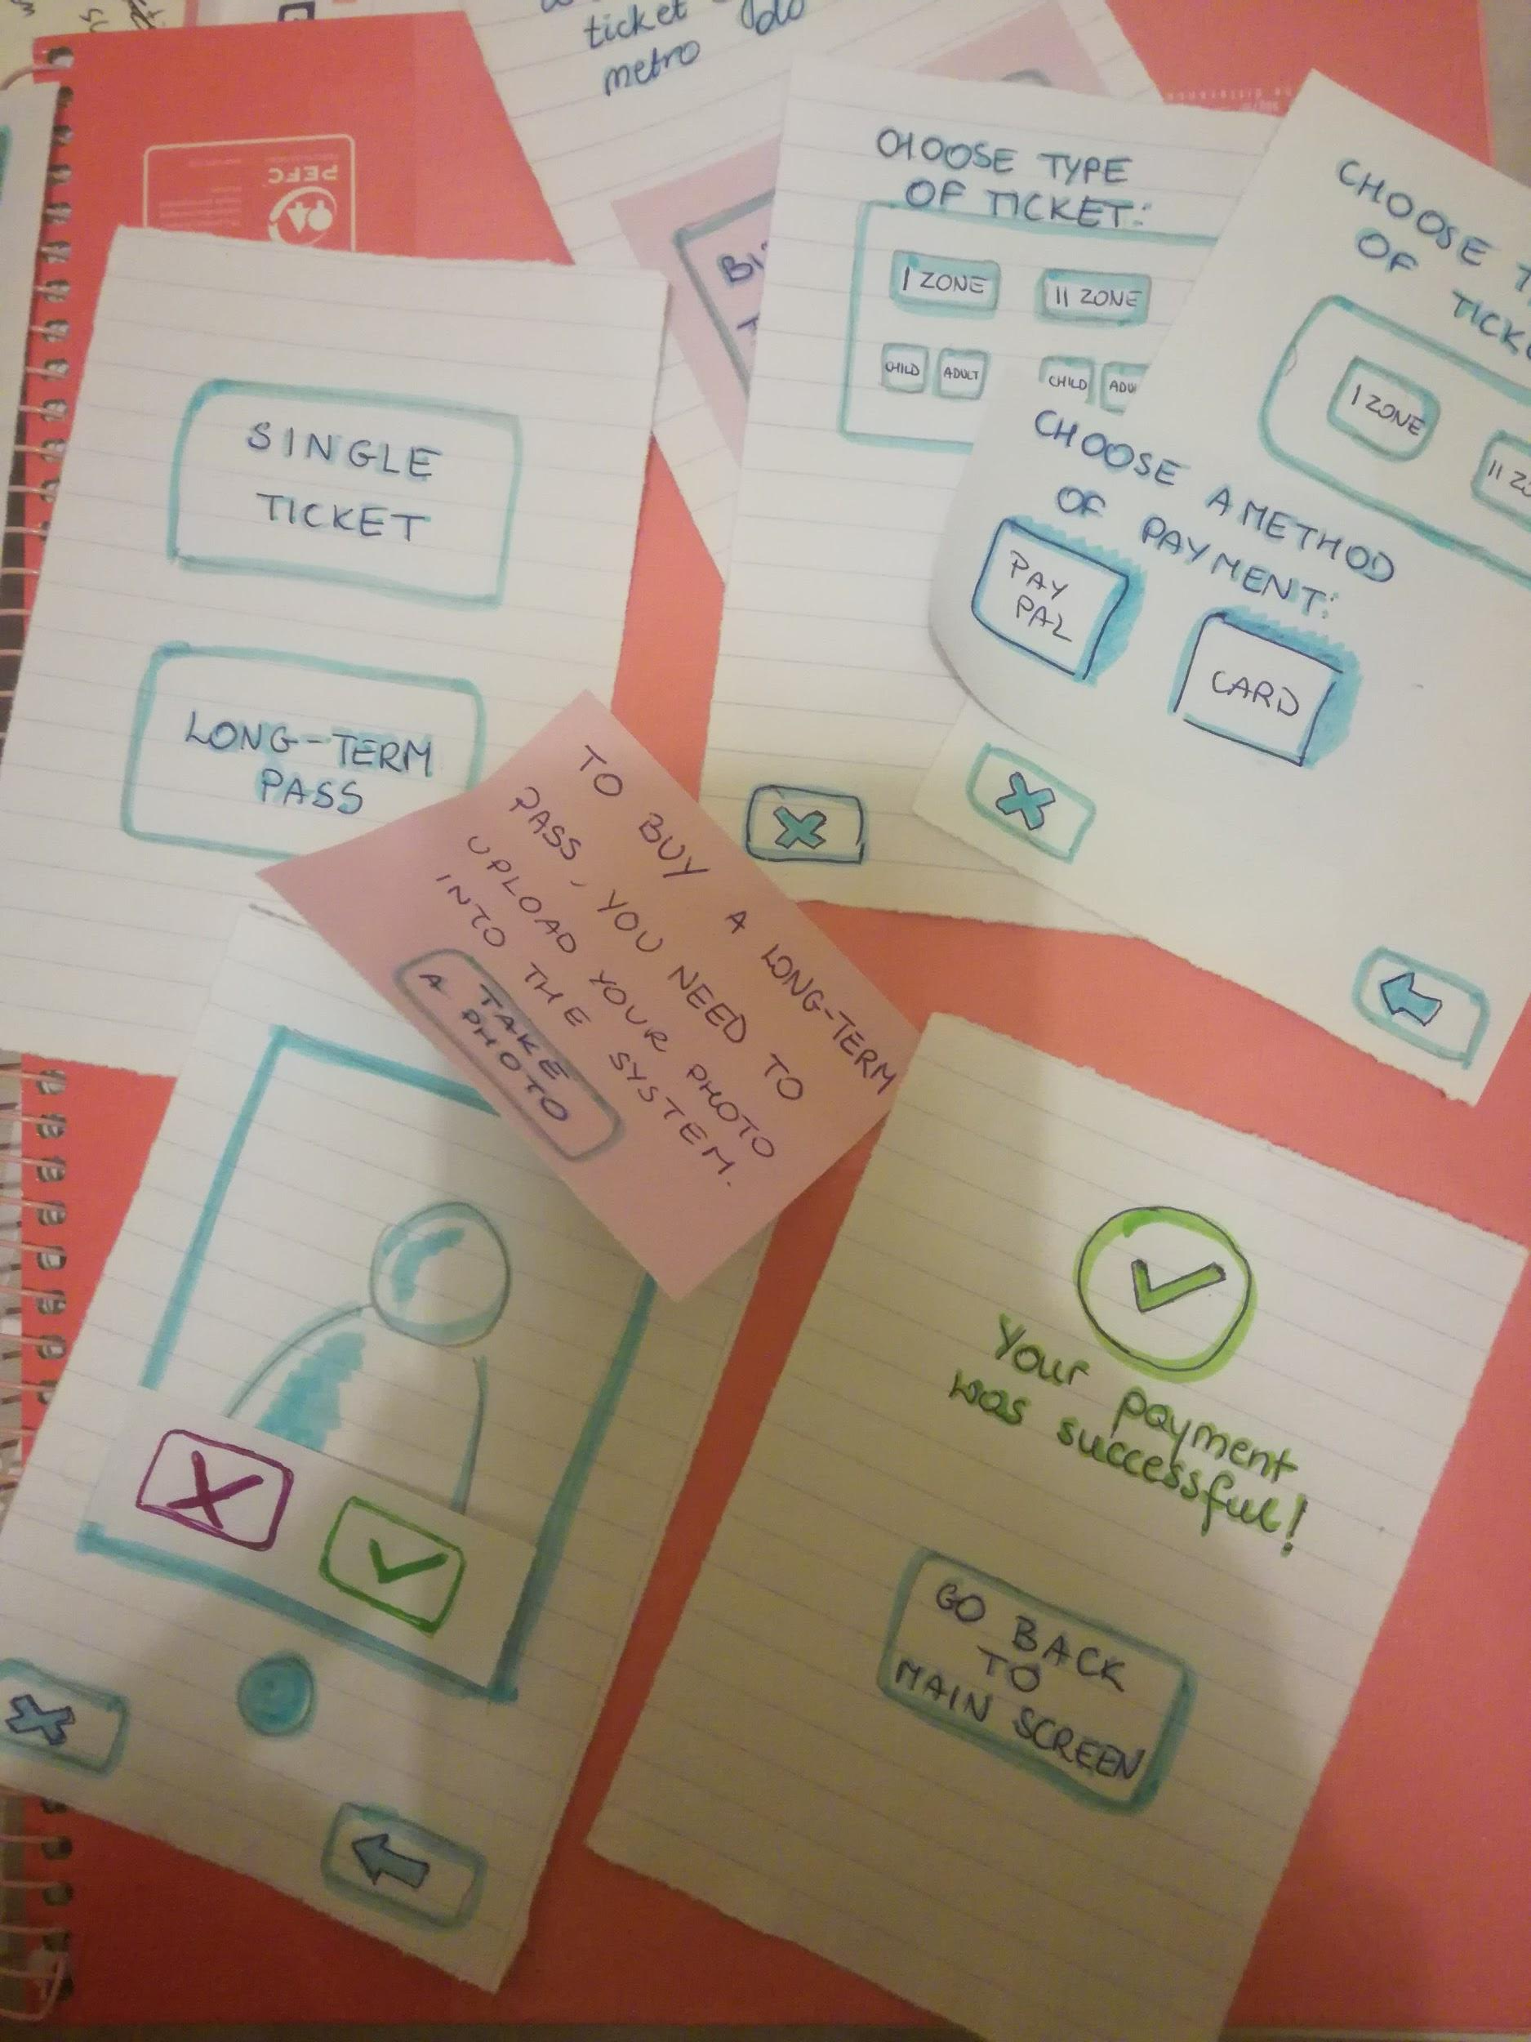
Our prototype
Validator
Paper prototype of mobile app
  select a ticket
  upload your face
  pay
  use for validation
Paper prototype of simple validator
2 x computer with camera
Paper prototype

Slide 4
Tasks

Slide 5


Explaining the basics of the system
  no barriers
  displays to display status of validation
  validator
  mobile app
Describing the tasks to perform
Performing tasks
Evaluating results and gathering outcome
2 states:
😡
ticket has not been validated
😍
user with validated ticket
Notes:
We use face detection system together with camera tracking to:
detect people that have not validated their tickets
Automatically validate users with monthly pass using face detection system.
General:
Observe the environment and comment aloud about
what you can see and
what do you feel.
Questions after the test
How our system will influence the metro system?
Is the system easy to understand?
Will the system motivate people to buy the tickets? (Mention that the status will be visible to everyone at the station)

Slide 6
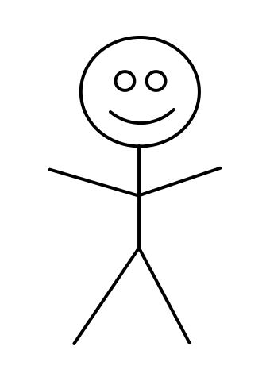
Validator
Face recon 2
Face recon 1

Slide 7
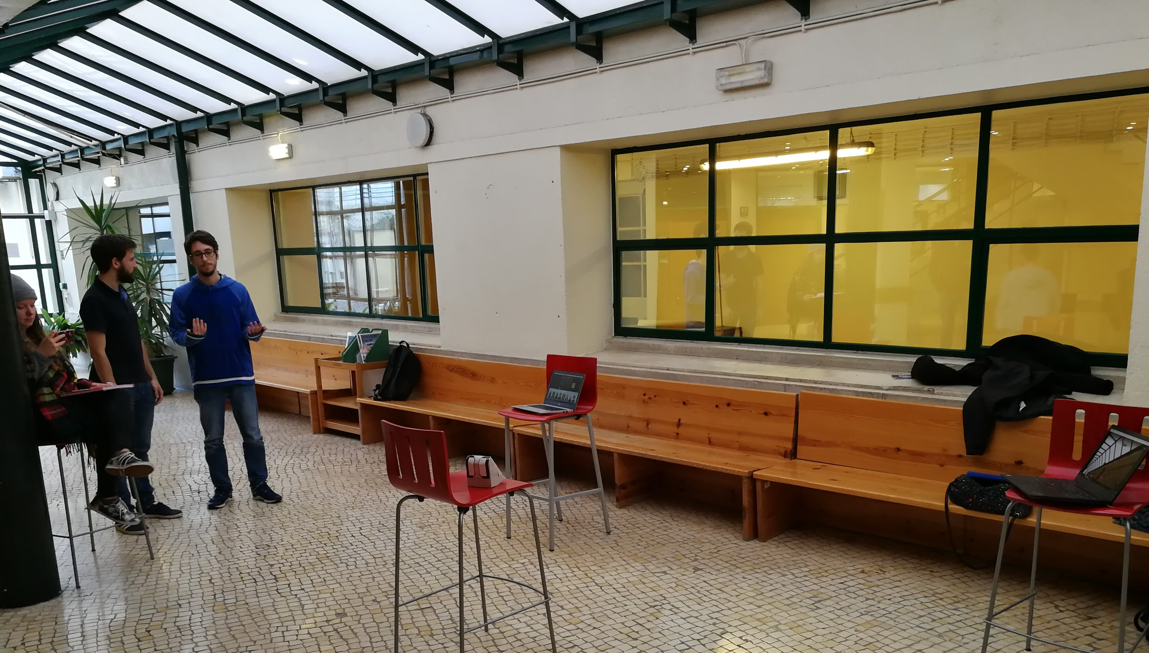
Facilitator
Display with status 1
User
Display with status 2
Validator
Human - computer

Slide 8
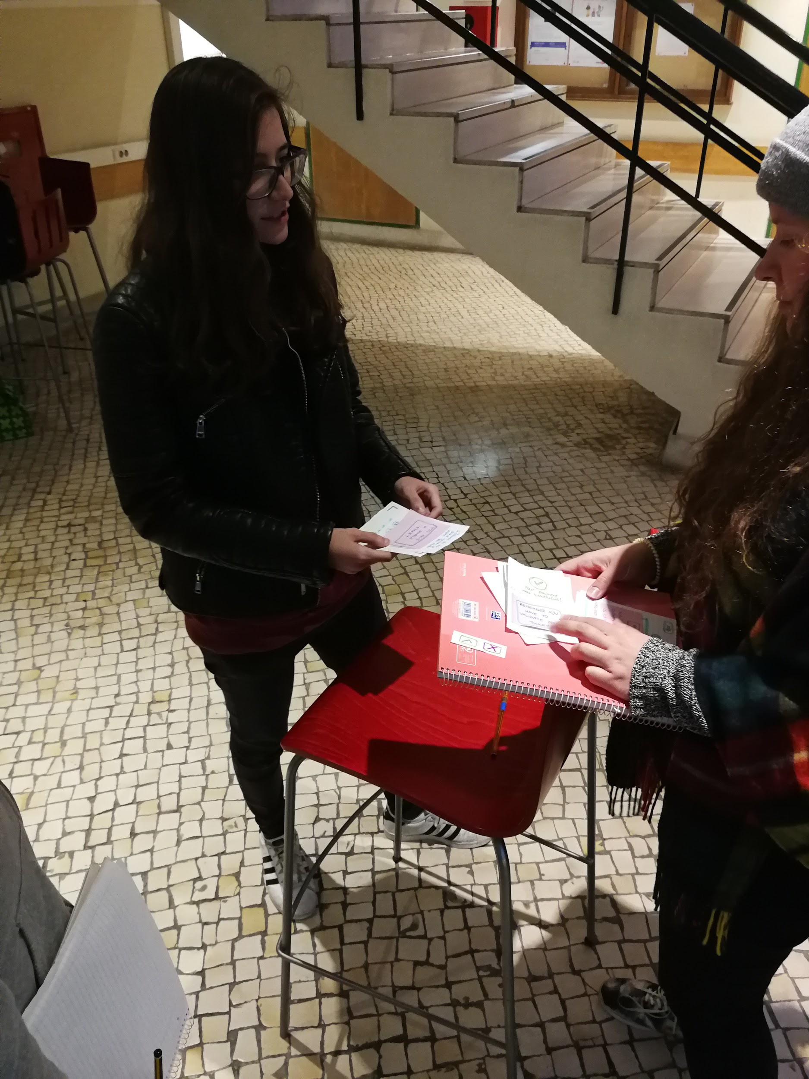
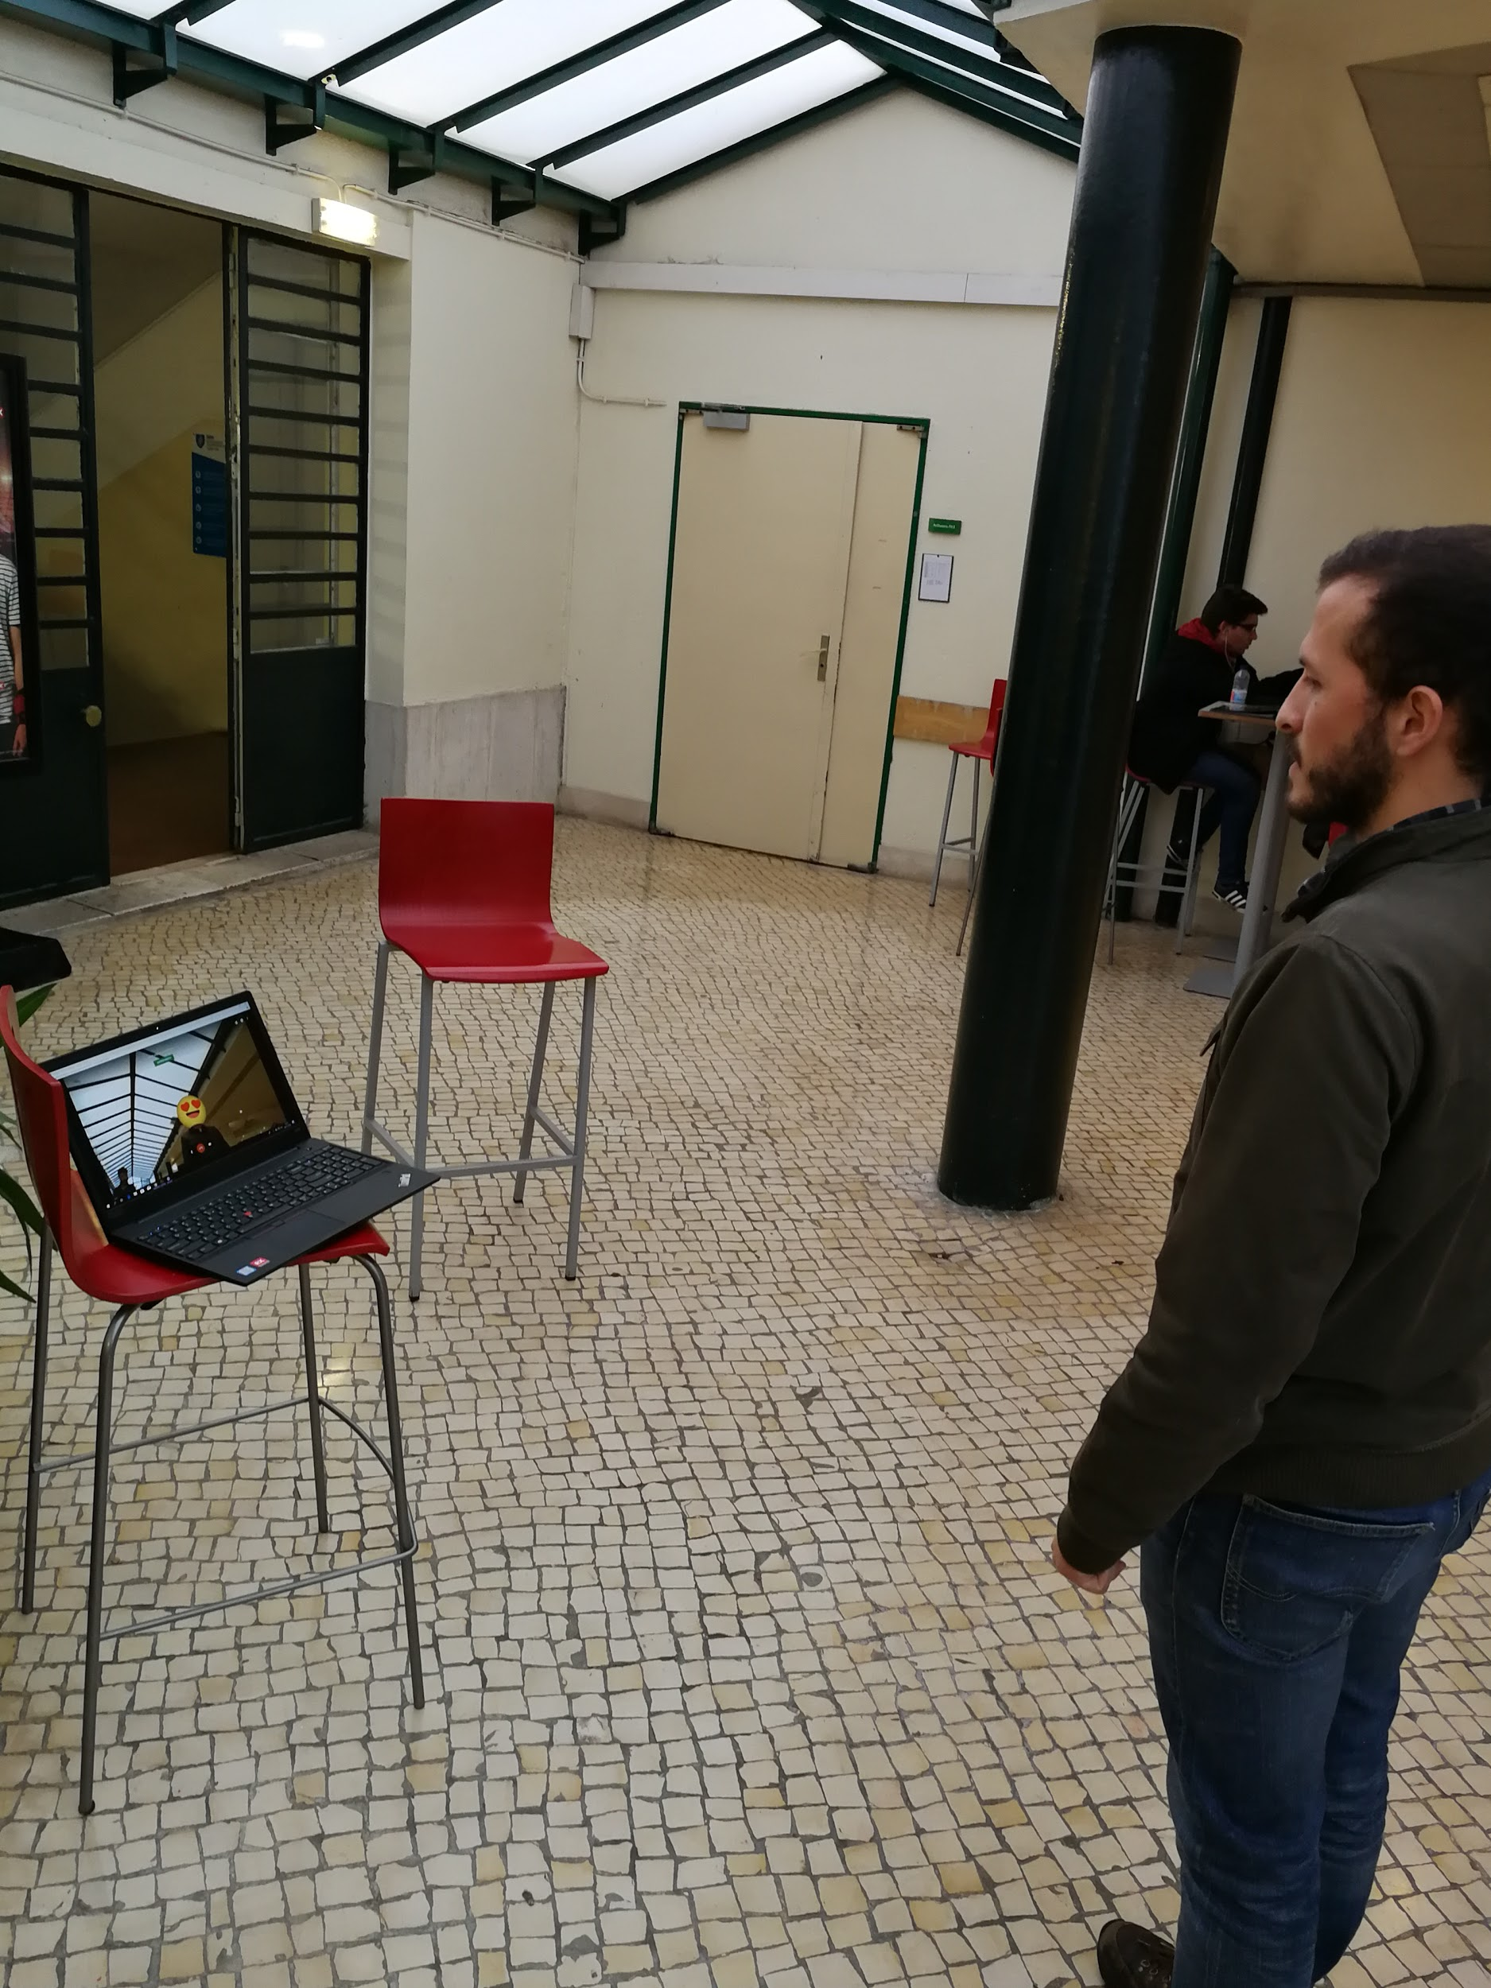
Paper prototyping
User performing task

Slide 9
Tasks
Go through the station into the train:
You need to buy a single ticket
You need to buy monthly ticket
You don't have any ticket
Go slowly, observe environment and comment aloud

Slide 10
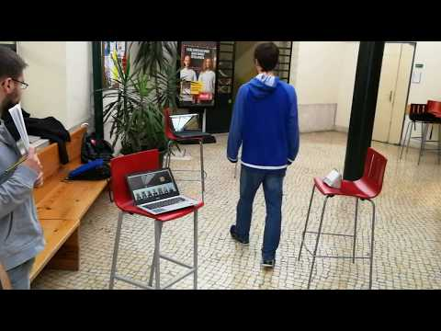

Slide 11
Results and Design Implications

Slide 12
5 users
4 male + 1 female
random students
2 with the detailed explanation
  get feedback about system, not idea itself
3 were performing tasks without detailed explanation
  simulating first time users

Slide 13
Positive outcome
the system is helpful in identifying that user forgot to validate a ticket
easy to understand based on other users actions
after short explanation - no problems in understanding and performing tasks
It's funny (referring to the faces being different)
Notes:
the system is helpful in identifying if she forgot her ticket
when user sees the other people using the system it is easy to understand how it works
after short explanation - no problems in understanding and performing tasks
It's funny (referring to the faces being different)

Slide 14
Problems and design indications
Displays were easily ignored
use big screens mounted on ceiling
The meaning of emojis is not that clear
Emojis selection need to be improved
Lack of understanding of the system in the early stages
provide short instruction or legend

Slide 15
Problems and design indications
If someone goes behind another person the camera won’t identify them
User can hide the face
we can claim that our cameras can still detect the person
Validates virtual ticket/Feel the single ticket is valid after buying online
better response in the purchase of the single ticket

Slide 16
On the instruction:
What were their main challenges?
What did they like the most?
What was the easiest task to perform?
Does your design match users?
mental model?
What tasks need to be redesigned?
Anything to add?

Slide 17
How it will influence the system?

Slide 18
Automatic validation of monthly tickets holders
don't need to validate
easier to use
Shame factor
publicly show people that haven't validated their tickets
people will be more motivated to buy and validate tickets
Real-time fast response
displaying real time video with the filter
add some fun to the boring everyday situation
Easy to understand
need only short explanation to make people understand it

Slide 19
Organization

Slide 20
JS - Jakub Syrek - Manager
N - Natalia Kostrzewa - Designer
MT - Michał Tomaszewski - Back-end developer
DX - Diogo Caria Ferreira - Review
JL - João Legas - UX
D - Diogo Landeiro - Front-end developer

Slide 21
Questions?

