Slide 1
Lab 7 – Low Fidelity Prototypes
Group 9

Slide 2
Critical Tasks

Slide 3
Critical Tasks
upload the face to the system
buy ticket in the mobile app
getting visual feedback on display
validating the metro card for users without face updated

Slide 4
Prototype

Slide 5
Scenarios
Ticket + upload face to the system
we use face recognition to detect and validate the user
Both single and period tickets are covered
Single "physical" ticket + NO face uploaded to the system
the user enters tracked area
is detected as not validated
validates ticket at the machine - status changes to validated
user's face is displayed as green

Slide 6
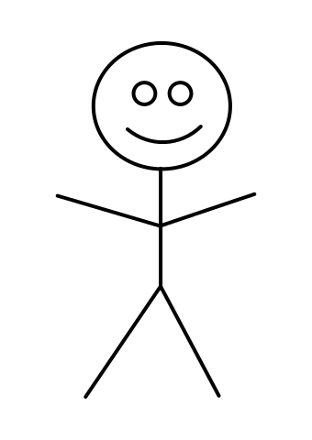
Validator
Face recon 2
Face recon 1

Slide 7
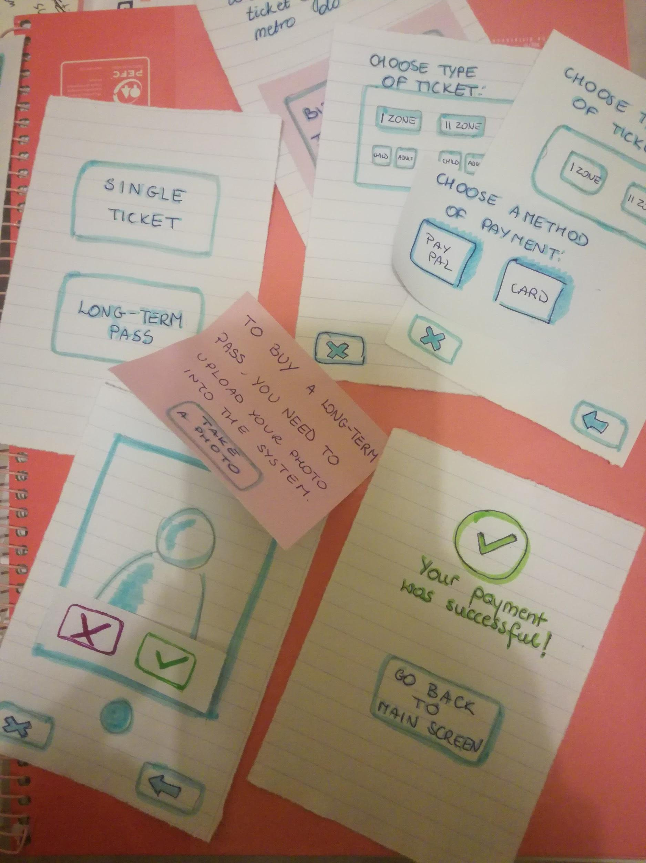
Attributes
Validator
Paper prototype of mobile app
select a ticket
upload your face
pay
Paper prototype of simple validator
computer with camera
Paper tickets
Paper prototype

Slide 8
Roles
1 x person operating computers and cameras
1 x human/computer - paper prototype
3 x observer
1 x facilitator

Slide 9
Organization

Slide 10
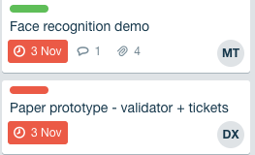
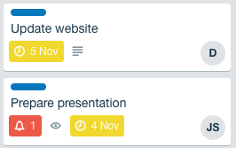
JS - Jakub Syrek - Manager
N - Natalia Kostrzewa - Designer
MT - Michał Tomaszewski - Back-end developer
DX - Diogo Caria Ferreira - Review
JL - João Legas - UX
D - Diogo Landeiro - Front-end developer

Slide 11
Questions?

