Slide 1
Lab 5 – Personas and Scenarios
Group 9

Slide 2
Personas

Slide 3
Attitude
Metro tickets are too expensive. He sometimes takes the risk and drives without a ticket when his monthly ticket is finished and he wants to save some money. The only thing that motivates him to pay is a fear of being caught and the fine he would have to pay. Sometimes he also forget his monthly pass at home. He chooses metro because it is the fastest way to get from one place to another.
Motivations
His main motivations is to travel cheap and preferably fast.
Frustrations
He has to take out a card and validate it every single time while walking to the metro, and he must be play closer attention to not forget it at home.
Pedro
Student
Age | 22
Profession | Journalism student at the University of Porto
Frequency of travels | Every day
Ticket type | Monthly pass
Goals
Save money
Attend classes
Go to parties
Finding the fastest way to his destination
Description
Pedro is a master journalism student living in porto since the start of his studies. He moved to the city from his home village in the suburbs of Peniche. He has to pay a high rent for his room and most of time he deals with the lack of money. To travel in the city he mostly uses metro.

Slide 4
Attitude
He would like to see as many touristic places as possible during his short stay (one week). He prefers direct connections, he doesn't like changing lines. He prefers not to use local currency, if possible. He want to use his card or phone for payments everywhere. He doesn't plan to visit Portugal soon again. He is not afraid of fines. He likes comfortable means of transport.
Motivations
The most important for him is to see the city and visit some of the most known places.
Frustrations
He doesn't like queues to ticket machines and crowds of people in the stations.
Bob
Tourist
Age | 35
Profession | Tourist from Texas, USA
Frequency of travels | Few days
Ticket type | Daily ticket
Goals
find the easiest way
travel directly to a place
pay for ticket by card or online
avoid queues
Description
Bob is a tourist from USA that is making his euro trip around the Europe. He has never been in Europe before and the Porto is the first city that he is visiting. At home he never uses public transport, always driving by his car.

Slide 5
Attitude
Antonio always buys the ticket.
The ticket prices are not important, he just wants to travel “secure” that in case of finding a controler, he has a ticket and will not be involved in a shame situation of not having one.
Motivations
He needs to find alternative way of transportation when his car is broken or when he can't reach his destination in any other way.
Frustrations
Antonio uses the metro very rarely so, when he needs to change the lines, he always gets lost. Antonio gets frustrated when the machine that he is using to buy the ticket in does not work correctly.
Antonio
Unusual user
Age | 44
Profession | Project Manager at IT company
Frequency of travels | Very rarely
Ticket type | Single ticket
Goals
Easy way to buy a ticket
Clean station and metro
No crowd
Not too much noise
Security
Description
Antonio is a IT project manager in a big company. He has a high education degree (phD in Computer Science and a MBA in Management). He has a high paid job. He is married and has three daughters.

Slide 6
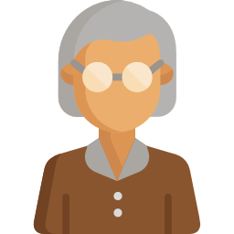
Attitude
Joana is a simple older woman. She wants to buy the ticket, but wants the process to be like it is forever, no mobile apps, no cards, just the simple exchange with cash.
She doesn’t mind taking longer routes if it means more comfort, less changes in lines and less walking.
Motivations
Joana only uses the metro for meeting her friends or to go to doctors appointments, so she wants things to be simple and easy, including having comfortable travels.
Frustrations
She doesn’t want change, she has done her routine for as long as she can remember.
Joana
Old lady
Age | 72
Profession | Retired nurse
Frequency of travels | Once-twice a week
Ticket type | One way ticket
Goals
find the easiest path
no need to change line or transport
comfort during the travel (find a place to sit)
Description
Joana is a retired nurse, she is a widow with 2 sons that visit her often. She has lived at her home for 30+ years so she knows everyone in her street, including the sales people from the metro she lives close to.

Slide 7
Scenarios

Slide 8
Pedro

Slide 9
User scenario
Who: Pedro
When: 10 AM Tuesday, one day after card's due date
Where: Metro station, 5 stations from University

Slide 10
User scenario
Pedro had to arrive at his university at 10:30 AM.
He was in a rush and suddenly he noticed that his transport card was expired.
At that moment he had no money for 30 days card.
He decided to use the metro without any ticket, even the single one, which in his opinion was too expensive.

Slide 11
User scenario sequence
Pedro went down to the metro station.
Pedro was looking around if there were no security guys. He looked a little bit stressed.
Pedro went further without validating.
Nobody came to Pedro - no security, no other users of the metro.
Pedro used the metro without paying for a ticket and nobody noticed that.
Pedro didn't feel any shame and in the future he will probably do the same thing.

Slide 12
Scenario sequence with our system
Pedro went down to the metro station.
Pedro was looking around if there were no security guys.
Pedro went further without validating.
Cameras validating system show his face with red colour at the big display. He ignored that.
Other users of the metro looked at Pedro as for the "one who is not paying".
The security guy got a notification that something was wrong with Pedro and came to him. He gave him a fine.
Finally, Pedro used the metro after buying a single ticket, but he was late for his classes.
Pedro felt bad about that situation as well as his pocket and in the future he won't probably do the same thing.

Slide 13
Bob

Slide 14
User scenario
Who: Bob
When: 11 AM Saturday
Where: Metro station in the middle of the city

Slide 15
User scenario
Bob had finished visiting a monument around 11:30 AM.
He still wants to visit something else before lunch time, so he was in a bit of a rush.
He arrived at the metro station and looked around for the validation machine, but suddenly he heard the metro arriving.
In order to not miss an opportunity to visit something else, he went inside without validating.

Slide 16
User scenario sequence
Bob went to the metro. He had already bought the ticket for the day.
He was looking for the validation machine, but he heard the metro coming.
He ran to the metro, without validation, so he could visit more places
Since there was no officer nearby, and he went straight into the metro, nothing could be done.
Bob was in a hurry, so he didn't thought much about it, and if the same situation happened again, he would probably do the same.

Slide 17
Scenario sequence with our system
Bob went to the metro. He had already bought the ticket for the day.
Since he already bought the ticket for the day, our cameras in the screen showed his face in a green light.
When he heard the metro coming, he ran to the metro, the validation was done automatically, so he was able to get in without any issues.
Bob was in a hurry, but he fact that he didn't to worry about he validation made the whole process easier for him

Slide 18
Antonio

Slide 19
User scenario
Who: Antonio
When: 8 AM Monday
Where: Metro Station
Why: His car is broken and has to find an alternative way of transportation.

Slide 20
User scenario
Antonio arrived in the metro station at 8.00AM.
He tried to buy a ticket in the automatic machine, but the machine was blocked, not responding to the Antonio commands.
After that, Antonio started getting hungry.
Antonio moved himself for another machine, but the other machine had a very big queue.

Slide 21
User scenario sequence
Antonio arrived at the metro station at 8.00AM.
Antonio looked for the automatic machines and had chosen one.
Antonio tried to buy the ticket but the machine was not responding promptly to their commands.
Antonio moved himself to another machine to buy the ticket.
Antonio was very upset because he spent a lot of time to buy the ticket. For the next time that he goes to the work without her own car, he going to look for another way for transportation than the metro.

Slide 22
Scenario sequence with our system
Antonio arrived at the metro station at 8.00AM
After entrain in the station, he picked up his phone and bought the ticket.
The cameras installed in the station had validate the ticket that Antonio bought through the app.
Antonio felt satisfied because he saved lot of time that could eventually spend in buying the ticket with conventional systems.
When Antonio’s car is not in good conditions, Antonio will always consider the metro as an alternative transportation, because it is easy to buy tickets and allows him to save time.

Slide 23
Joana

Slide 24
User scenario
Who: Joana
When: 11 AM Friday, for a cup of coffee
Where: Baixa, Porto

Slide 25
User scenario
Joana meets her friend every Friday at 11 AM, 4 stops away from hers.
She usually buys her ticket on Thursdays at the local shop, but that Thursday she forgot.
She arrived at the station at 10:30 AM.

Slide 26
User scenario sequence
Joana arrived at the station at 10:30 AM.
Joana proceeds to the platform to validade her card at the same time the metro is arriving.
She notices that she has no valid ticket.
She decides to enter the metro anyway since the trip is short and she doesn’t want to walk back to the machine just to buy a ticket.
Nothing bad happened to her, but she felt bad she didn’t pay the ticket.

Slide 27
Scenario sequence with our system
Joana arrived at the station at 10:30 AM.
She passes through our system and sees her face in red on the screen.
She remembers she didn’t buy the ticket on the day before.
Since she is still close to the machines, she decides to go back and buy a ticket.
She goes to the metro platform and validates her ticket before entering the metro.
She payed for her ticket this time, making it so that she doesn’t feel bad.

Slide 28
Prioritization

Slide 29
Prioritization
Upload the user's face to the database - 19 November
Face recognition - 19 November
Filtered faces on the displays - 26 November
Tracking system - 26 November
Card optimization for the system - 3 December

Slide 30
Organization

Slide 31
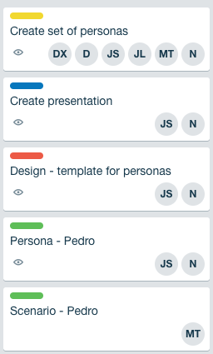
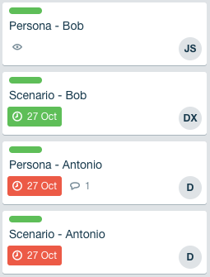
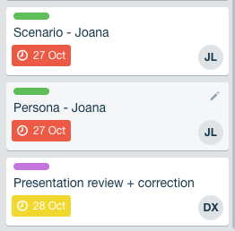
JS - Jakub Syrek - Manager
N - Natalia Kostrzewa - Designer
MT - Michał Tomaszewski - Back-end developer
DX - Diogo Caria Ferreira - Review
JL - João Legas - UX
D - Diogo Landeiro - Front-end developer

Slide 32
Questions?

Slide 33
Sources:
https://www.flaticon.com/
https://icons8.com/

