Slide 1
Lab 4 – User Research Results
Group 9

Slide 2
On field interviews

Slide 3
Structured and closed
General Questions:
How often do you use metro? (twice a day, more?)
What type of ticket do you have? (monthly, zapping, one way)
What is your average travel time?
How long are you a user of the metro?
Have you ever crossed barriers without ticket? How you did it?

Slide 4
Semi-structured and open interview
Open questions:
What do you find inconvenient while travelling by metro?
What do you think about process of buying the ticket?
Why people decided to drive without ticket?
What is the main reason for you to pay for the ticket?
One ‘metro-dream’ (just think what would you like to implement in metro system).

Slide 5
Women, about 40 y.o
2-3 times a week
Zapping
Avg. travel time 25 min
Never used metro without paying
A long time user (2.5 years)
Biggest pain? | Short trains. Crowd of people to get inside.
Feelings about process of buying tickets? | Easy and without problems.
Why people decide to drive without tickets? | -
Why you pay for the ticket? | It's a good thing to pay. It is worth it.
How to improve metro? | Integrate tickets into phones. Get rid of physical tickets (they don't always work)

Slide 6
Student, about 20 y.o
Every day
Monthly ticket
Avg. travel - 6 stations
Quite often used metro without paying
A long time user (12 years)
Biggest pain? | Trains could arrive more often.
Feelings about process of buying tickets? | Machines are okey and easy to use.
Why people decide to drive without tickets? | They don't have their card with them or the card doesn't work (faster to go through with someone)
Why you pay for the ticket? | Afraid of being caught by security.
How to improve metro? | More space on the stations and inside trains.

Slide 7
Women, about 30 y.o
5 days a week
Monthly pass
Avg. travel time - 10 min
It could happen sometimes to not pay
Average time user (8 months)
Biggest pain? | Dirty stations
Feelings about process of buying tickets? | Machines are very often broken - don't take money
Why people decide to drive without tickets? | It's expensive if you use that occasionally.
Why you pay for the ticket? | It's faster to cross with a ticket than try to sneak inside
How to improve metro? | Keep it clean and well-kept

Slide 8
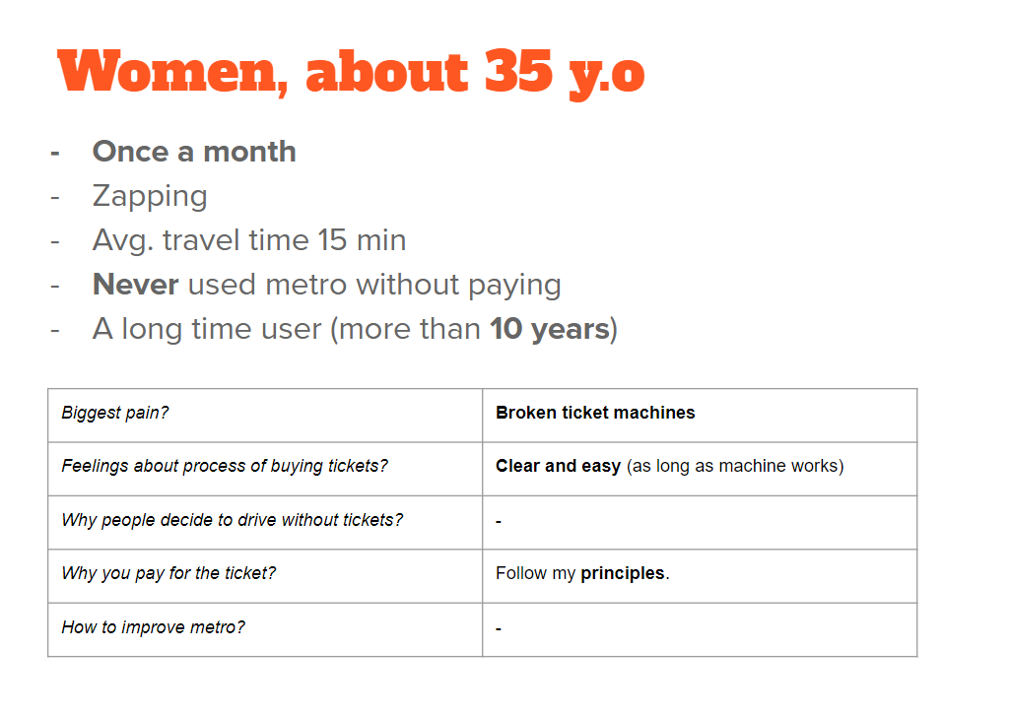
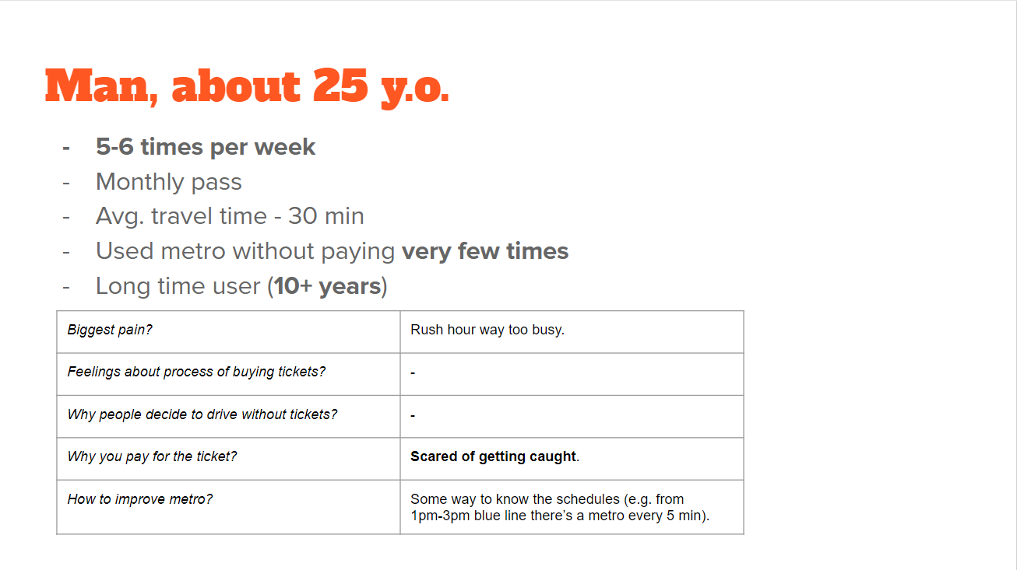
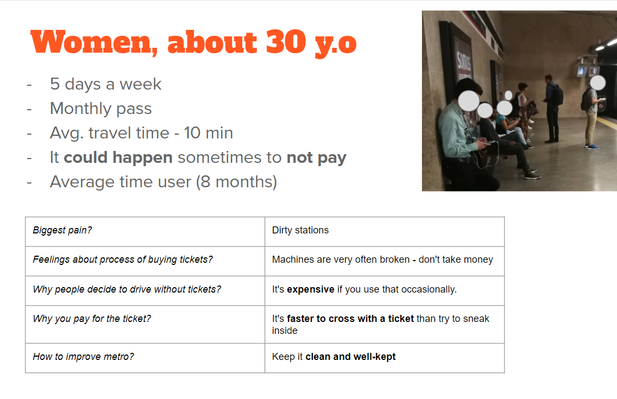
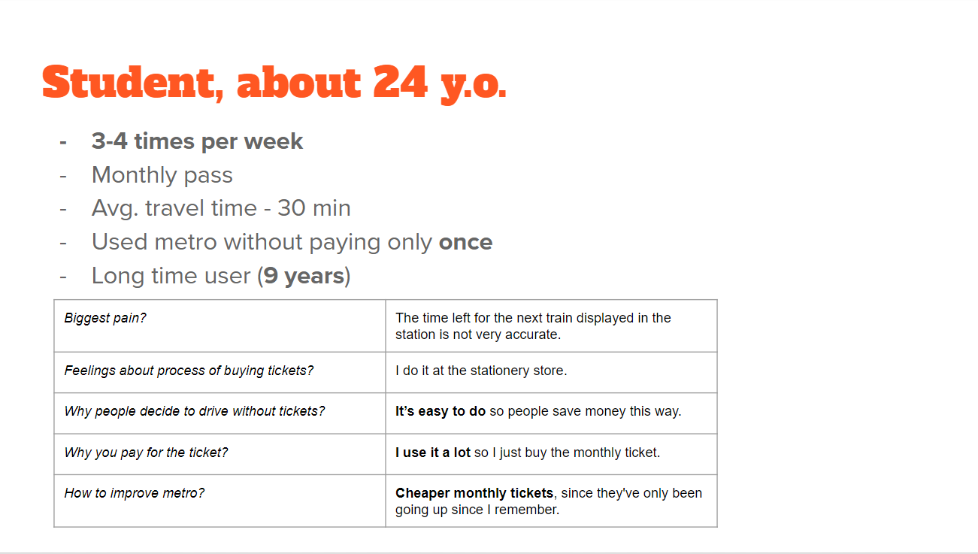

Slide 9
Data Analysis

Slide 10
Interviews Information
Gender | Age | Days of use (by month) | Travel time(in minutes) | Always paid ticket? | How many years use the metro?
F | 35 | 1 | 15 | YES | 10 years
F | 40 | 10 | 25 | YES | 2.5 years
M | 20 | 30 | 10 | NO | 10+ years
F | 30 | 20 | 10 | NO | 10 years
F | 20 | 20 | 20 | NO | 6 months
M | 25 | 25 | 30 | NO | 10 years
M | 25 | 20 | 15 | YES | 10 years
F | 24 | 20 | 30 | NO | 9 years
M | 45 | 30 | 15 | NO | 5 years
M | 25 | 10 | 7 | NO | 0.1- months

Slide 11
Correlations/Intrepertations
Most people use the metro for small/medium trips (Ave:18 minutes/6 stations)
The more you use the metro, the more times you will not pay;
The shorter your travel time is, the more chance is that you will not pay;
The younger you are, the higher chance you will not pay;
-0,61818
0,052822
0,360291

Slide 12
Observation of users

Slide 13
Concrete examples
A middle aged man tried to use his monthly pass to go out of the metro system, but his card didn’t work. He tried 3 times, but then he realised there is a queue of people waiting for him, so he asked someone to go through and sneaked behind this person.
Card probably was working before since he went into the metro system.
Pressure of people waiting for you to cross make you breaking the rules.
A lady tried to went through the gate with one ticket. It didn’t work. She tried with another one, and it still didn’t work. After that, she just went to the next gate and sneak behind someone else.
Maybe she forget that she doesn't have enough balance
Maybe card was not working

Slide 14
General examples
There’s higher chance for people to not validate when:
the train is coming
they are doing other things (talking, on the phone, etc…)
they have monthly pass
there are to many people
The distance to the validation machines affect the process and the experience;
Sometimes the validation doesn’t work, and people need to pass the card again. This delay the process for other people, and increases pressure in the user;
Most ‘rush hour’ problems happen inside the metro zone, not before/in the area of validation;

