Slide 1
Business Model Canvas
Work BY:
Group 9
João Legas 76120
Diogo Landeiro 76273
Michal Tomaszewski 91718
Natalia Kostrzewa 91691
Jakub Syrek 91872
Diogo Caria Ferreira 93985

Slide 2
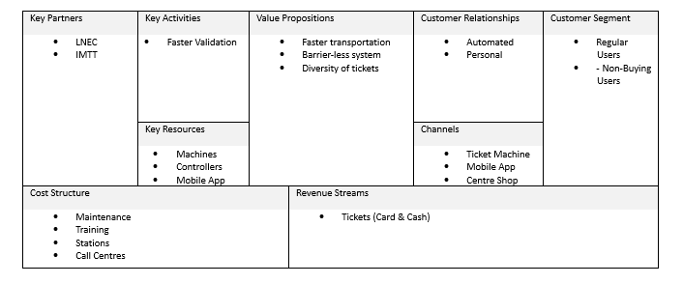
Current System

Slide 3
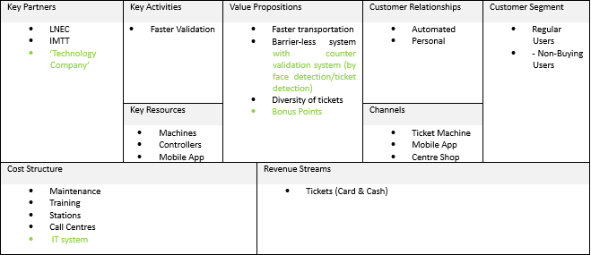
Camera Idea

Slide 4
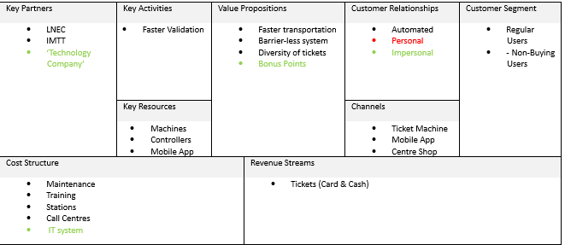
App Idea

