Slide 1
Lab 13 – Final User Study
Group 9

Slide 2
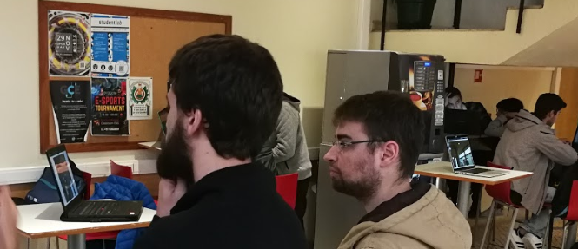
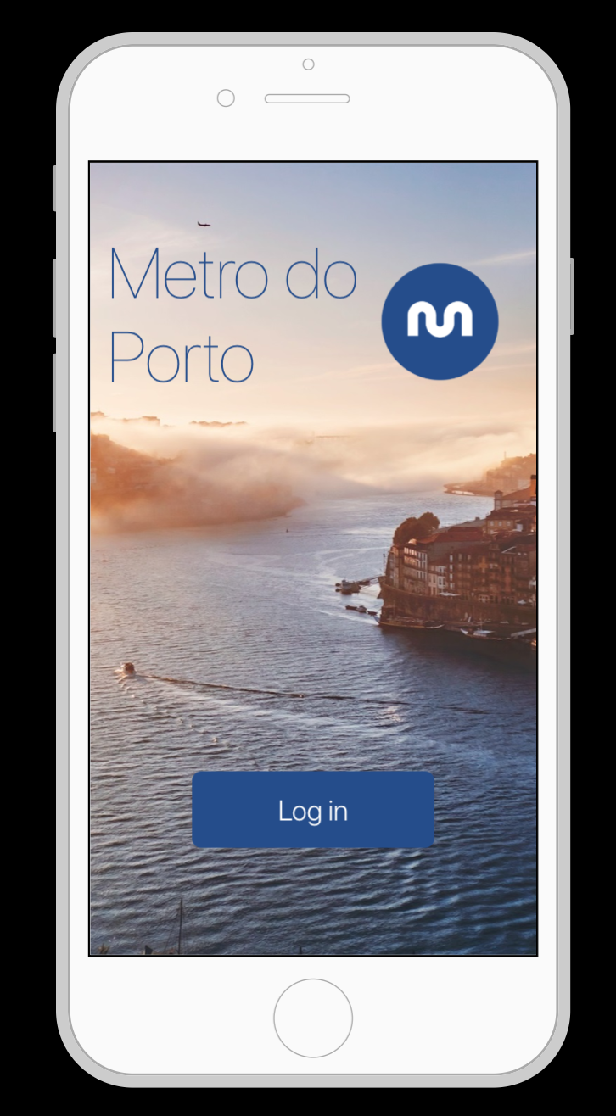
Our prototype
Computers
Prototype of mobile app
select a ticket
upload your face
pay
use for validation
2 computers with cameras plus validator (as a separate single computer)
(also validator)
App
Prototype
New design!

Slide 3
Used methods
Notes:
describe (and justify) what methods were used:

Slide 4
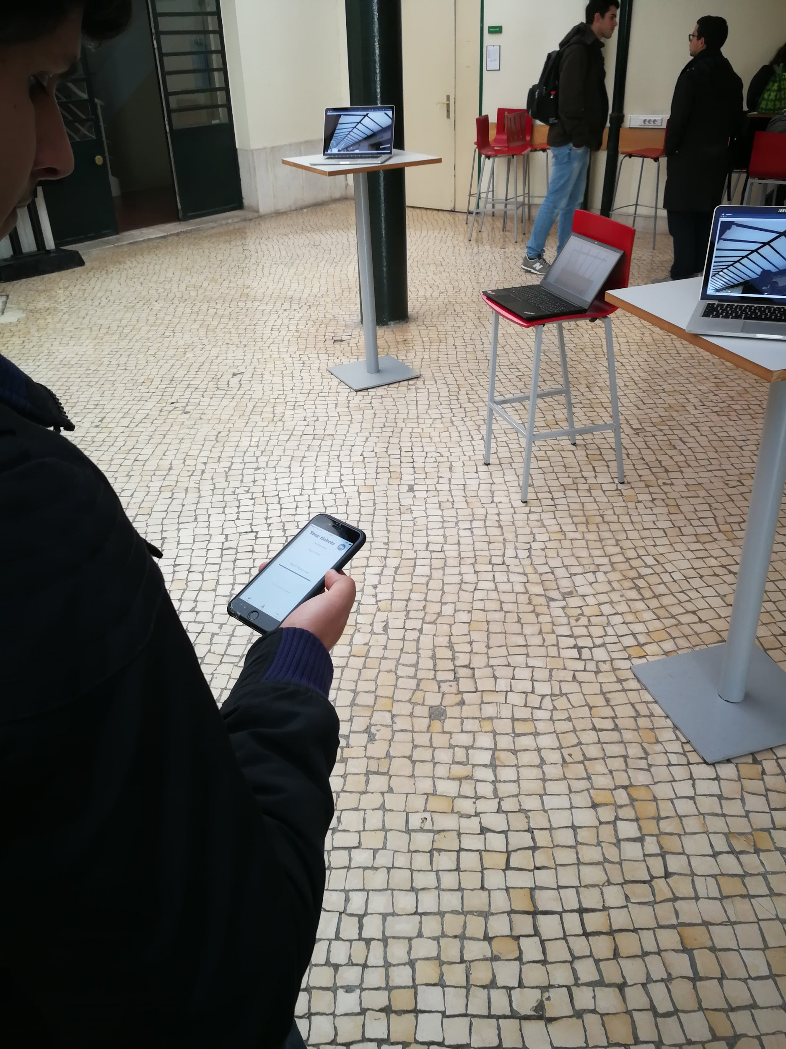
Explaining the basics of the system
no barriers
display of the validation status
validator
mobile app
Describing the tasks to perform
Performing tasks
Evaluating results and gathering outcome

Slide 5
Tasks
Go through the station into the train:
You need to buy a single ticket and validate it
You need to buy monthly ticket
You don't have any ticket
Go slowly and observe environment

Slide 6
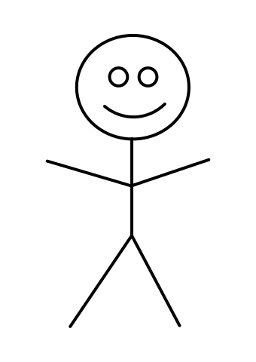
Tasks Performance
User
Face recon 2
Face recon 1
Validator
Crowd

Slide 7
Tester is passing by cameras and validator.
Then is asked about:
his feelings about system (including mobile app)
if emojis are clear.
To collect more data we were counting time that user needed to buy and validate ticket.

Slide 8
Tester as observer
One of our team member doing scenarios and random people are observing.
Just a simple explanation - it is a system of validation in metro of porto.
In the end questions about:
emoji states,
what exactly team member was doing,
if it’s clear enough about little bit of more explanation (e.g. infobox).

Slide 9
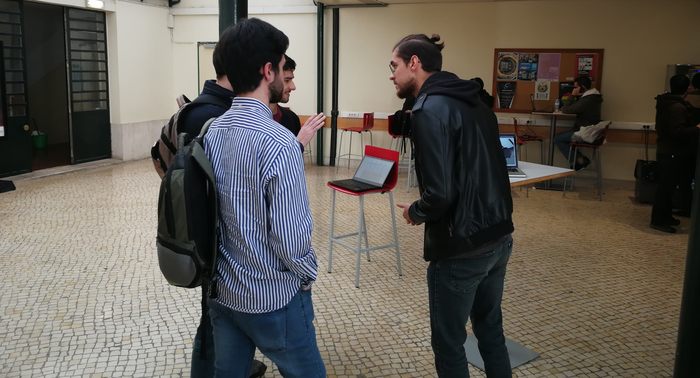
Tester as observer

Slide 10
Collecting results
Quantitative results:
time to perform tasks
satisfaction
Qualitative results
observations
participants’ opinions

Slide 11
Analysis of results

Slide 12
26 random people
22 students
3 workers
1 older person

Slide 13
28 sec.
time on average to buy and validate the ticket
Notes:
Based on 10 users

Slide 14
73%
of users understand system without ANY explanation
Notes:
22/26

Slide 15
96%
of users understand system with just a simple info box
Notes:
25/26

Slide 16
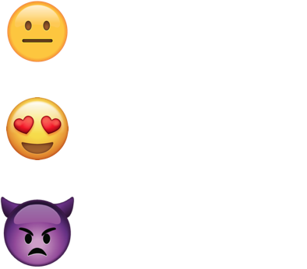
Info box
Neutral state
Validated
NOT validated

Slide 17
Further improvements

Slide 18
Further improvements
crowd detections systems to detect people hiding their faces,
use better quality camera to detect faces.
more functionalities in the mobile app,
use better and bigger displays.

Slide 19
Questions?

