Slide 1
Lab 11 – Usability Testing
Group 9

Slide 2
Think Aloud with Wizard of Oz
Used methods
Notes:
describe (and justify) what methods were used:

Slide 3
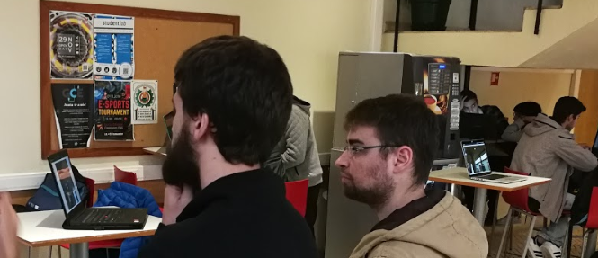
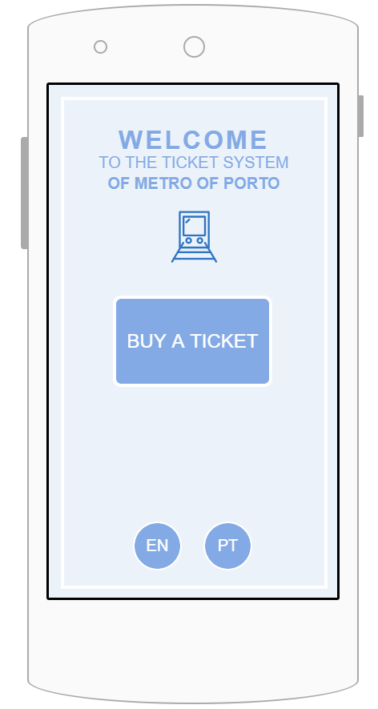
Our prototype
Computers
Prototype of mobile app
select a ticket
upload your face
pay
use for validation
2 computers with cameras plus validator (in the first computer)
(also validator)
App
Prototype

Slide 4
Tasks

Slide 5
Beginning:
Explaining the basics of the system
no barriers
display of the validation status
validator
mobile app
Describing the tasks to perform
Performing tasks
Evaluating results and gathering outcome
New State!
3 states:
user has yet to be validated
ticket has not validated
user has validated
😐
😡
😍
Notes:
We use face detection system together with camera tracking to:
detect people that have not validated their tickets
Automatically validate users with monthly pass using face detection system.
General:
Observe the environment and comment aloud about
what you can see and
what do you feel.
Questions after the test
How our system will influence the metro system?
Is the system easy to understand?
Will the system motivate people to buy the tickets? (Mention that the status will be visible to everyone at the station)

Slide 6
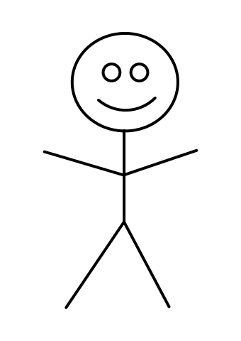
Tasks Performance
User
Face recon 2
Face recon 1
😐
Validator
Crowd

Slide 7
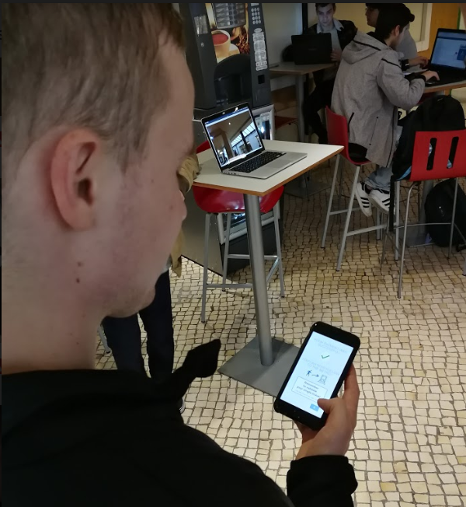
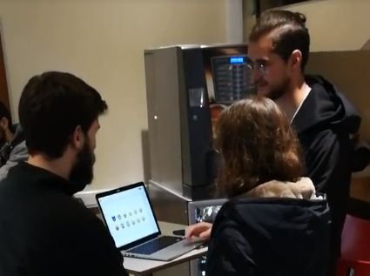
App Prototype
Emojis test

Slide 8
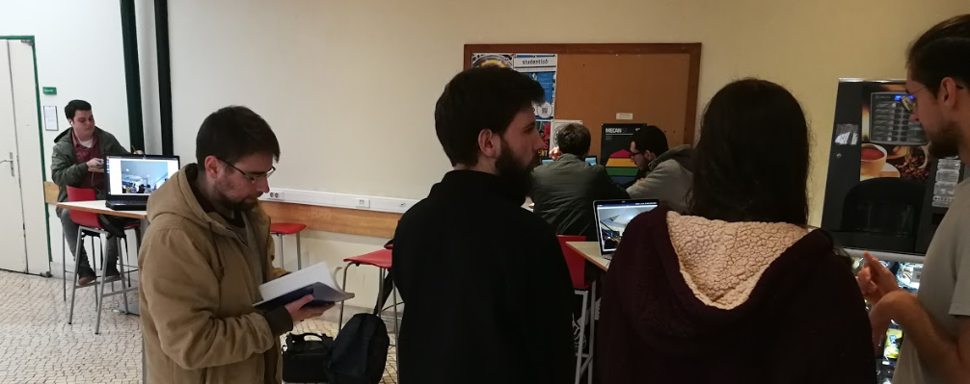
Crowd
Facilitator
User
Notetaker
Display with status 2
Display with status 1 +
validator

Slide 9
Tasks
Go through the station into the train:
You need to buy a single ticket
You need to buy monthly ticket
You don't have any ticket
Go slowly, observe environment and comment aloud

Slide 10
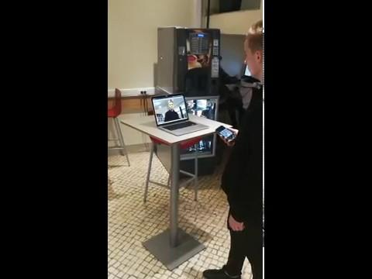

Slide 11
Results and Design Implications

Slide 12
5 users
3 male + 2 female
random students
3 did the emoji test before the tasks
users that were not biased
2 did the emoji test after the tasks
users that could be biased

Slide 13
Positive outcome
Old
The system is helpful in identifying that user forgot to validate a ticket
Easy to understand based on other users actions
After short explanation - no problems in understanding and performing tasks
It's funny (referring to the faces being different)
New
It’s better for the monthly users
It’s easy to associate the emojis and its meaning
Notes:
the system is helpful in identifying if she forgot her ticket
when user sees the other people using the system it is easy to understand how it works
after short explanation - no problems in understanding and performing tasks
It's funny (referring to the faces being different)

Slide 14
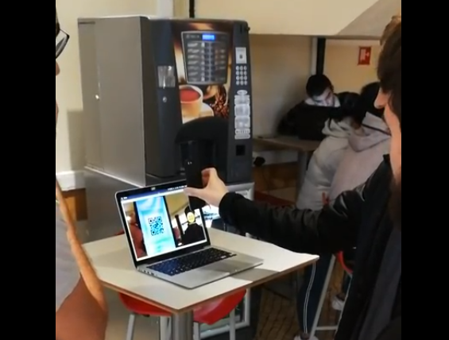
Problems and design indications
Some of the app screens were not easy to understand
Facilitate the understanding of each screen
Some buttons are too small to press, or have misleading meanings
Change the buttons layout
Not easy to recognize that the ticket was validated
Change the feedback given to the user on ticket validation

Slide 15
Emojis selection

Slide 16
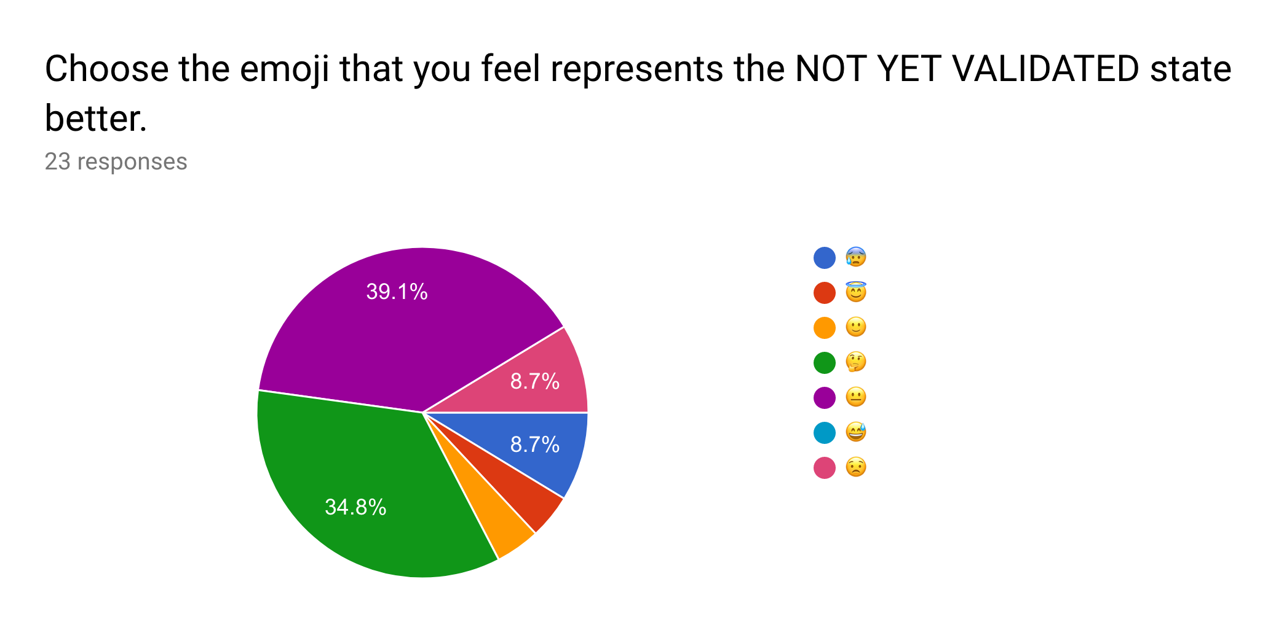
😐
as neutral

Slide 17
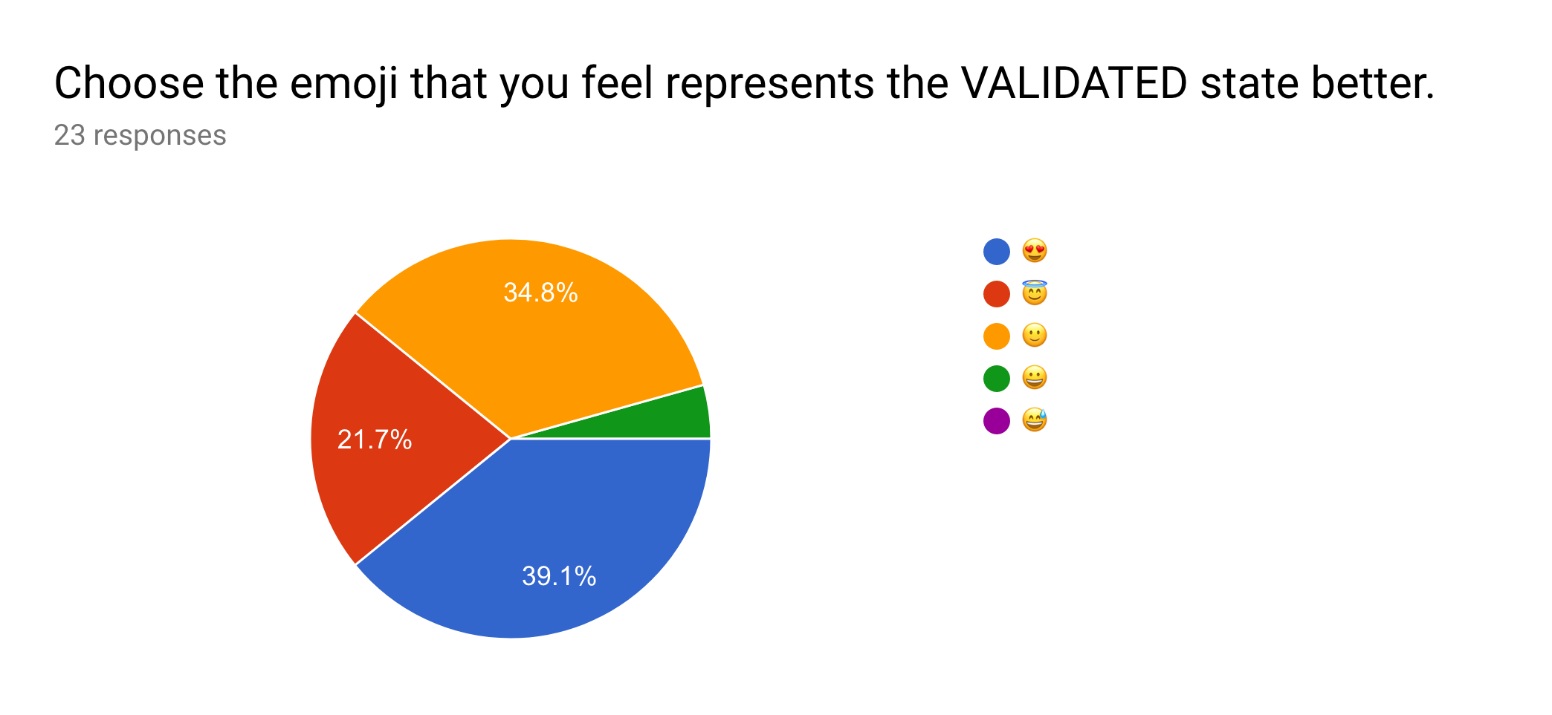
😍
as VALIDATED

Slide 18
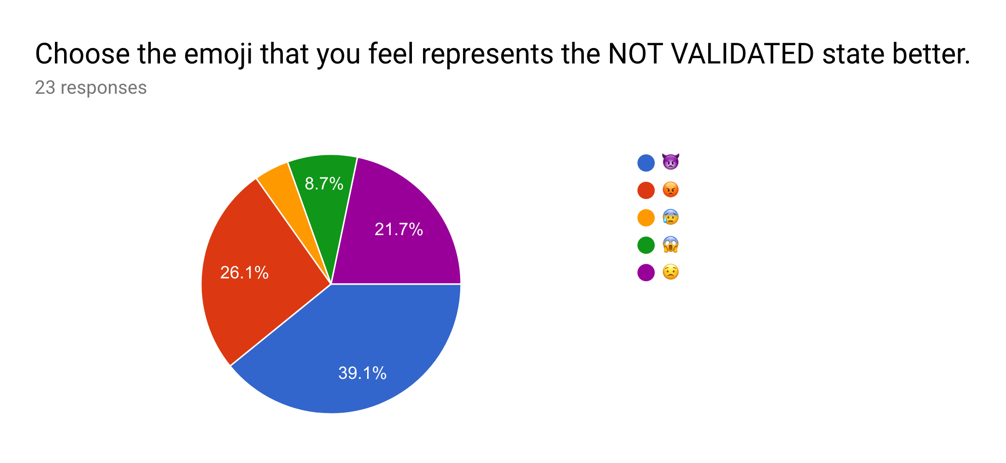
😍
as NOT VALIDATED

Slide 19
Organization

Slide 20
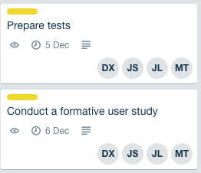
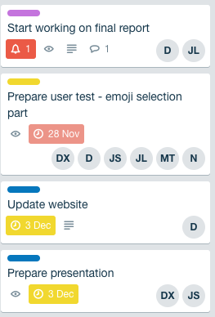
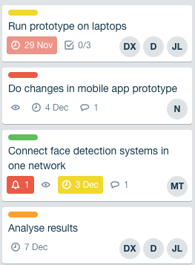
JS - Jakub Syrek - Manager
N - Natalia Kostrzewa - Designer
MT - Michał Tomaszewski - Back-end developer
DX - Diogo Caria Ferreira - Review
JL - João Legas - UX
D - Diogo Landeiro - Front-end developer

Slide 21
Questions?

